Slide 1
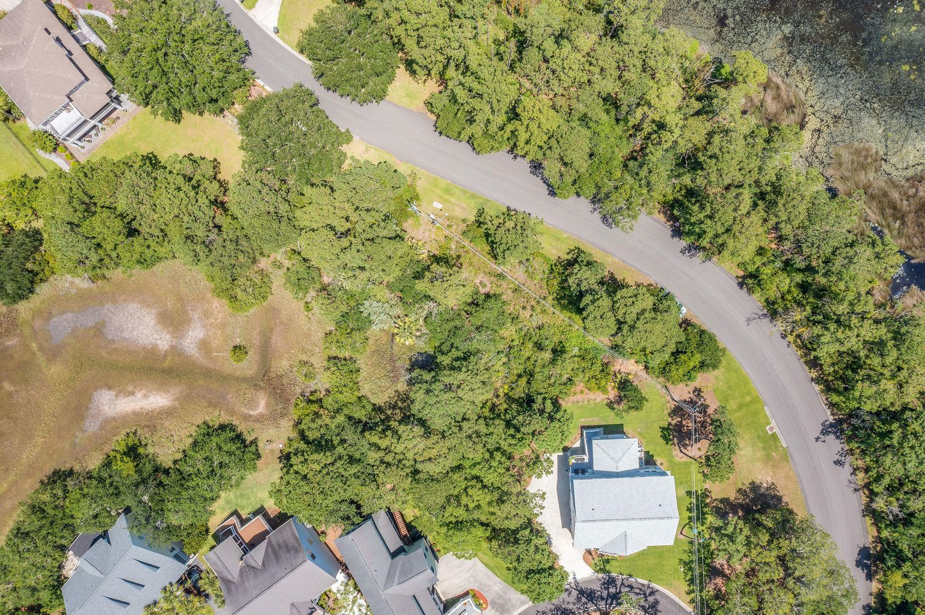
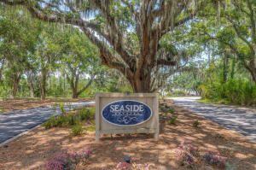
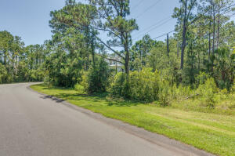
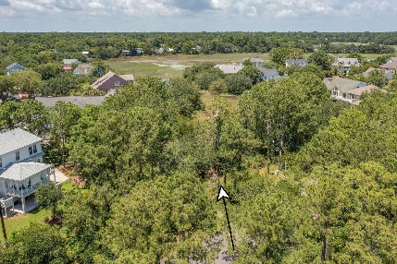
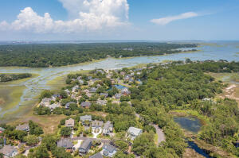

Ready For That Dream Home?
1250 Seaside Plantation Drive
Seaside Plantation · Charleston
MLS# 21019382 · $325,000
Amazing opportunity to own a large lot on a tidal creek in the highly sought after Seaside Estates neighborhood. There's a community boat ramp in the neighborhood Minutes to Folly Beach and downtown Charleston.
Kelly Snyder
843-457-5951
kelly.snyder@agentownedrealty.com
Greg Gelber
843-494-2354
greg.gelber@agentownedrealty.com
AgentOwned Charleston Group | 902 Savannah Hwy | Charleston, SC 29407-7802

