Slide 1
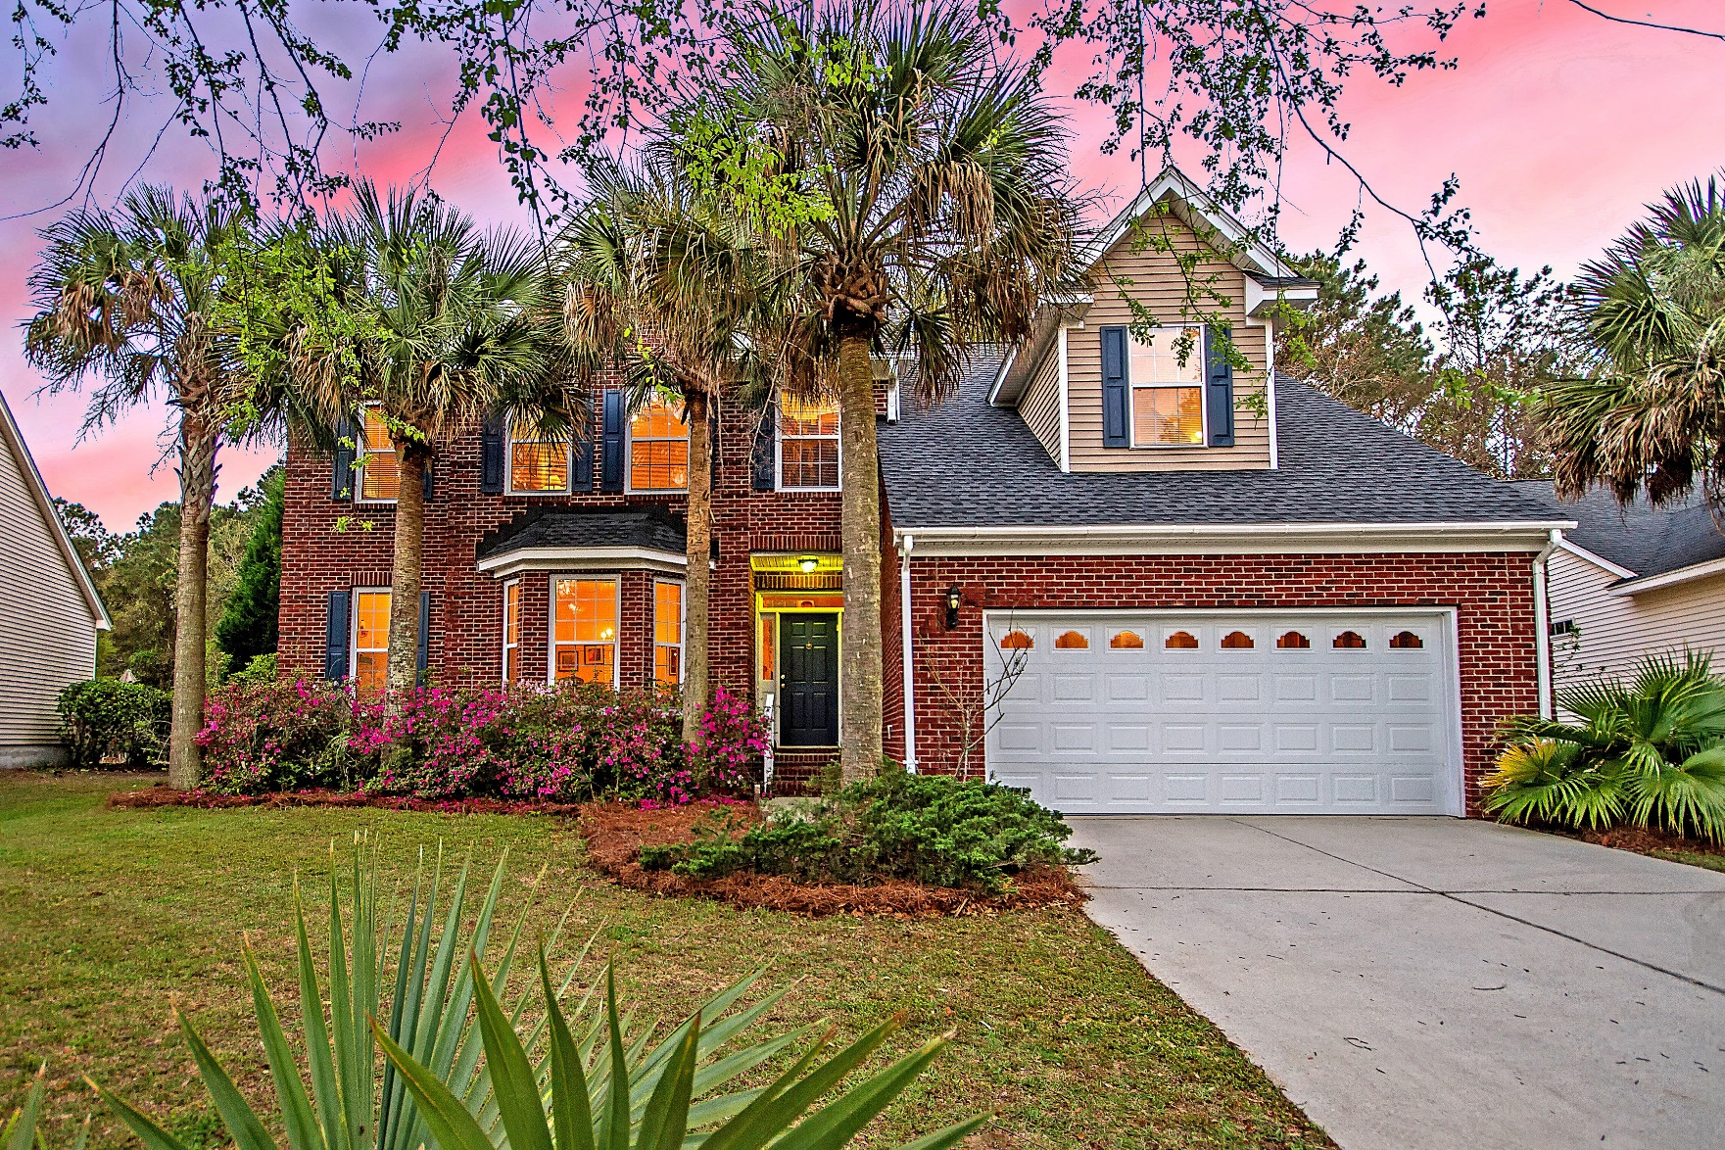
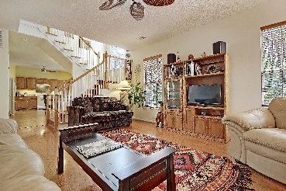
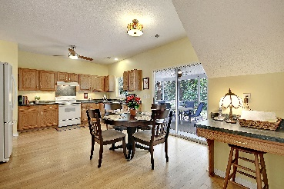
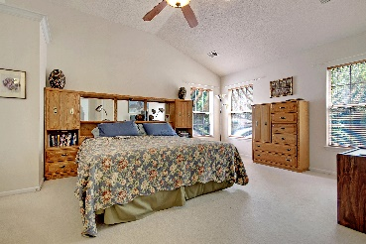
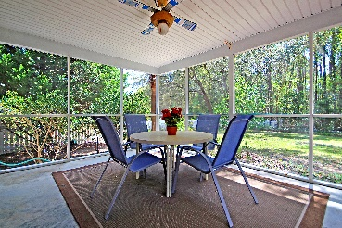


1252 Wild Olive Drive Seaside Farms :: Mount Pleasant, SC 29464 MLS# 19010653 :: $510,000 4 Bed / 2½ Bath / 2,202sf
Just Reduced!
Price Reduced!
PRE-INSPECTED home in Seaside Farms. WALKING DISTANCE to neighborhood amenities and nearby shopping and dining. 10 minute drive from front door to toes in the sand at Isle of Palms BEACH. NEW ROOF in 2019 and NEW HVAC in 2018. Enjoy the LARGE LOT, FENCED YARD, pond view and wooded buffer. Large Kitchen, eat-in area and Family Room with Fireplace. The OVER-SIZED SCREEN PORCH and paver PATIO off the kitchen/eat-in area brings in fresh air and sunshine. The master bedroom enjoys abundant natural light, a large walk-in closet, dual vanity bath with step-in shower and garden tub. The other two rooms are good sized, and the FROG has lots of good light and is ready to be 4th bedroom/office/media room.
Steve Kaul, REALTOR
(843) 817-5547 · skaul@carolinaone.com www.charlestonhousehunt.com
Carolina One Real Estate · 195 W Coleman Blvd · Mt Pleasant, SC 29464-3495

