Slide 1
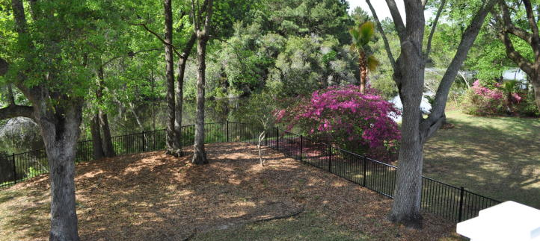
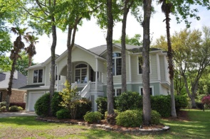
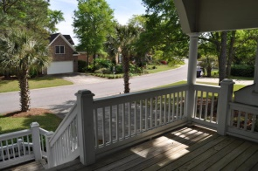
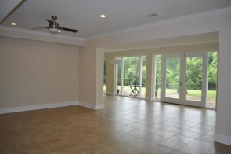
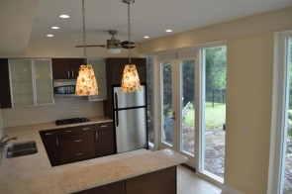
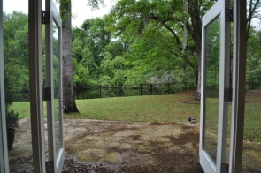
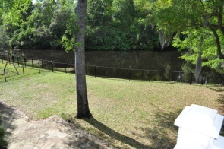
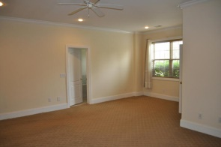
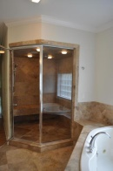
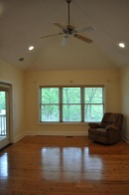
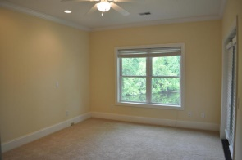
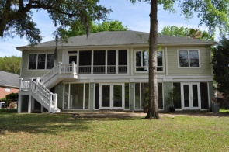


Hidden Lakes Gem ~ Best Value in Town
1253 Waterfront Dr - Mt Pleasant - MLS# 15009854 - $780,000
Are you in need a home with lots of space for a growing family? Do you have relatives or friends from up North visiting you often (especially during their cold winters?!) Perhaps you have parents or extended family who live with you and you're looking for separate space for them? Maybe you entertain often? This gorgeous home in desirable Hidden Lakes may be the right fit! This elevated-style home has an entirely useable ground floor because it sits in an ''X'' flood zone. The downstairs consists of a huge mother-in-law suite with a 3 car garage, 2 bedrooms, a full bathroom, huge living room and a gorgeous kitchen overlooking the backyard and pond. Upstairs you'll find 2 large guest rooms on one side of the large, open kitchen/living room, and a massive Master Suite on the other side. Hidden Lakes is one of the most desirable neighborhoods in inner Mt. Pleasant - just a few minutes from the beaches, downtown, the shops at Seaside Farms and Town Centre. The unique community boasts a huge, fresh water lake and canal system that's open to all homeowners and their guests for fishing, sailing, paddle boarding, electric boats, etc. There's a neighborhood pool, clubhouse, tennis courts, playground, boat & rv storage yard, and most homes are connected to the neighborhood irrigation system which draws water straight from the lake. (Talk about savings on your water bill!) There are so many reasons you'll love this home in Hidden Lakes!
The Boulevard Company, LLC
Mark Macpherson
mark@beachbreak-properties.com
843.367.5640 Mobile

