Slide 1
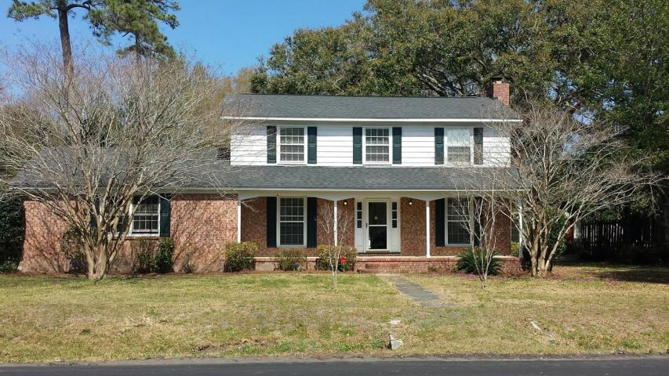
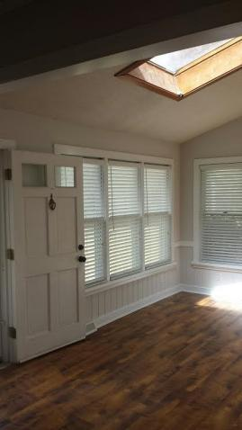
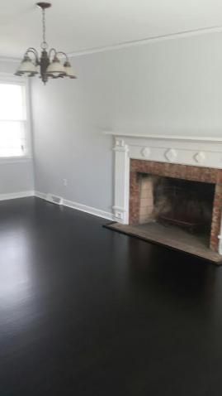
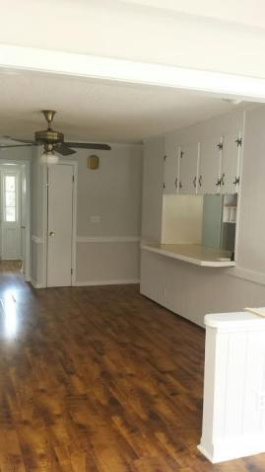
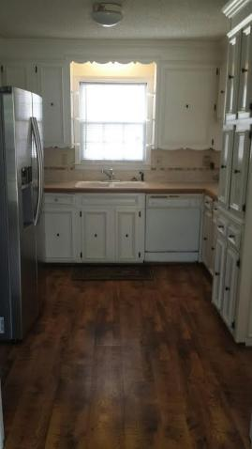
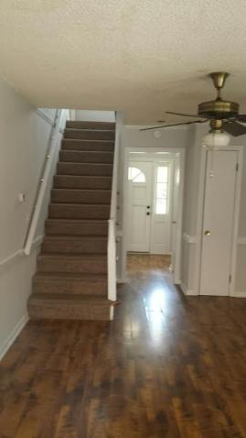
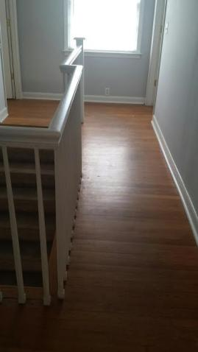
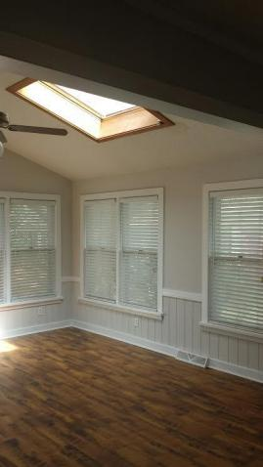
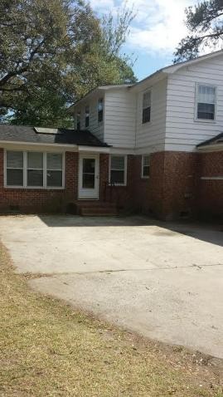
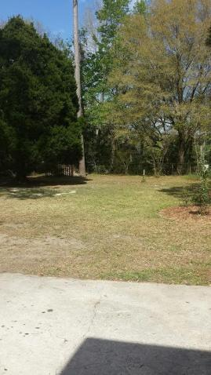


Just Reduced $20k
Over half-acre in Mt Pleasant!
1254 Robin Road
Moss Park ~ Mount Pleasant ~ MLS# 17009557 ~ $435,000
Reduced to sell $20,000. Owner says "get it sold" Location, Location!! This wonderful home is in the middle of Mt Pleasant with over a half acre of land with plenty of room to expand. Close to everything and no HOA fees. Charming, immaculate, 4 bedroom, 1 & 1/2 bath, move-in ready family home in central Mt. Pleasant! Moss Park subdivision is one of Mount Pleasant's best kept secrets! Home sits on a beautiful .57 acre lot with mature oaks, camellias, azaleas, gardenias & fig trees that will keep the freezer loaded. Home is loaded with character with original hardwood floors all upstairs, dining rooms and living room. Updated thermal windows and architectural shingles. Samsung Refrigerator convey in as-is condition.
Nice sunroom with sky lights and a cozy wood burning fireplace in living room. Home has well and water pump besides city water.
Also, the yard has an electric fence for pets. This home is ready to go! Close to downtown (only 6 miles to the Ravenel Bridge!), beaches (3 Miles to Sullivan's Island!), and Town Center (2.5 miles!) Homes in this neighborhood do not come on the market very often. Very easy to see! Seller is selling said property/home as is.
Owner is willing to buy a one year home warranty.
Gloria McGrew
(843) 437-7405
gmayexit@gmail.com
BHHS Carolina Sun Real Estate 1440 Ben Sawyer Blvd ste 1503 Mt Pleasant, SC 29464

