Slide 1
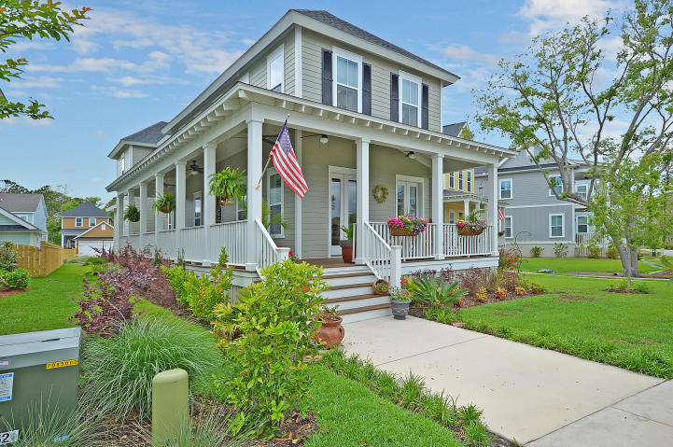
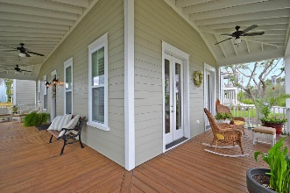
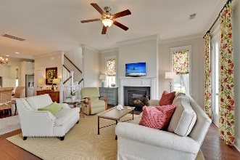

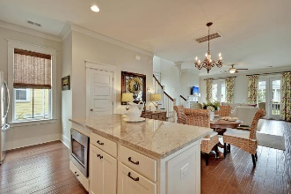
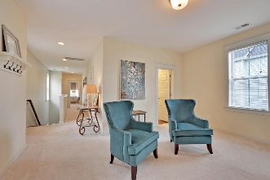
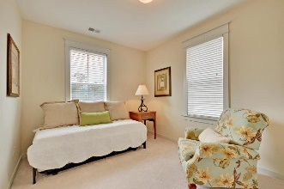


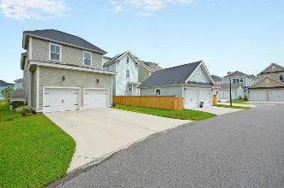
James Island Waterfront Community $2,500 Realtor Bonus at closing with ratified offer by July 31st
1255 Adela Hills Drive Seaside Plantation ~ Charleston, SC 29412
MLS# 17009574 ~ $509,980
3 Bedrooms | 2½ Baths | 2,362 sf
Freeman's Point , James Island's premier waterfront community, located just minutes to historic downtown Charleston and beautiful Folly Beach. This less than two year old, well designed seaside plan offers 3 bedrooms, 2.5 baths, an open living area, attached 2 car garage, and a charming wrap around front porch. Hardwood floors are located in the first floor living spaces. The chef's styled gourmet kitchen features 3 cm granite countertops with a stainless under-mount sink, stainless energy star gas appliances, dual wall ovens and large center island. On the second floor is a large loft/living area along with the owner's suite with spacious walk-in closet, tiled shower and his & her vanities. Also upstairs are two nicely-sized secondary bedrooms with a shared bathroom.
Phil Sabatino
philsaborealtor@gmail.com | (843) 860-5140 | www.bnre.info
Brand Name Real Estate | 4 Carriage Lane, Suite 106 | Charleston, SC 29407

