Slide 1
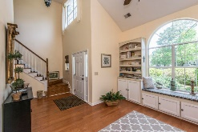
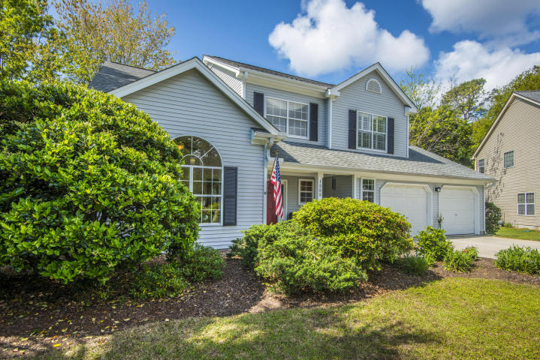
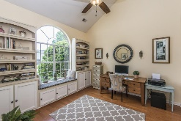
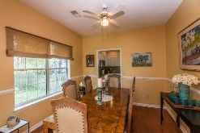
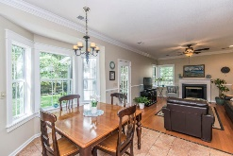
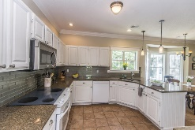
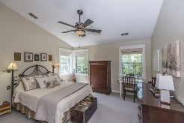
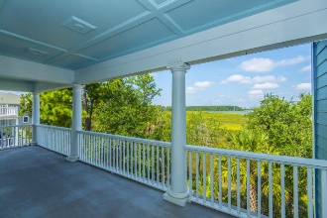
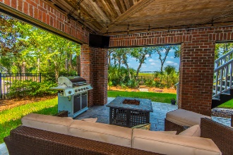
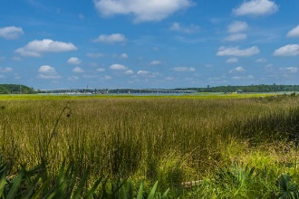
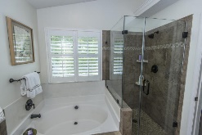
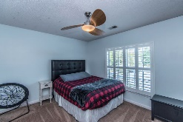
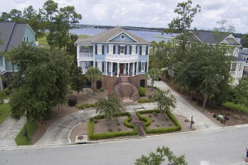
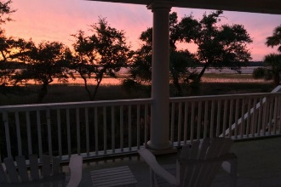

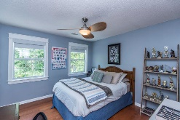
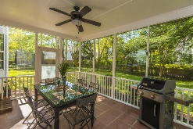
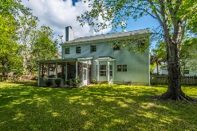


1255 Brasie Court Charleston National ~ Mount Pleasant, SC 29466
Best Buy in Charleston National
Nestled into the top of a tree-lined cul-de-sac in a beautiful golf course neighborhood, this completely updated home will wow you from the moment you drive up! The dramatic two-story foyer, gleaming hardwood floors and arched case openings set the tone for what you'll find in this jewel of a home. A study with vaulted ceiling, located just off of the foyer, features custom built-in cabinets, bookshelves and a sunny window seat and is idea as a home office or formal living room. An arched opening leads into a formal dining room with chair rail trim. Spacious enough to accommodate a large table and buffet pieces, you can just picture hosting family and friends for those special occasion dinners. The family chef will love spending time preparing meals in this home's updated kitchen!
Asking $414,500
MLS# 18013402
2,062 SqFt
4 Bed/2½ Baths
Don Dawson 843-514-0452 ddawson@carolinaone.com Carolina One Real Estate • 2713 Highway 17 North • Mount Pleasant, SC 29466
www.TeamDawsonSC.com

