Slide 1
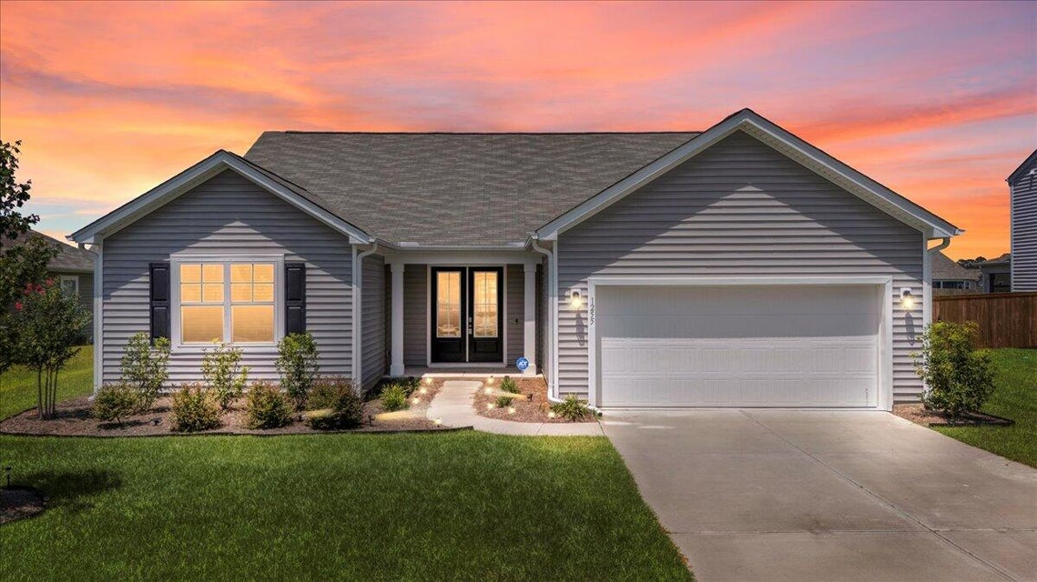



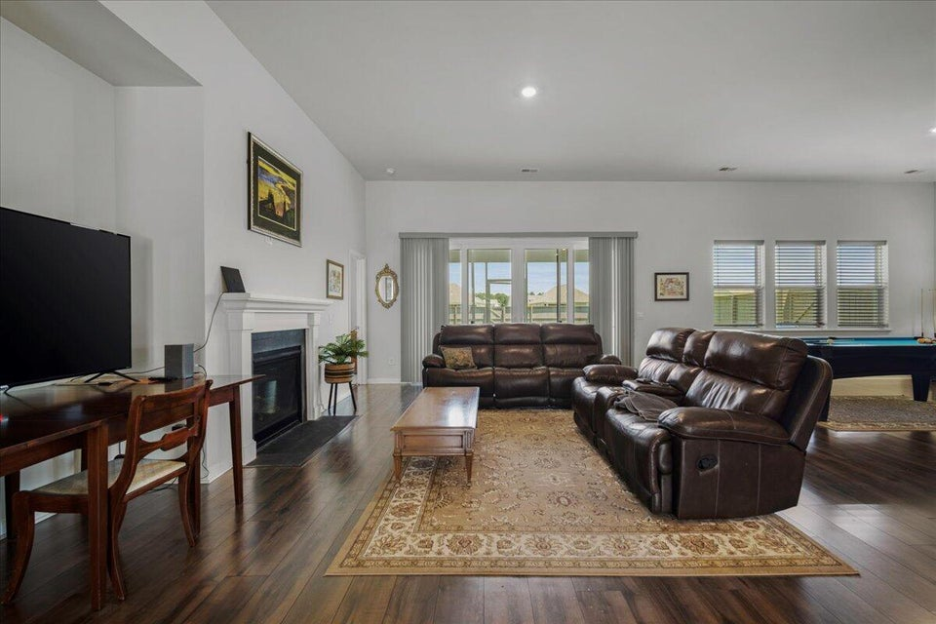
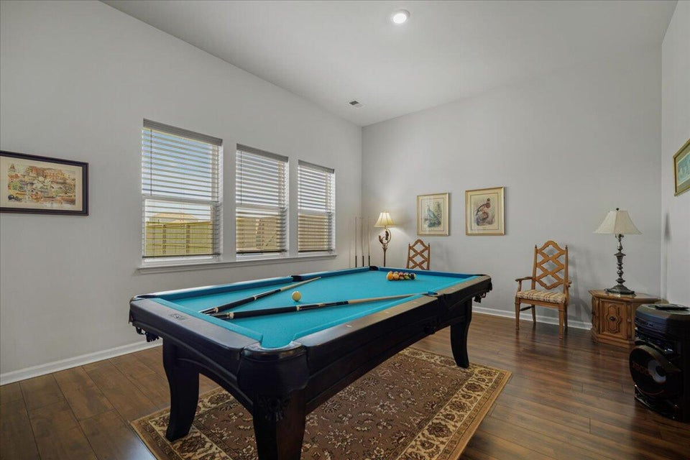
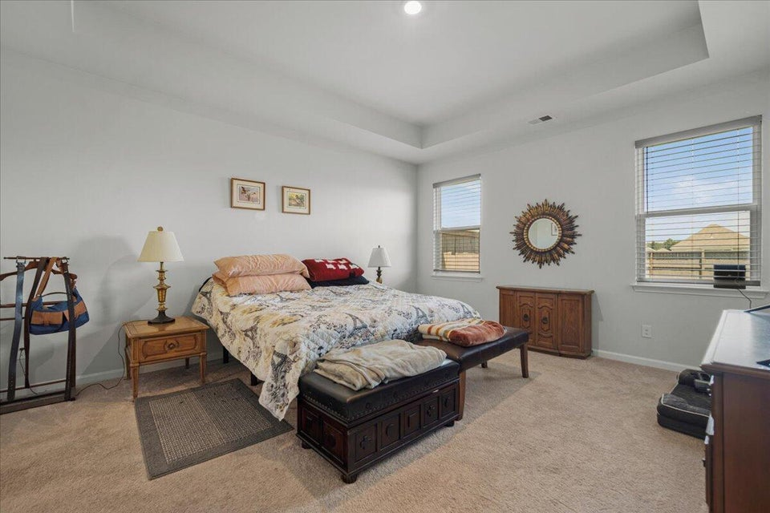
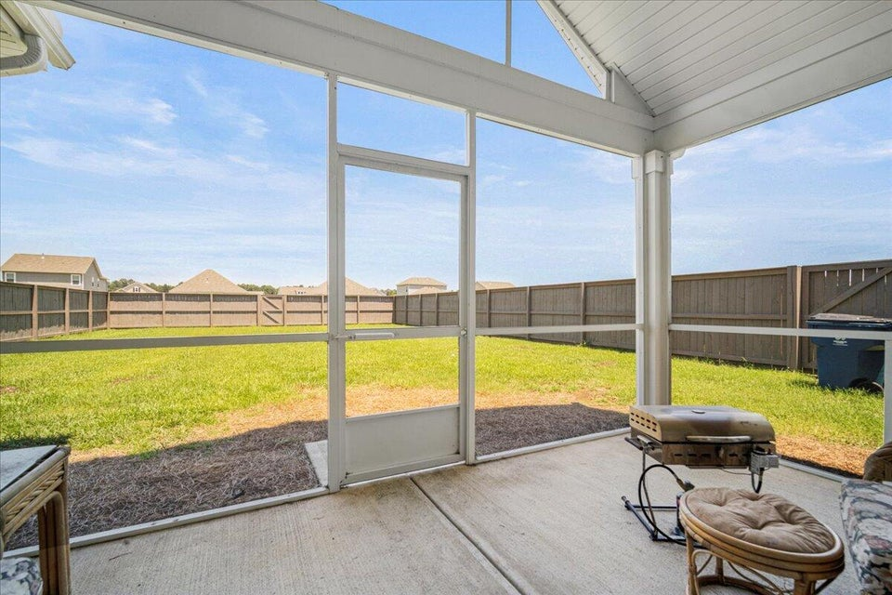


MINUTES TO MT PLEASANT seller offering up to $12,250 in concessions
1255 Wading Point Boulevard
French Quarter Creek | Huger, SC 29450 | MLS# 25021115 | $507,000
Welcome to French Quarter Creek—a natural gas community nestled in the scenic beauty of Huger, SC, just minutes from Mt. Pleasant and a short drive to the beaches of Isle of Palms and Sullivan's Island. This community offers the perfect blend of peaceful Lowcountry living and modern convenience, with easy access to shopping, dining, and outdoor adventures. Step inside this spacious one-story, open-concept home featuring 3 bedrooms and 2.5 baths, beautifully landscaped, fully fenced yard, and screened porch ideal for outdoor living and entertainment. Residents enjoy an array of amenities, including a clubhouse, resort-style swimming pool with cabana, fire pit, bocce ball court, dog run, and scenic fishing ponds—all surrounded by natural Lowcountry landscapes and close to Lake Moultrie, the Wando River, and the Francis Marion National Forest for endless outdoor recreation.
Experience a lifestyle that balances relaxation and activity in a welcoming, amenity-rich neighborhood with quick access to the best of Mt. Pleasant and Charleston's beaches.
VIDEO TOUR | VIRTUAL TOUR
Telecia Bilton
843-412-3586
tmbilton@rogcoastal.com
Realty ONE Group Coastal
1510 Trolley Rd
Summerville, SC 29485

