Slide 1
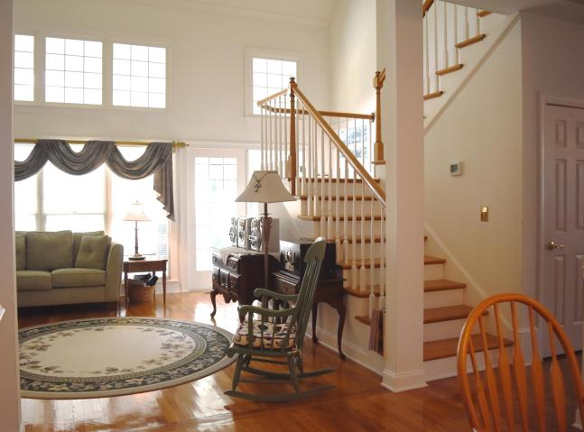
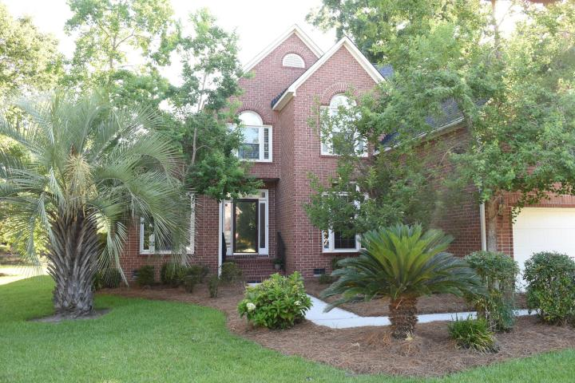
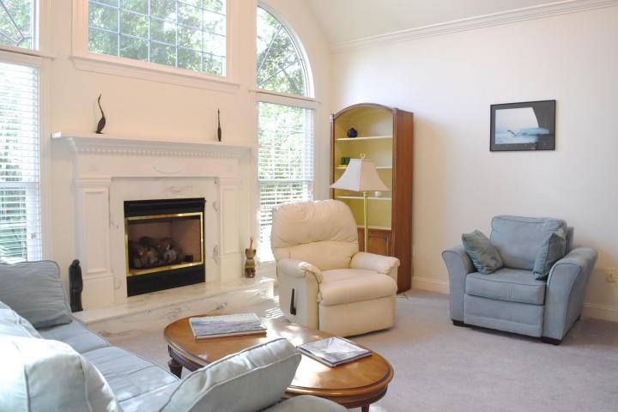
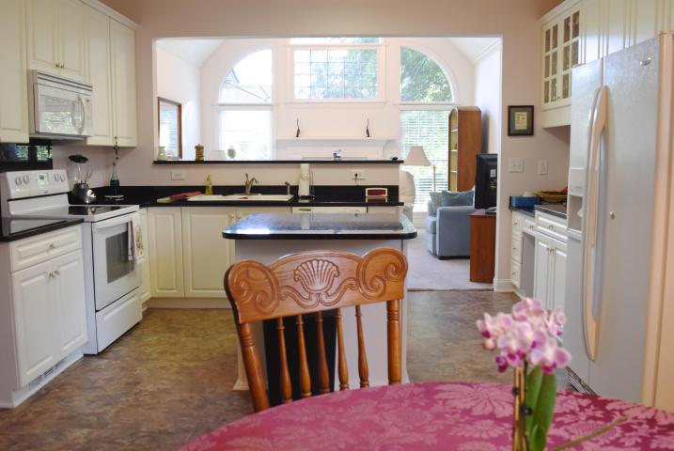
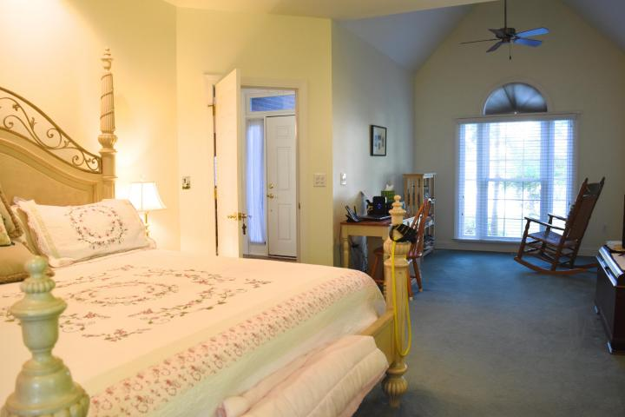
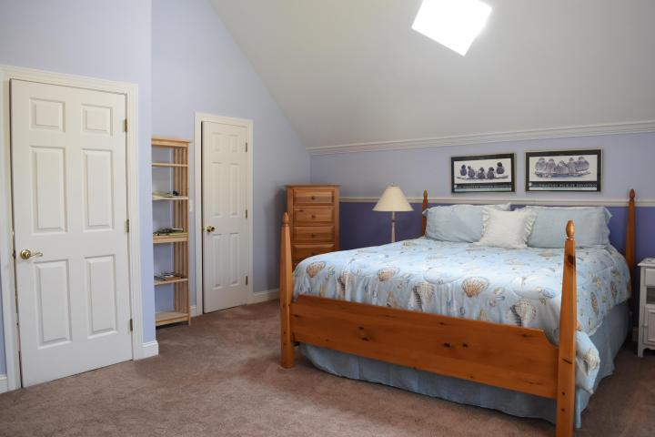
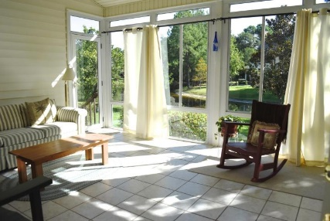
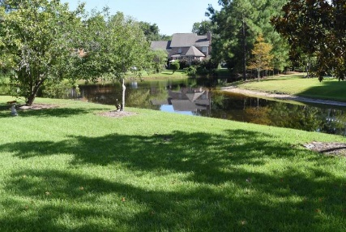


1257 Wynnwood Court Brickyard Plantation ~ Mount Pleasant MLS# 16020540 ~ $599,900
Agent Open Thurs 9/22 ~ 11:30-1:00...$50 Bottles Gift Card!
If you are looking for a neighborhood with mature landscaping and first class amenities near the center of Mount Pleasant, your home should be in Brickyard Plantation! This well maintained all brick home on a pond lot that doesn't require flood insurance, is ready for you with some fantastic features that include a recently replaced roof, new windows in 2009, new patio in 2012, 2 staircases, workbench in garage, granite in kitchen, and a view from the front door that takes you through the spacious sunroom out to the beautiful pond lot. The open floor plan is bright and great for entertaining. There are large bedrooms that include lots of storage and a downstairs separate master suite with a tray ceiling, double sinks and a vaulted sitting area/office. Architectural details include columns, extra wide custom chair rail and wainscoting, and three piece crown and dentil molding. There are separate living rooms/office and dining rooms and the living room opens to a very large heated/cooled sunroom. This 3,200 square foot, 4 bedroom, 2.5 bath executive home with lots of storage and a 2 car garage on a .3 acre cul-de-sac lot may be just the home that you have been looking for! Seller will provide $2,000 in closing costs for seller to do upgrades/paint/etc.
Open House previously scheduled for 9/15/16 Has been rescheduled due to bad weather
Cheryll Woods-Flowers
ABR, e-Certified, SHS
(843) 442-2219
www.woodsflowers.com

