Slide 1
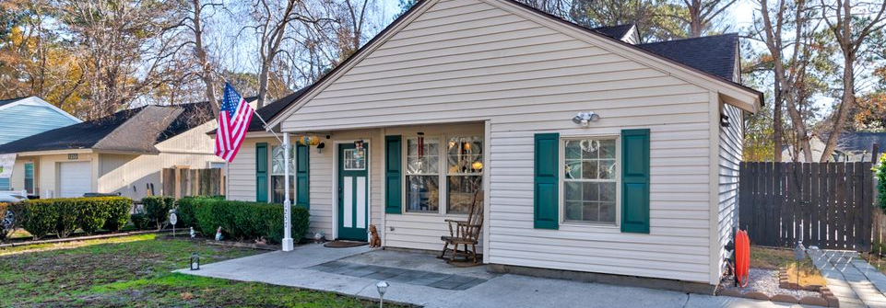
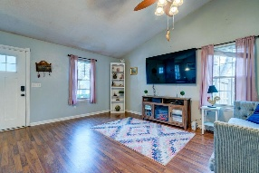
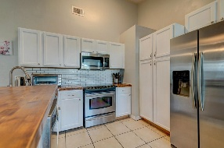
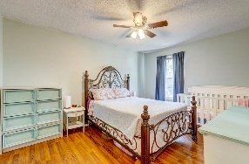
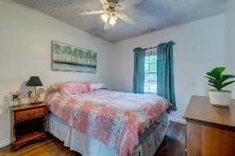
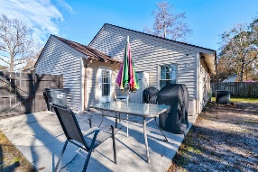
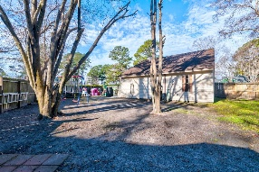

Immaculate Home Priced at 270k!
All Appliances Convey!!
Michael Moseley
843-442-0959
michaelsmoseley@gmail.com
charlestonrealestateandgolf.com
1257 Maryland Drive
Moss Point | Ladson, SC 29456 | MLS# 25003372 | $270,000
Corner lot conveniently located to Palmetto Commerce, North Charleston, Goose Creek, and Summerville. Kitchen has stainless steel appliances and butcher block counters. All appliances, including refrigerator, washer, and dryer convey. New HVAC was installed in the summer of 2023.
Bathroom has been recently renovated with brand new shower, tiles, and paint. Home has fully fenced in backyard with privacy fence and no HOA. Don't forget Dorchester 2 schools, including Ashley Ridge High!
Carolina Elite Real Estate | 1081 East Montague Ave | N Charleston, SC 29405

