Slide 1
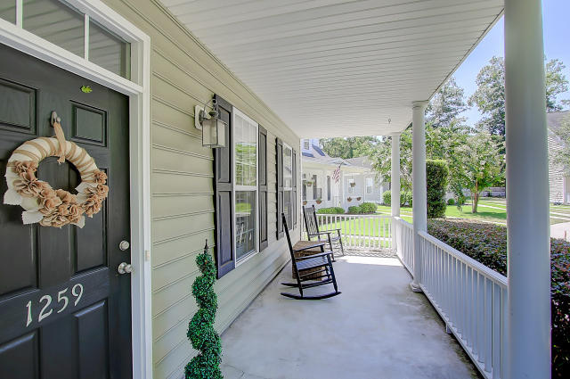
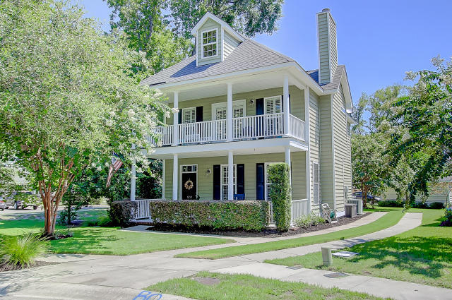
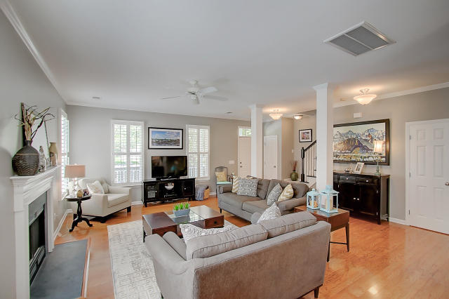
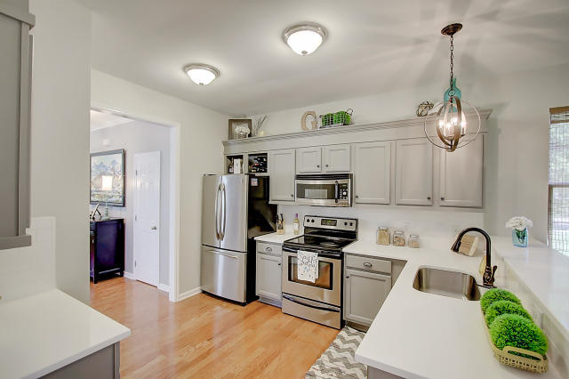
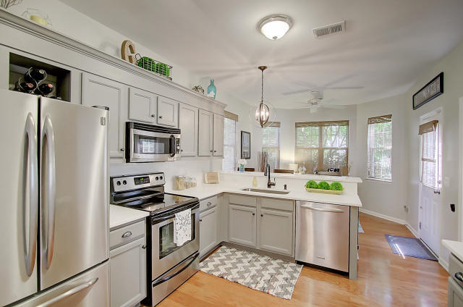
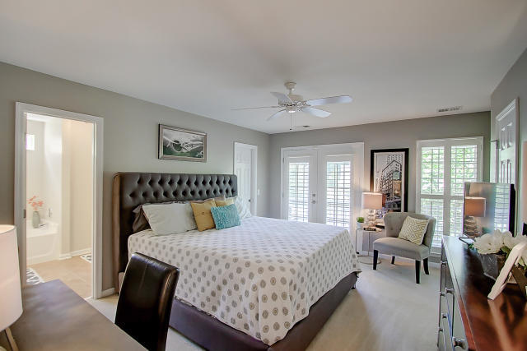


1259 Fallen Oak Drive
Laurel Grove
Mount Pleasant, SC 29466
MLS# 16018796
$347,500
New Price in Laurel Grove...
Stunning Inside and Out
'Pristine' is the best word to describe 1259 Fallen Oak in Laurel Grove. This beautiful home is situated on a corner lot with new lush landscaping. The double porches gives that true Low country feel. Upon entering this home you'll immediately see the meticulous care given from the paint choices, plantation shutters, wood floors, the well designed, updated kitchen with Quartz counters and SS appliances and so much more. This open plan is great for entertaining and the double closest in the master is a big bonus. The HVAC is less than 2 years old. Truly a move-in ready home close to schools and shopping.
Darlene Smith
Office - (843) 886-8110
Mobile - (843) 696-7824
darlenesmith@carolinaone.com
DarleneSmithTeam.com
Carolina One Real Estate
1503 Palm Blvd Ste
Isle of Palms, SC 29451

