Slide 1
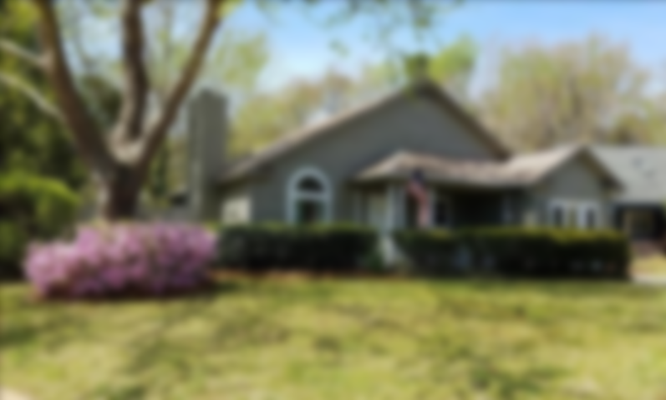

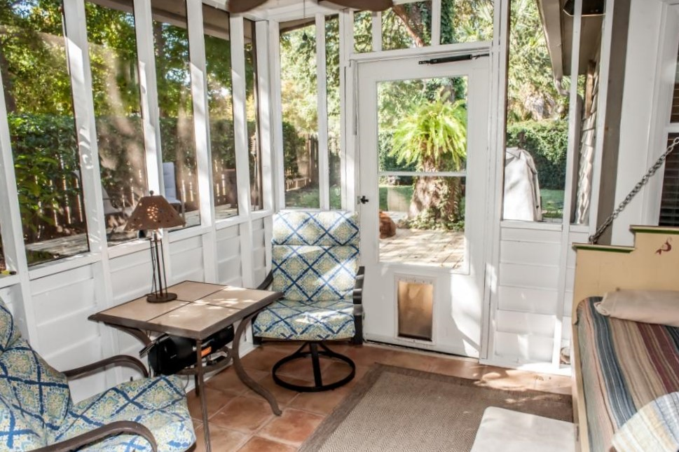
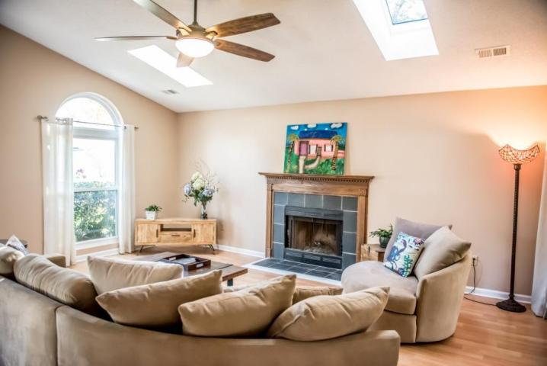
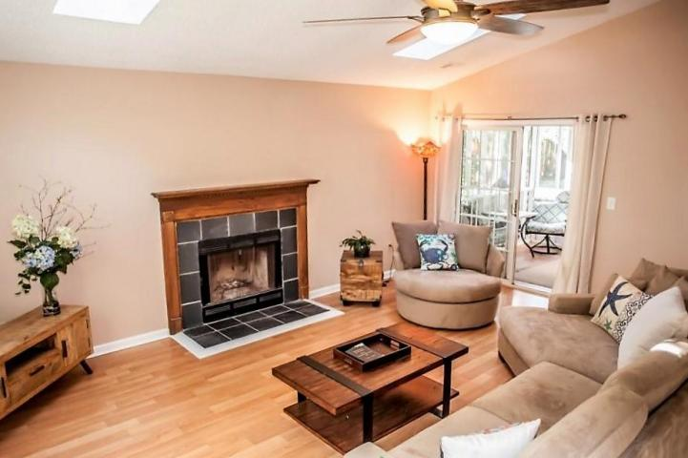
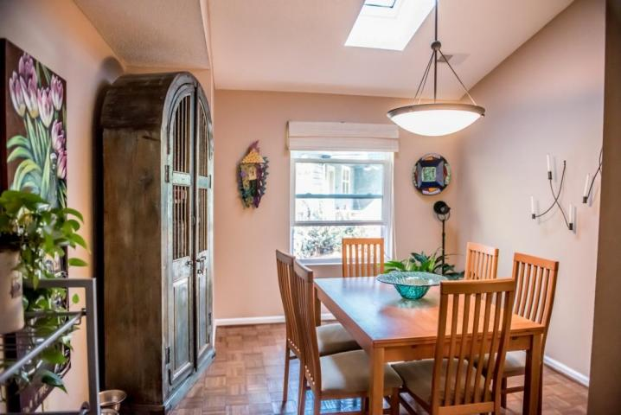
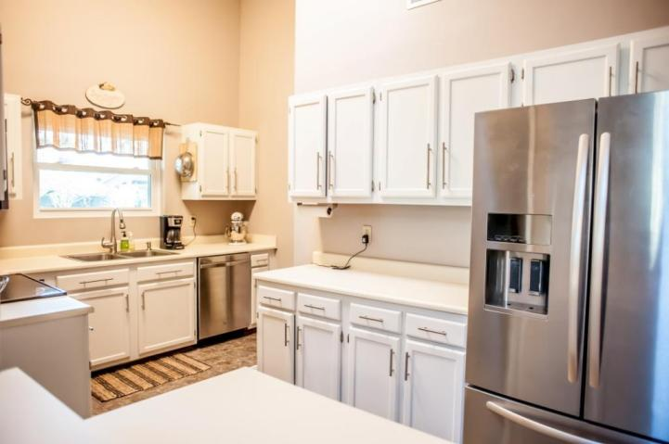
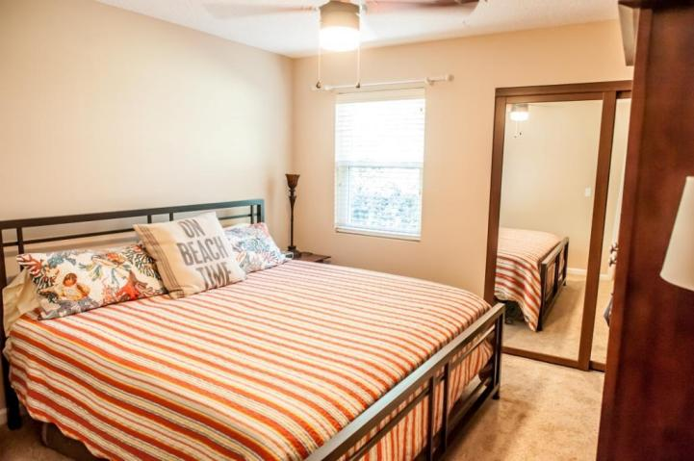
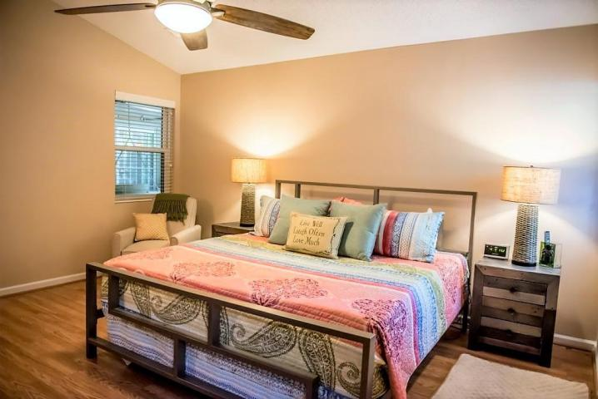
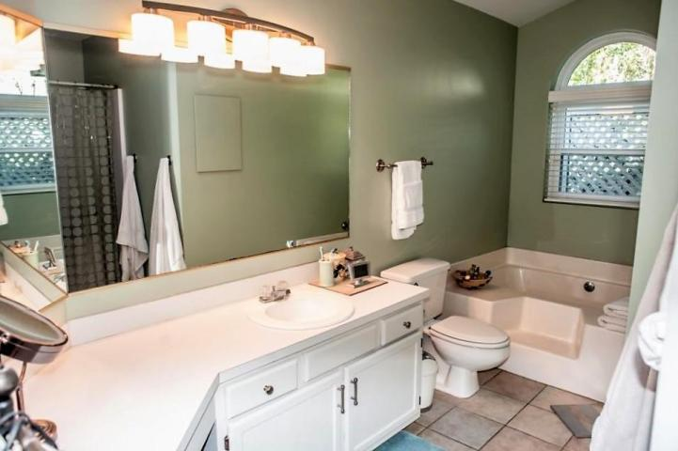
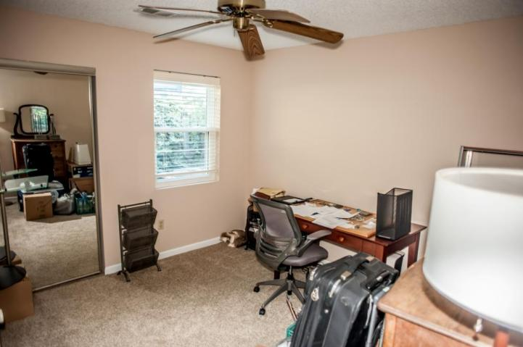
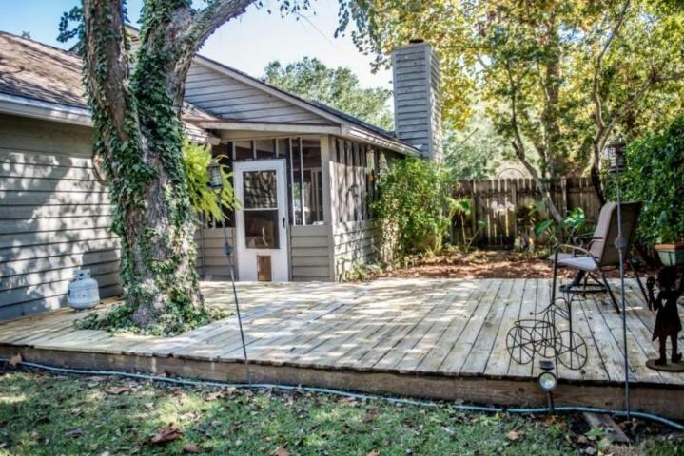
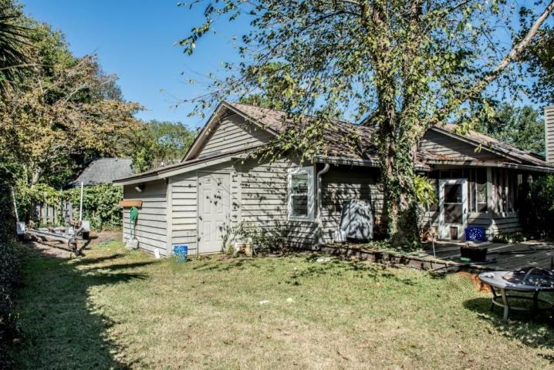
One Level Home ~ Energy Efficient Central Mt Pleasant ~ Private Boat Parking
1259 Llewellyn Road
Chelsea Park ~ Mount Pleasant ~ MLS# 18004570 ~ $369,900
Best Value in the neighborhood! This adorable one level home is biking distance from both Sullivan's Island and Isle of Palms, the historic Old Village and Shem Creek. Centrally located, this cozy neighborhood is convenient to I-526, great shopping, grocery stores and restaurants galore. Everything is just minutes from your front door. Enjoy the Lowcountry lifestyle on the screened porch, or back deck shaded by mature trees. There is a fenced yard with private boat parking and additional outside storage. Low maintenance tile, wood and wood laminate floors, vaulted ceilings and new, tempered skylights throughout. Large master suite with walk-in closet, huge master bath with a soaking tub, and stand alone shower. Bonus room has outside access and is perfect for office or den. The home also has a separate dining room, living room with a wood burning fireplace, two additional bedrooms, and large second bath to complete the spacious interior. Freshly painted, custom wide slat blinds, plenty of storage and closets, with a termite bond in place. The thermal pane, double hung windows are hurricane rated and were just installed! No Flood Insurance Required! There is a well pump for landscape irrigation, so you can have the greenest yard in the neighborhood and not use city water. Front load washer and dryer are new and convey. This house is move-in ready. Bring offers!
Behren Kittrell
(843) 870-3549
behrenk@scflatfeerealty.com
CharlestonFlatFeeRealEstate.com
Charleston Flat Fee Real Estate
2024 Covey Lane
Charleston, SC 29412

