Slide 1
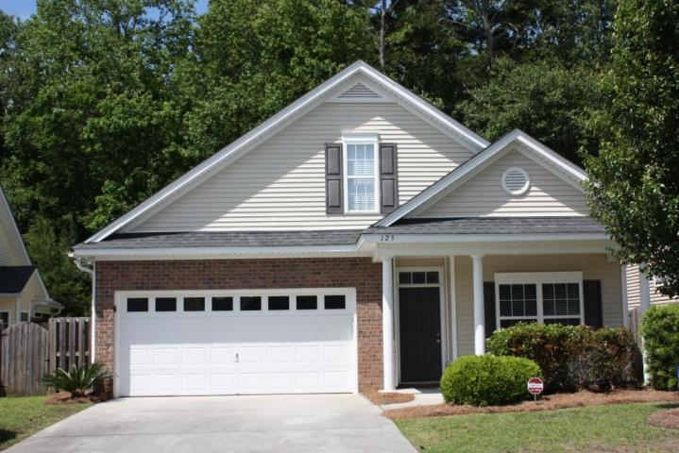
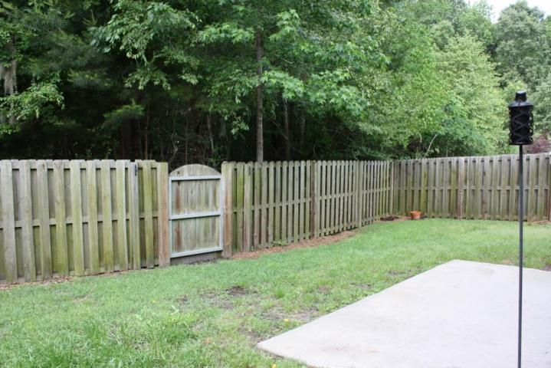
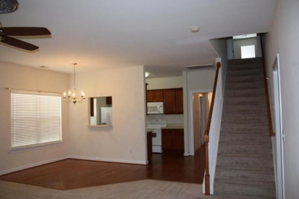
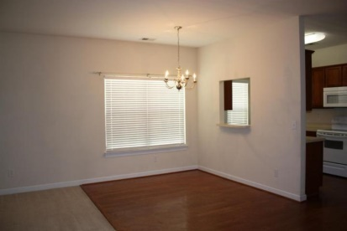
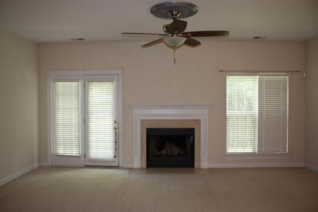
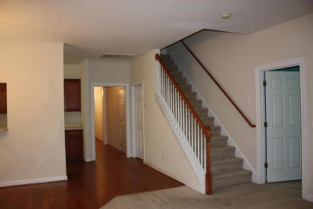
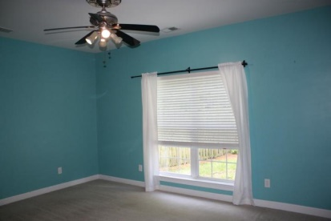
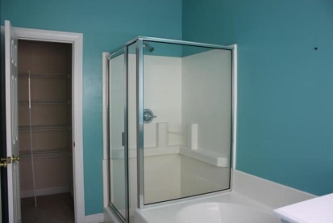
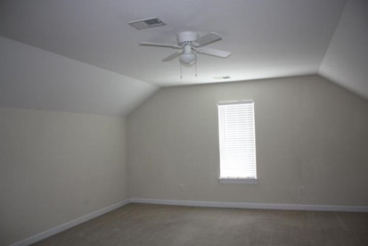
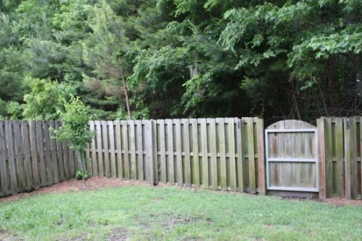


Move-In Ready Home in Dorchester Dist. II
125 Garden Grove Drive
Bridges of Summerville | Summerville, SC 29485 | MLS# 15012855 | $180,000
Welcome to The Gardens in Bridges of Summerville. This popular 1-story ranch floor plan features hardwood flooring in the foyer, kitchen and dinette. The kitchen includes flat panel maple cabinets with crown molding, built in microwave, flat top range, dishwasher & disposal. A marble-surround wood burning fireplace in the great room can be seen from the kitchen. The first floor master suite looks out over the private, fenced back yard. This master suite includes a walk in closet, dual sinks, linen closet, separate garden tub, and shower. A full bath, guest bedroom/office, and laundry room are found off the front foyer. Huge FROG is the 3rd bedroom. Don't forget to see the private fenced back yard. Enjoy low maintenance living with full front yard landscaping and pressure washing.
Marie Hamilton
Mobile - (843) 324-4774
mariehamiltonsc@gmail.com
Keller Williams Realty Charleston West Ashley
1180 Sam Rittenberg Ste 105
Charleston, SC 29407

