Slide 1
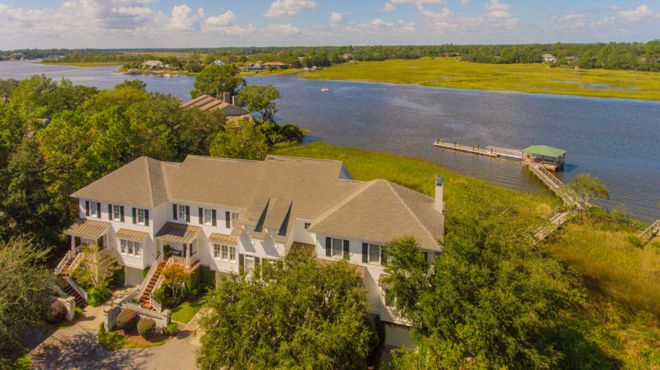
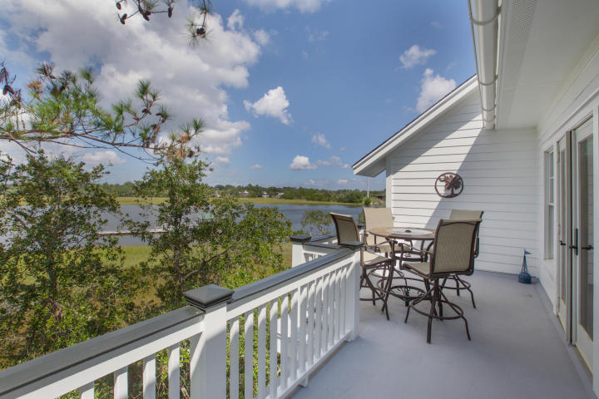
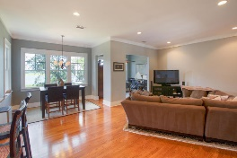
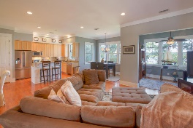
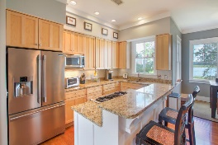
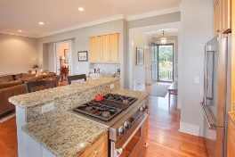
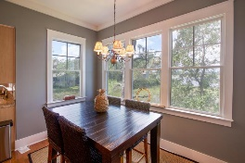
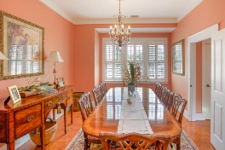
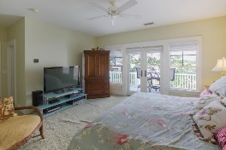
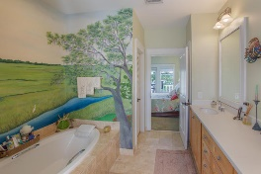
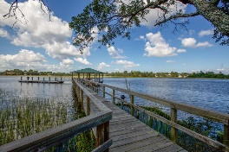
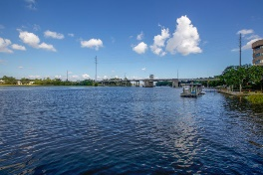
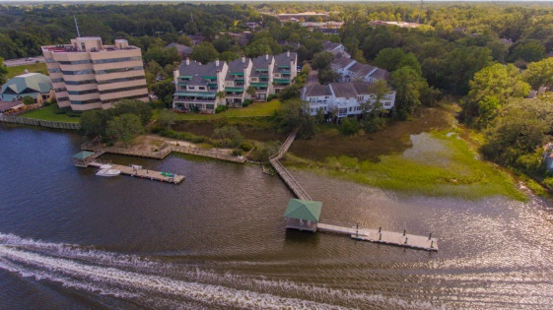

Beautiful Waterfront Townhome The Intercostal Waterway is Your Backyard
125 Wappoo Landing Circle #22
Wappoo Landing ~ Charleston, SC 29412
MLS# 17026684 ~ $849,900
Rare opportunity to own on deep water ICW. Deep waterway town home unit with incredible views from most every room in the home. Only five minutes to Charleston City Marina by boat and seven minutes to downtown Charleston by car. Folly Beach is a ten to fifteen minute drive. Can't beat this location. Beautiful unit which offers up to three bedrooms. The downstairs bedroom is currently being used as a formal dining room but is easy to convert back to private bedroom space. Granite countertops, hardwood floors, 10 ft ceilings on main living area. The master bedroom has private balcony overlooking the magnificent views of intercostal waters. Enjoy water views and watch wildlife from your bedroom, living area, or kitchen. Open floor plan with lots of storage. Drive under garage and generous storage space on the bottom level. The community has a dock with large covered pier head to enjoy evening drinks and sunsets (incredible southern sunset views) or morning coffee and floater to dock your boat during the day. Master Bathroom has large soaking tub and separate shower with two vanities and two linen closet. The master bedroom has lots of space and a large walk-in closet. You must see this unit to truly capture the beauty of the views and living space provided.
Deborah Meuli
(843) 822-0133
dmeuli@comcast.net
Wendy Deitsch
(843) 270-0433
wendy@lifetreeliving.com
LifeTree Real Estate, LLC | 3094 Hwy 17 North | Mt. Pleasant, SC 29466 | www.lifetreerealestate.com

