Slide 1
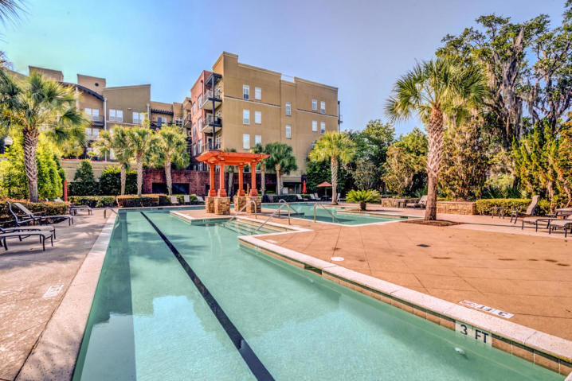
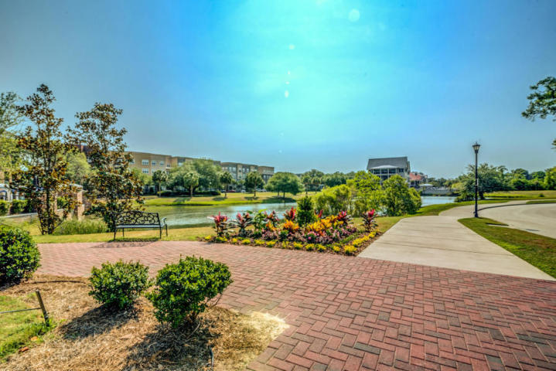
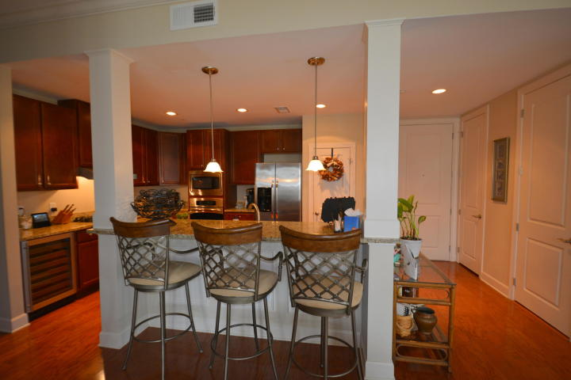
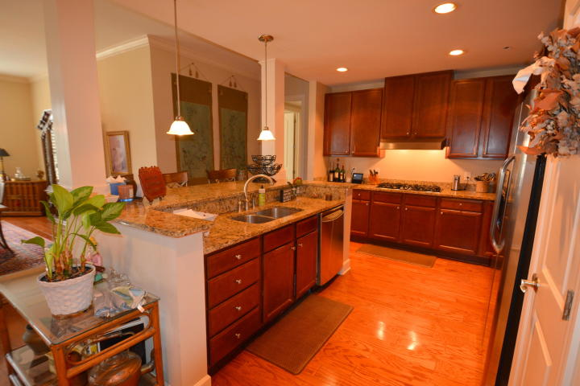
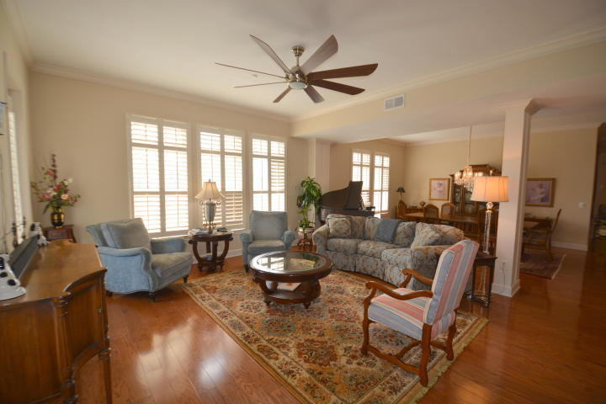
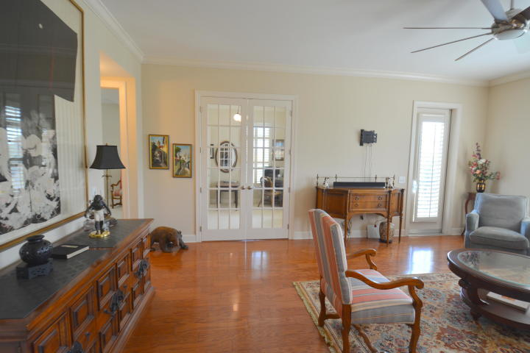
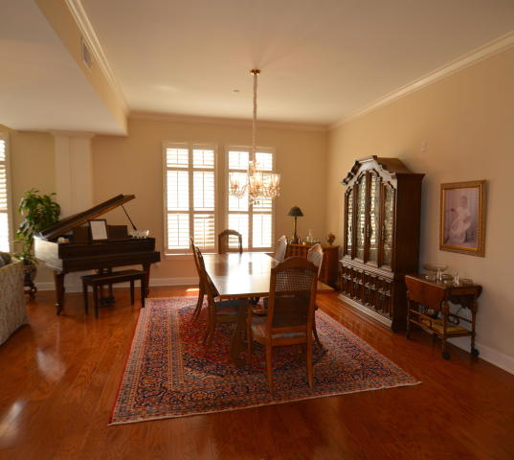
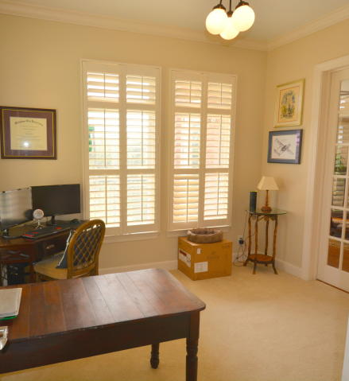
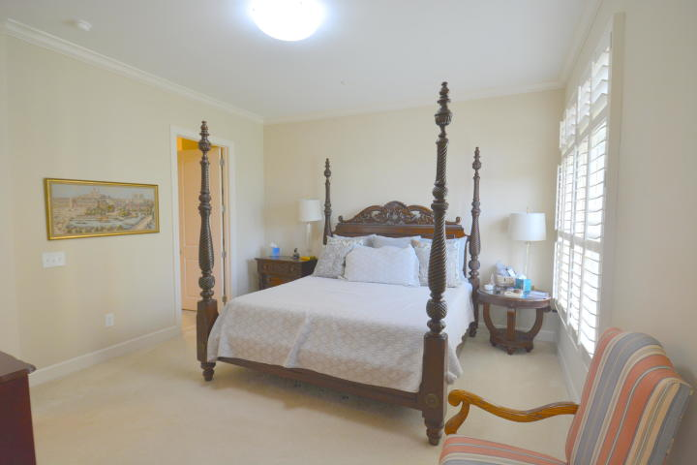
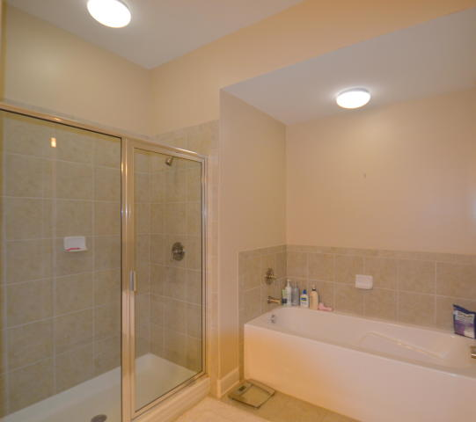
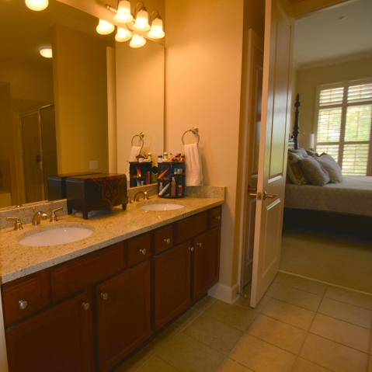
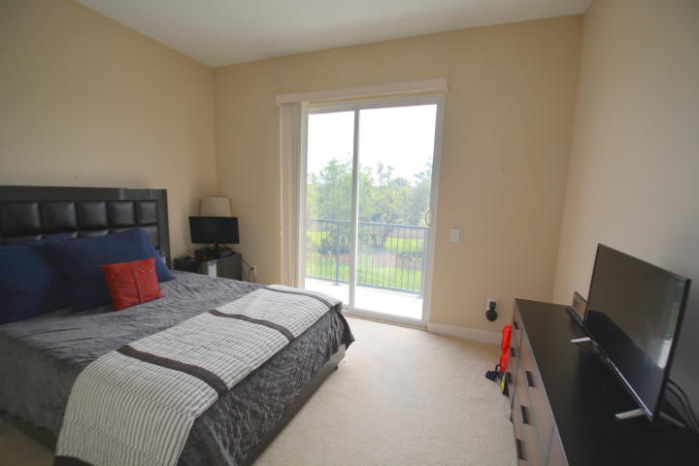
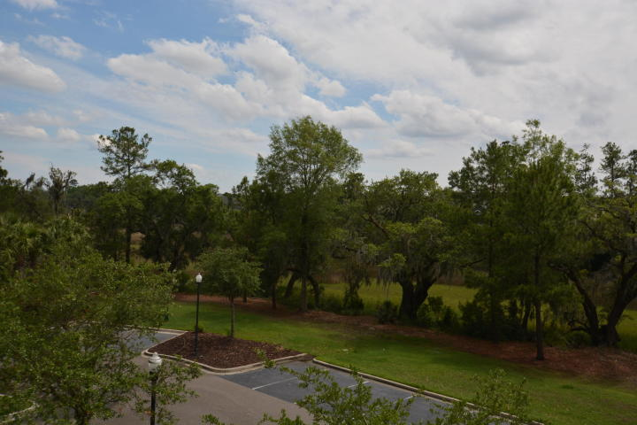
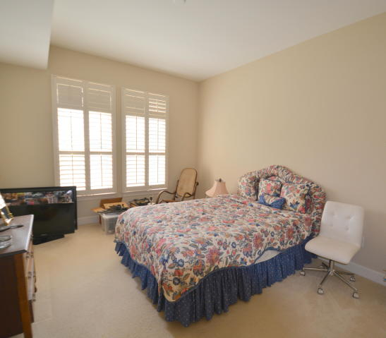


Open House ~ Saturday & Sunday from 1 to 4
Hosted by Sarah Graham | 843-693-0620 | sarahrgraham@kw.com
Buy.......Build.....Begin
125 Pier View Street #208
Pier View | Charleston, SC 29492 | MLS# 19017654 | $510,000
Welcome to Pier View. This open floor plan condo contains 2291 Square Feet and is an exceptional example of luxury living at its best. With three bedrooms and two and one half bathrooms, this upscale CORNER Unit has two verandas providing wonderful views of the Marsh and Daniel Island. Since your location is in Downtown Daniel Island you are a short walking distance to the restaurants, shops and wonderful amenities that make this Island so special. You will fall in love with the Gourmet Kitchen with Granite Countertops, a five burner Gas Cook top, Stainless Steel Appliances, a wine cooler and a large island with countertop will become the heart of your home and a favorite place to entertain guests. Plantation Shutters are everywhere. The openness and abundance of Natural Light are fantastic. The Kitchen opens to the very large Dining Area and this flows into the open and very large Living Area. Space, light and openness make this floor plan just pop.
The Master Bedroom Suite is located on one end of this luxurious condo with a large Master Bathroom. The attention to detail is amazing. From the pocket door leading into the very large walk-in closet in the Master to the French doors opening into the study from the living area and the Master Bedroom to crown molding everywhere, the attention to detail is so very nice. You have a large soaking tub, a large walk in shower, dual granite vanities and more in this great Master Bathroom.
The Guest Wing is on the other side of the condo with privacy doors giving you and your guests a very nice separation. The two bedrooms and extraordinary Guest Bathroom are stunning. And you have another veranda in the first guest bedroom giving your lucky guests their own fantastic view.
This luxurious condo also features plantation shutters and crown molding as well as hardwood floors throughout the main living area. One assigned parking spot comes with each unit and my clients have rented a second parking space on an annual rental that expires in February of 2020. We understand it can be easily renewed. You will also find a caged storage area in the secure and covered garage. The building is secure with elevator access to each floor and a convenient garbage chute, Resort style amenities include the swimming pool, landscaped courtyard and outdoor grilling area.
Buyer pays a one-time neighborhood enhancement fee of .5% x sales price to Daniel Island Community Fund at closing and an estoppel fee to the Daniel Island Property Owners Association, Inc. Community Fund Disclosure is attached. Daniel Island resale addendum will be required on offer to purchase.
Bob Ramella, Broker
CRS, CDPE, RCC, e-Pro
(843) 330-8300
bob@bobramella.com | bobramella.kw.com
Keller Williams Realty Charleston | 496 Bramson Ct Ste 200 | Mt. Pleasant, SC 29464

