Slide 1
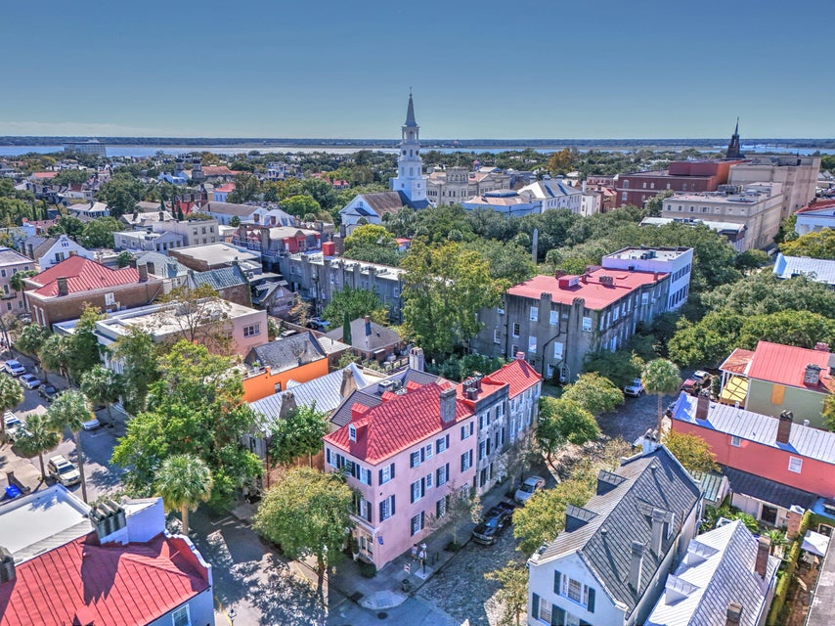
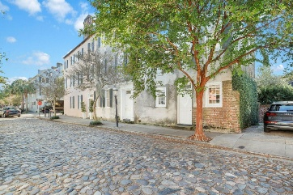
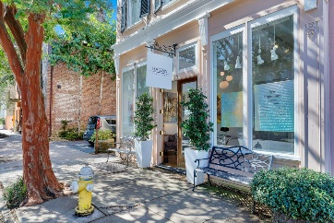
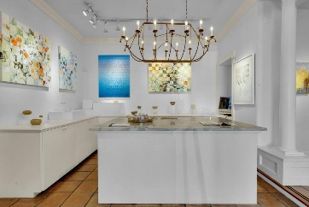
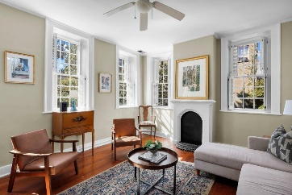
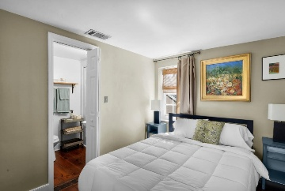
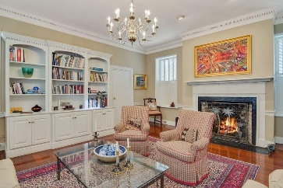
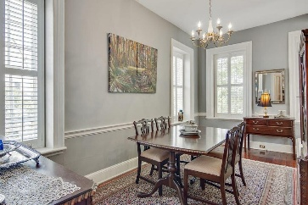
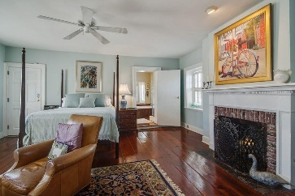
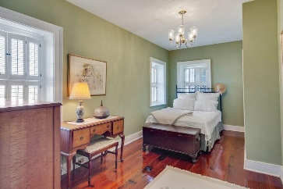
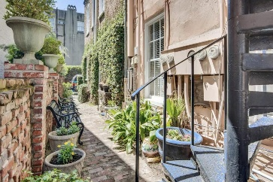



French Quarter Investment Opportunity
125 Church Street
French Quarter
Charleston, SC 29401
MLS# 24026229 | $4,100,000
Unit 1: SqFt: 2,905; Baths: 1
Unit 2: SqFt: 1,225; Bedrooms: 3; Baths: 2.5
Unit 3: SqFt: 1,000; Bedrooms: 2; Baths: 2
Nestled on Charleston's iconic French Quarter on the corner of the gorgeous cobblestone Chalmers and Church Street, this stunning triplex offers a rare investment opportunity in one of the city's most desirable locations. This remarkable circa 1801 property comprises two charming residential dwellings at 19 and 21 Chalmers Street, alongside a thriving commercial space currently occupied by the esteemed Hagan's Fine Art Gallery & Studio.
The property retains its historic charm with original wood floors throughout, vintage fireplaces, and breathtaking views that capture the allure of downtown Charleston. The two residential units offer a blend of vintage charm and modern convenience, perfect for discerning tenants who appreciate the character of an era gone by. Beyond the walls, two dedicated parking spaces ensure convenience in this sought-after area, while the cobblestone road adds a timeless elegance to the property's exterior. This triplex stands as an unparalleled investment, with the potential for both commercial and residential income streams. This property has been renovated and is meticulously maintained with newer HVACs, recoated roof, and more. Here's the chance to own a piece of Charleston's history where elegance, history, and prime location converge. All furniture conveys with exception to artwork. Not in a flood zone.
VIDEO TOUR
Nick Mazzilli
843-640-5575
nick@themazzilliteam.com
themazzilliteam.com
Maven Realty
2180 McMillan Ave
#71672
Charleston, SC 29405

