Slide 1
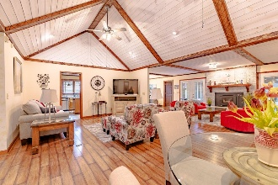
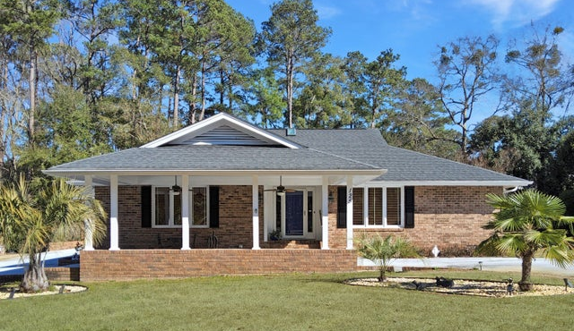
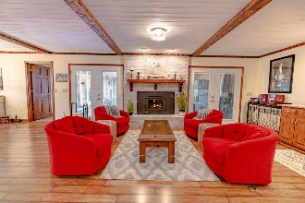
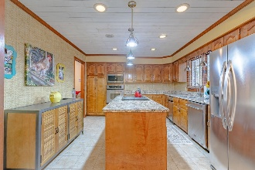
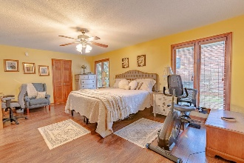
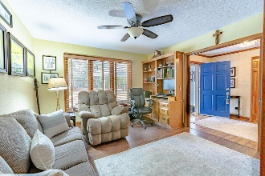
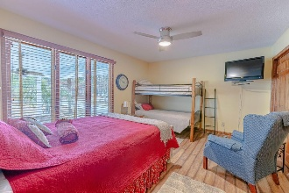
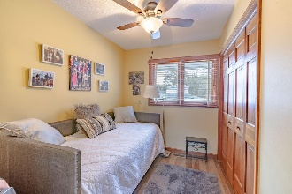
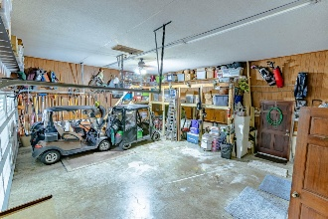
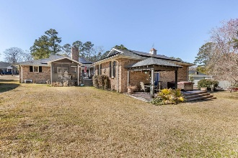


125 Cooper Drive
Santee Cooper Resort | Santee, SC 29142 | MLS# 25004218 | $480,000
Open House this Saturday March 15th from 1-3
Open House
Wednesday, 7/20
3-5PM
Welcome to this beautifully maintained 2,674 sq ft ranch-style brick home, nestled in the secure and desirable gated Santee Community. This exceptional property features 3 bedrooms, 3 full baths, a den/office, and an expansive open floor plan, all conveniently situated on one level for easy living. As you approach, a long, welcoming driveway leads you through mature landscaping, setting the tone for the elegance that awaits. Upon entering, you are greeted by a spacious foyer that opens up to an airy open-concept living area, highlighted by stunning 13' vaulted beamed ceilings, a gorgeous fireplace focal point, and abundant natural light. The kitchen offers an ample amount of wood cabinetry, an island for additional prep space, and a cozy dining area that comfortably accommodates a large table, featuring a charming bay window. French doors seamlessly connect the indoor space to a remarkable 500 sq ft deck; part of which is screened-in, while the other portion serves as a serene courtyard area in addition to a pergola, perfect for relaxing or entertaining guests. The Bedrooms are thoughtfully designed for optimal separation, enhancing comfort and tranquility. A spacious primary suite has two walk-in closets and an en-suite bathroom featuring dual vanities and a glass-doored walk-in shower, perfect for unwinding after a long day. The guest suite includes three double-door closets with convenient private bath access. A well-appointed 200 sq ft den/office space complete with a built-in desk and bookcase is ideal for remote work or quiet study. An oversized garage spanning 680 sq ft with 12' ceilings, features a versatile 252 sq ft room with private access, offering plenty of storage options, a man-cave, or work area. The garage also has a 300 sq ft deck which is hot tub ready for soaking under the stars.
This home takes energy efficiency to the next level; equipped with solar power panels and a battery system, these features significantly reduces energy costs by up to 70%, making it not only eco-friendly but also very economical.
You can enjoy access to Lake Marion, a Country Club membership offering golf, tennis, a boat ramp, and much more while living in this desirable neighborhood.
Some key updates include:
- 2017: New 30-year shingle roof, HVAC system, windows, exterior doors, kitchen renovations, and deck installation.
- 2019: Fresh interior paint throughout.
- 2021: The Great Room was vaulted to enhance the open living area with a peaked ceiling height of 13'.
- 2022: Installed a wood-burning fireplace insert with a circulating fan for cozy evenings.
This stunning property is the perfect blend of comfort, privacy, and community, making it a must-see! Don't miss this opportunity to live in a serene and picturesque setting, schedule your private tour today!
Brandon Ray
(843) 499-1928
brandon.ray@carolinaone.com
www.lakelifescstyle.com
Carolina One Real Estate
900 N Main St
Summerville, SC 29483

