Slide 1
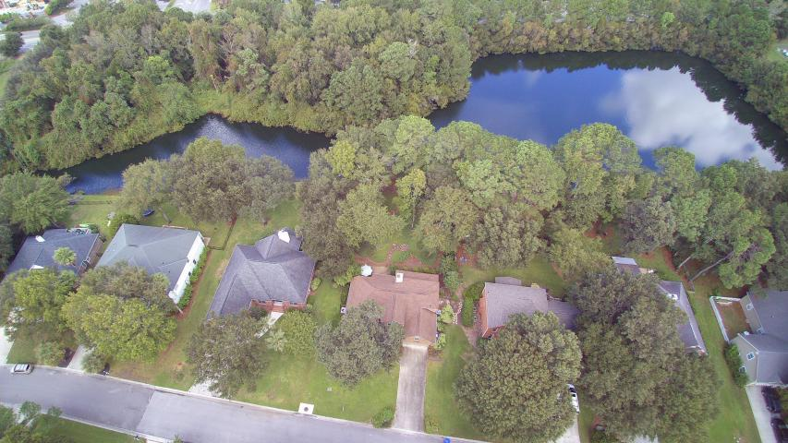
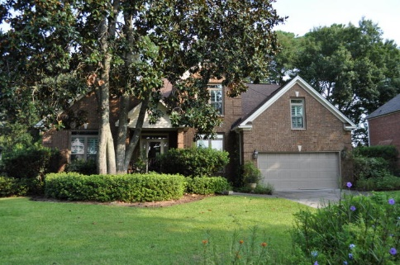
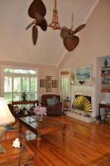
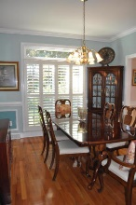
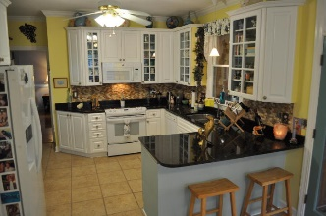
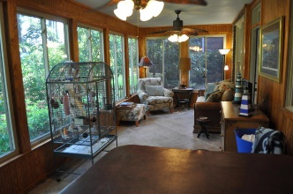
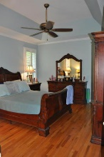
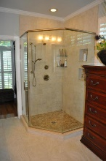
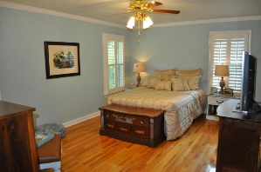

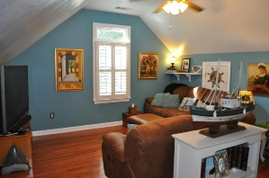
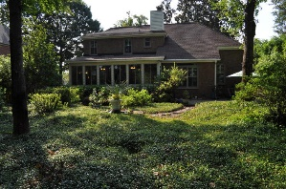
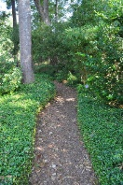
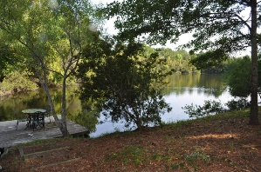



Hidden Gem in Hidden Lakes
1138 Waterfront Dr
Hidden Lakes ~ Mt Pleasant ~ MLS# 16000069 ~ $765,000
1261 Waterfront Drive
Mt Pleasant ~ MLS# 16024241 ~ $629,000
Hidden Gem of a home in wonderful Hidden Lakes! This beautiful, brick home features a downstairs Master bedroom, two upstairs bedrooms, a FROG/4th bedroom, large eat-in kitchen, and a fantastic climate controlled sunroom that has not been included in the listed square footage. (approx. 280 add'l sq. ft) The owners have meticulously cared for this home over the years, and have recently updated all the bathrooms and the kitchen. Newer roof covering (2005); newer HVAC units (2009 - still under 10 year warranty!); newer windows; clean crawl space; and so much more! The home sits on a gorgeous lot in the back of Hidden Lakes. It feels so private and secluded with the pond and so many trees around, you may forget you're in the middle of Mount Pleasant when you're in your new back yard!
The Boulevard Company, LLC
Mark Macpherson
mark@beachbreak-properties.com
843.367.5640 Mobile

