Slide 1
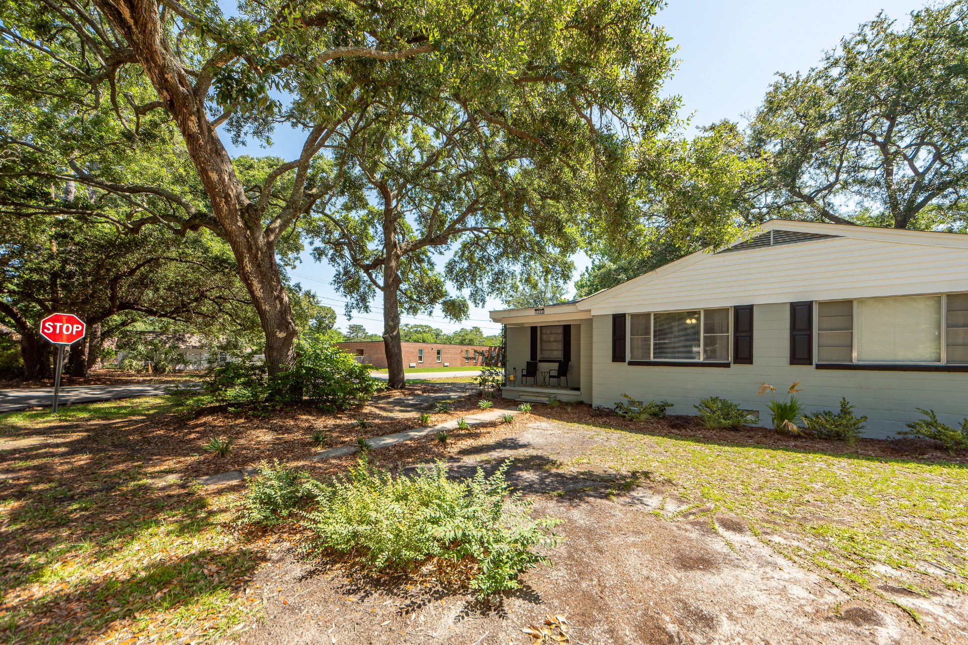
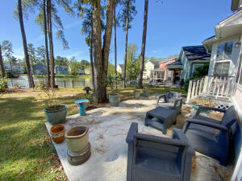
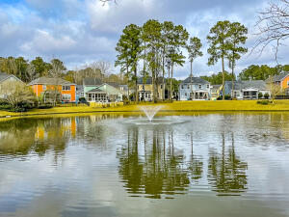
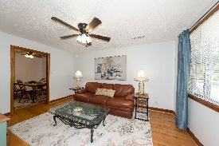
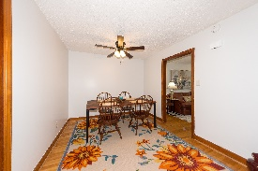
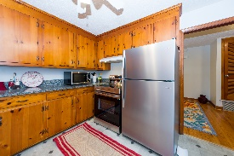
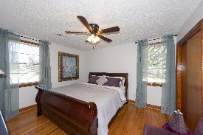
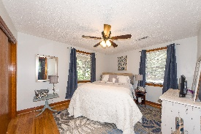
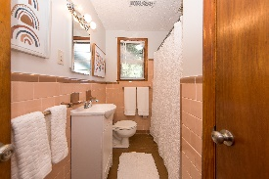


SHORT TERM RENTAL IN WEST ASHLEY
1262 Wisteria Road
Fairfield Pines | Charleston, SC 29407 | MLS# 22014801 | $2,400
Pristine, charming FURNISHED MONTHLY RENTAL.. turn-key, 2bedroom/1bath duplex on oak-filled gorgeous corner lot in cozy quiet neighborhood and in a fabulous location with huge fenced backyard, great for pets. Home includes all utilities and has been freshly painted, inside and out, top to bottom. All hardwood floors, new mini-blinds, ceiling fans with light kits in every room including the kitchen. There is a brand new stainless steel stove/oven and refrigerator, microwave convection oven, air-fryer, Ninja Bullet, all dishes, utensils, cutlery, etc... Brand new full sized Amana washer and dryer. Home includes new 50'' Samsung TV in living room and each bedroom has brand new Vizio. Water, electric, lawn service, internet and cable included. All linens for bedroom and bath also included.
Katherine Blakely
843-709-7355 | katherine@purpose-one.com
Purpose One Properties | EXP Realty LLC

