Slide 1
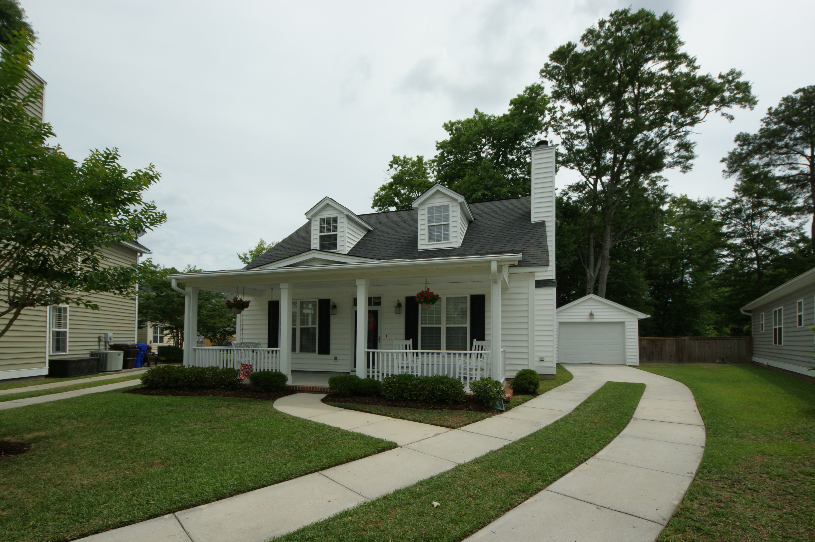
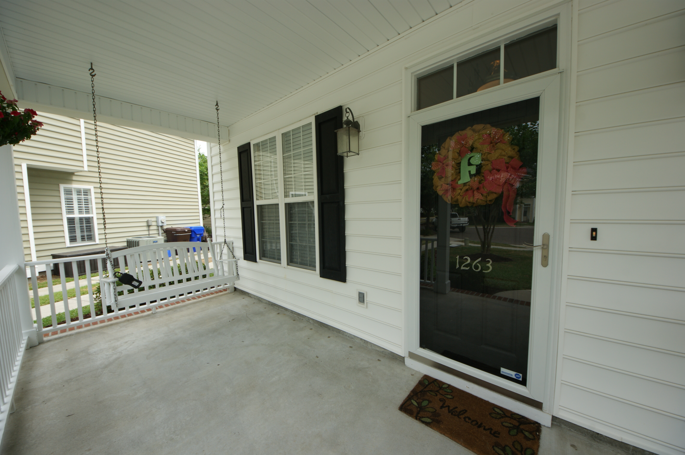
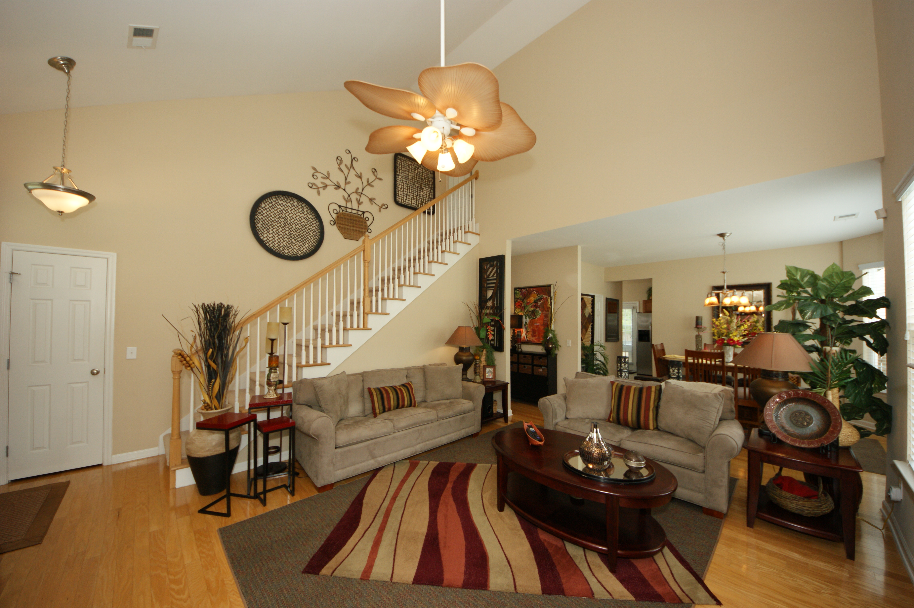
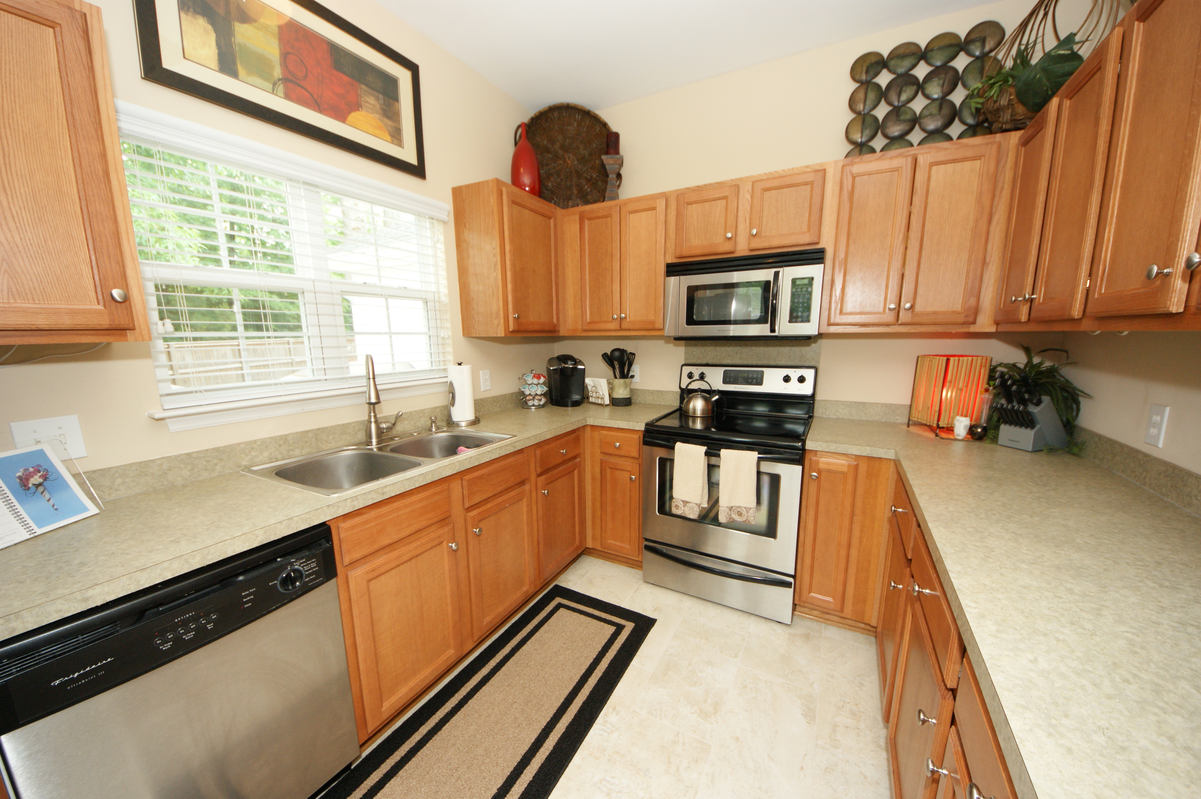
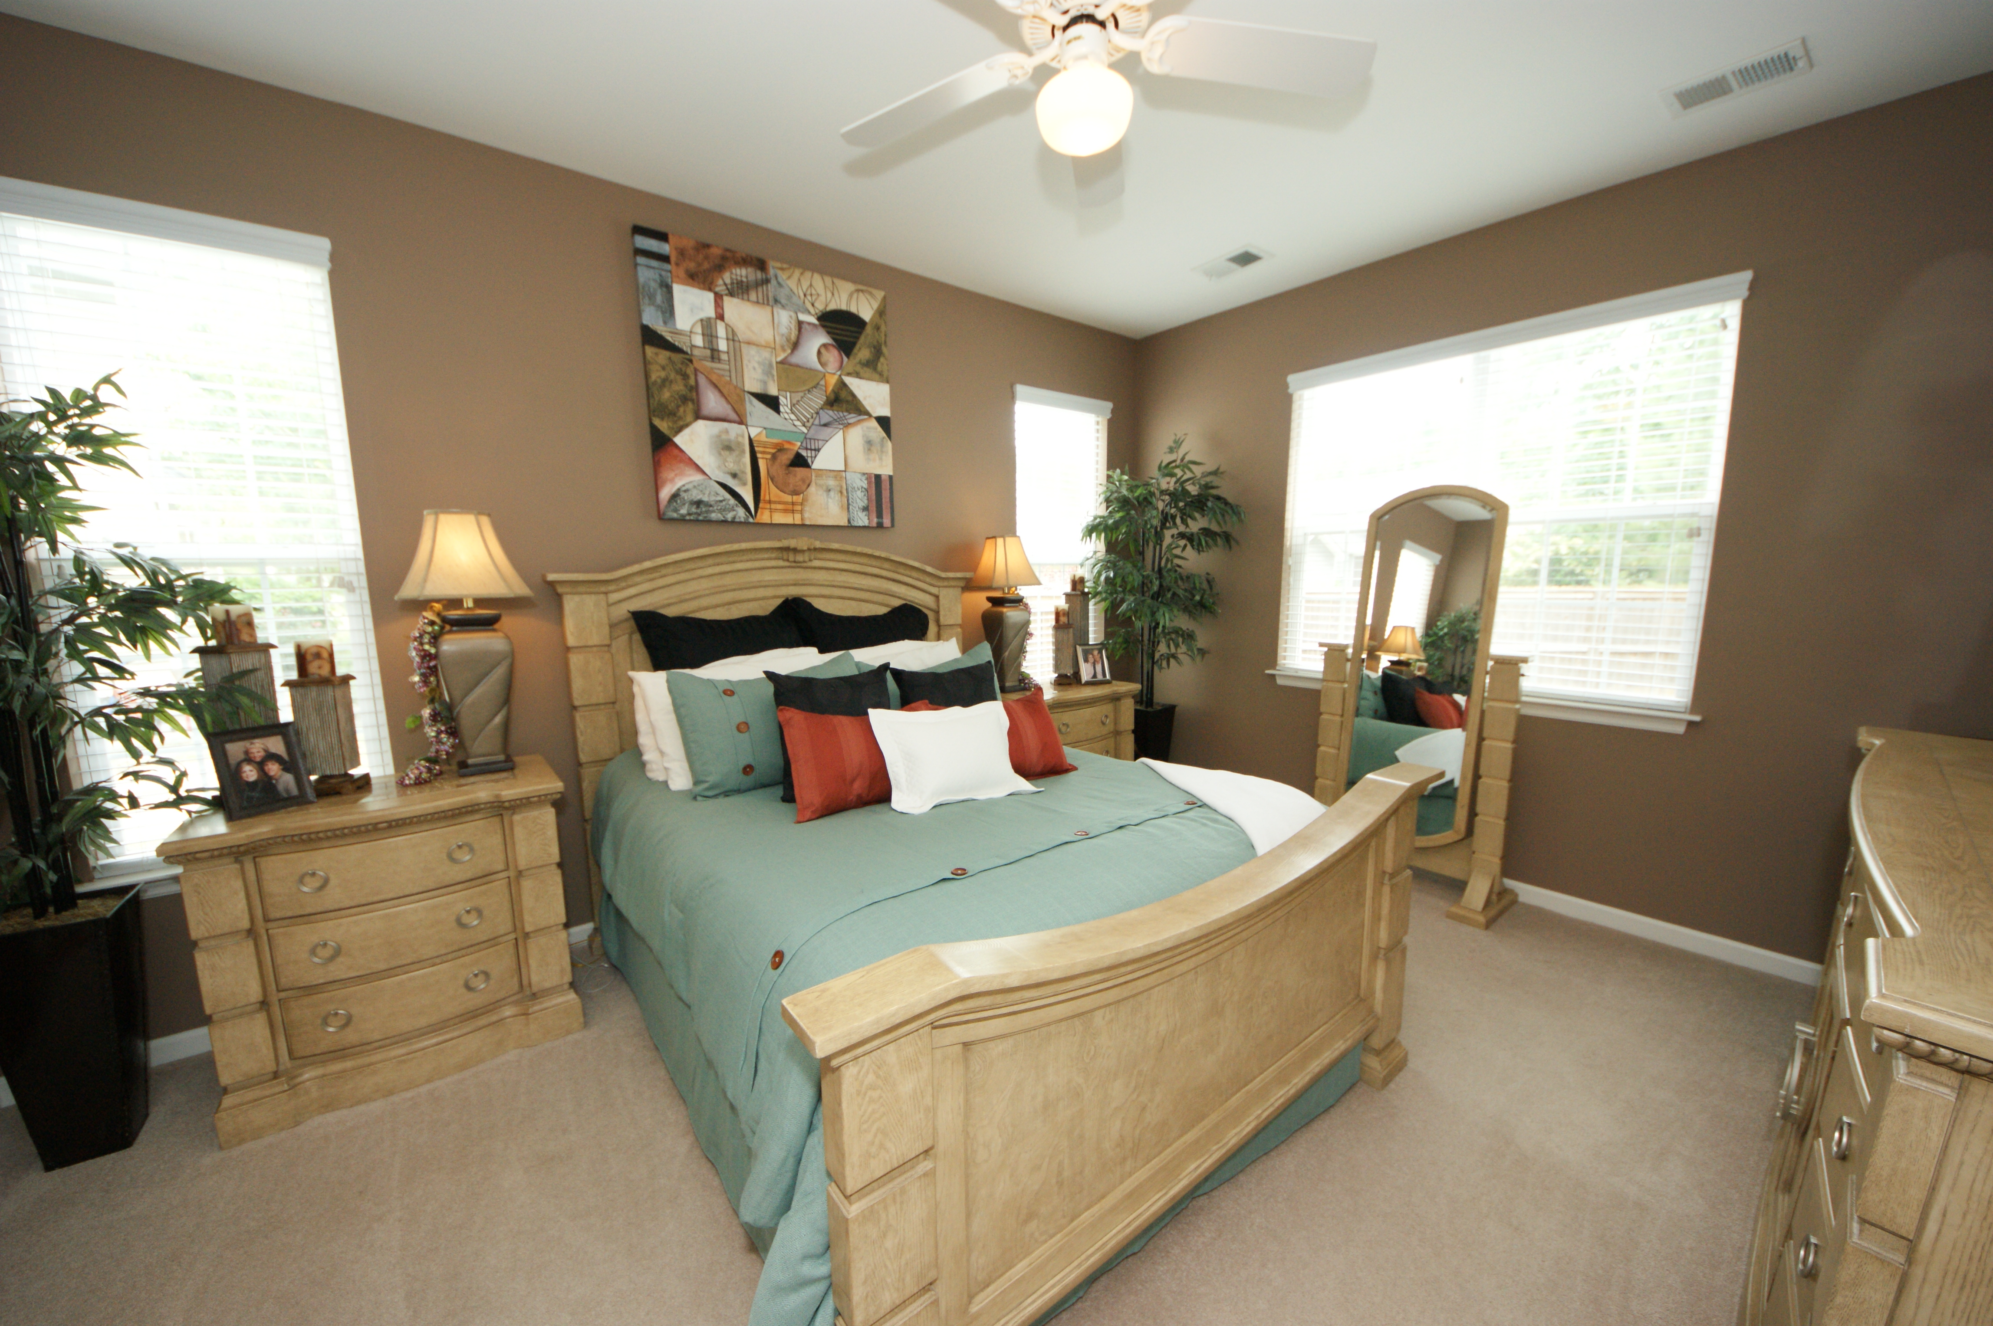
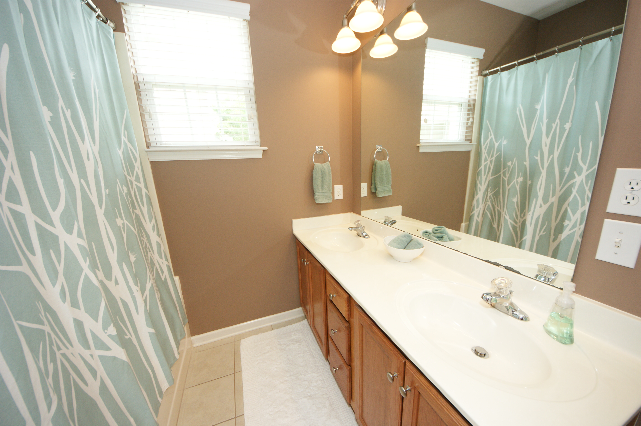
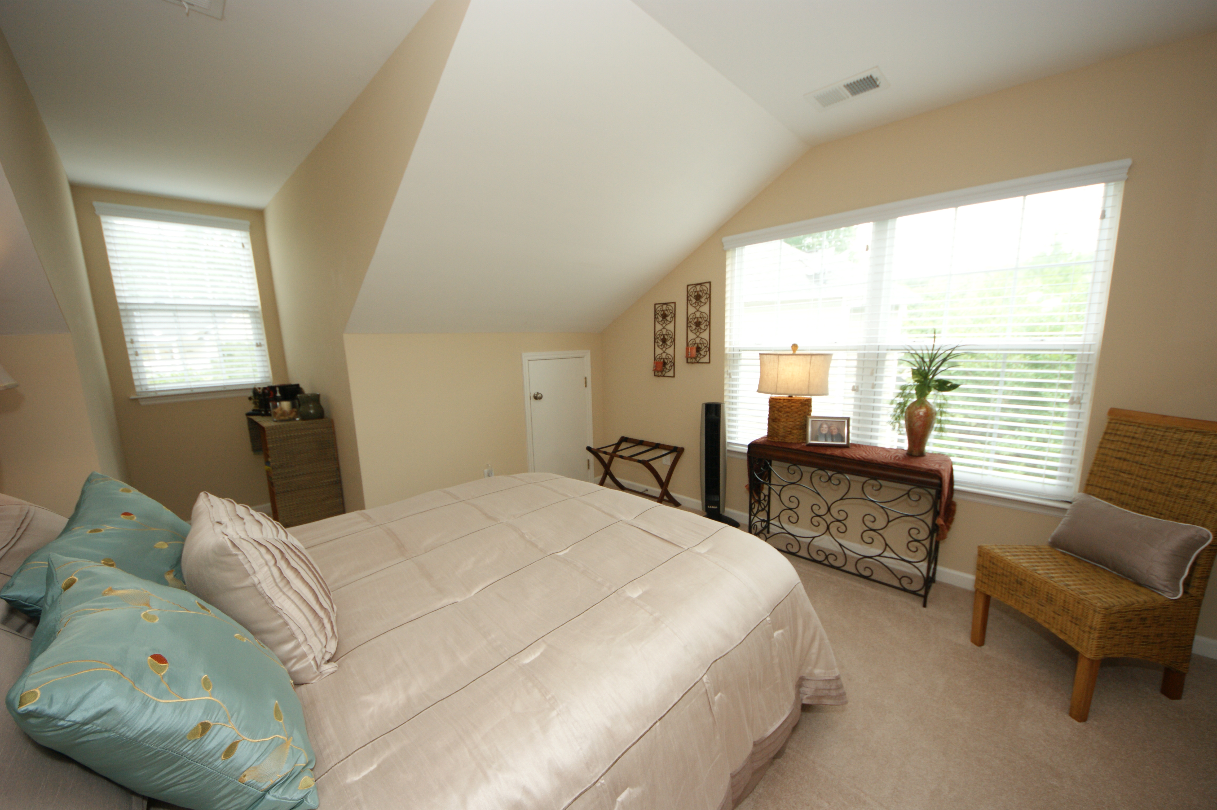
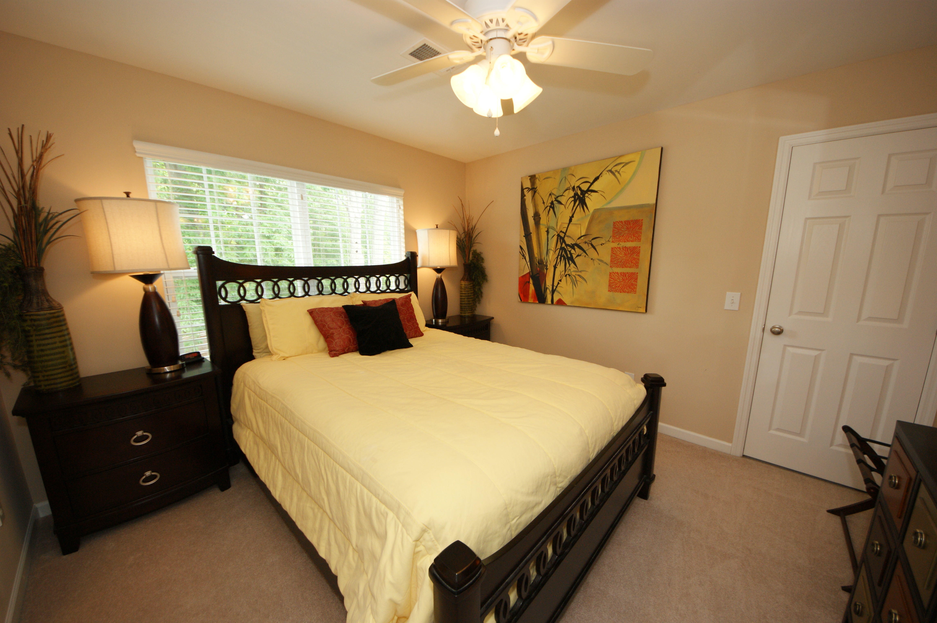
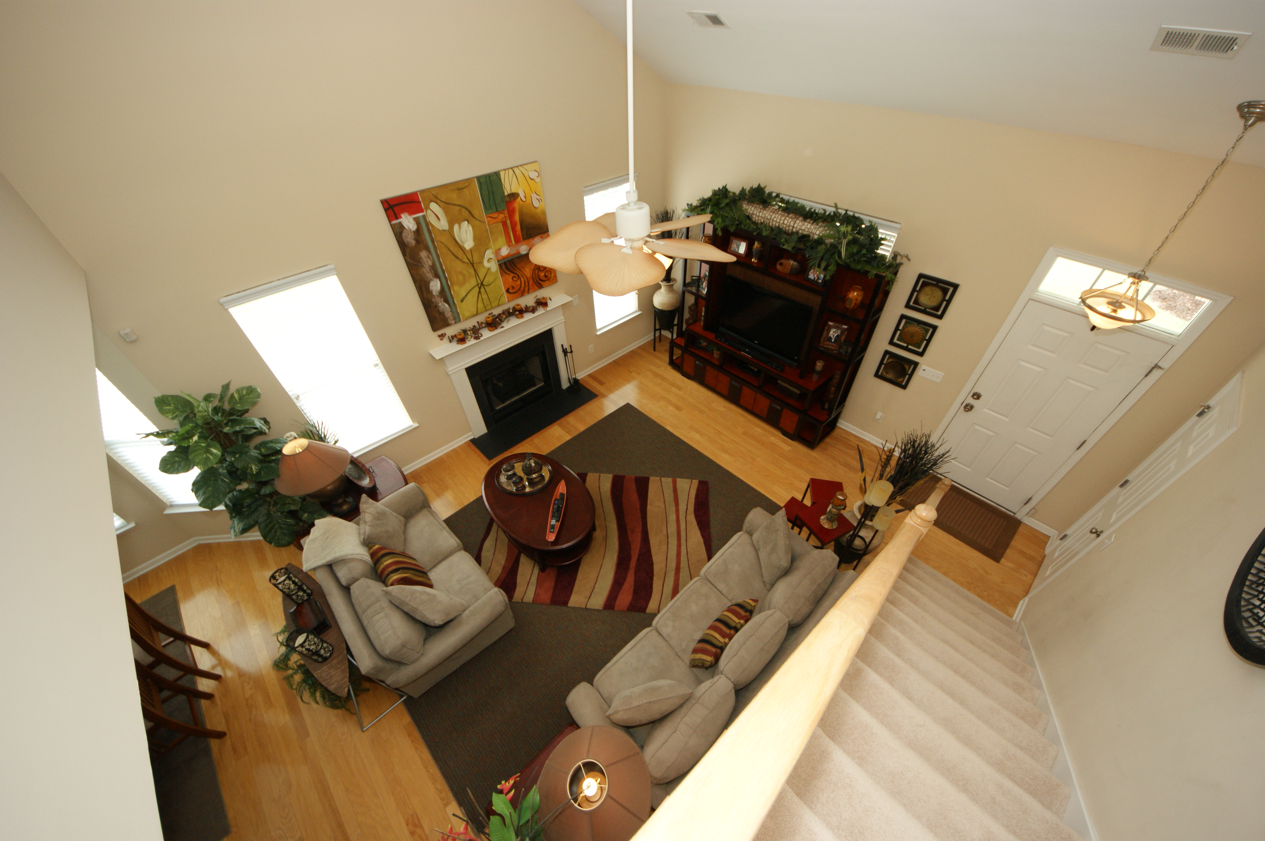
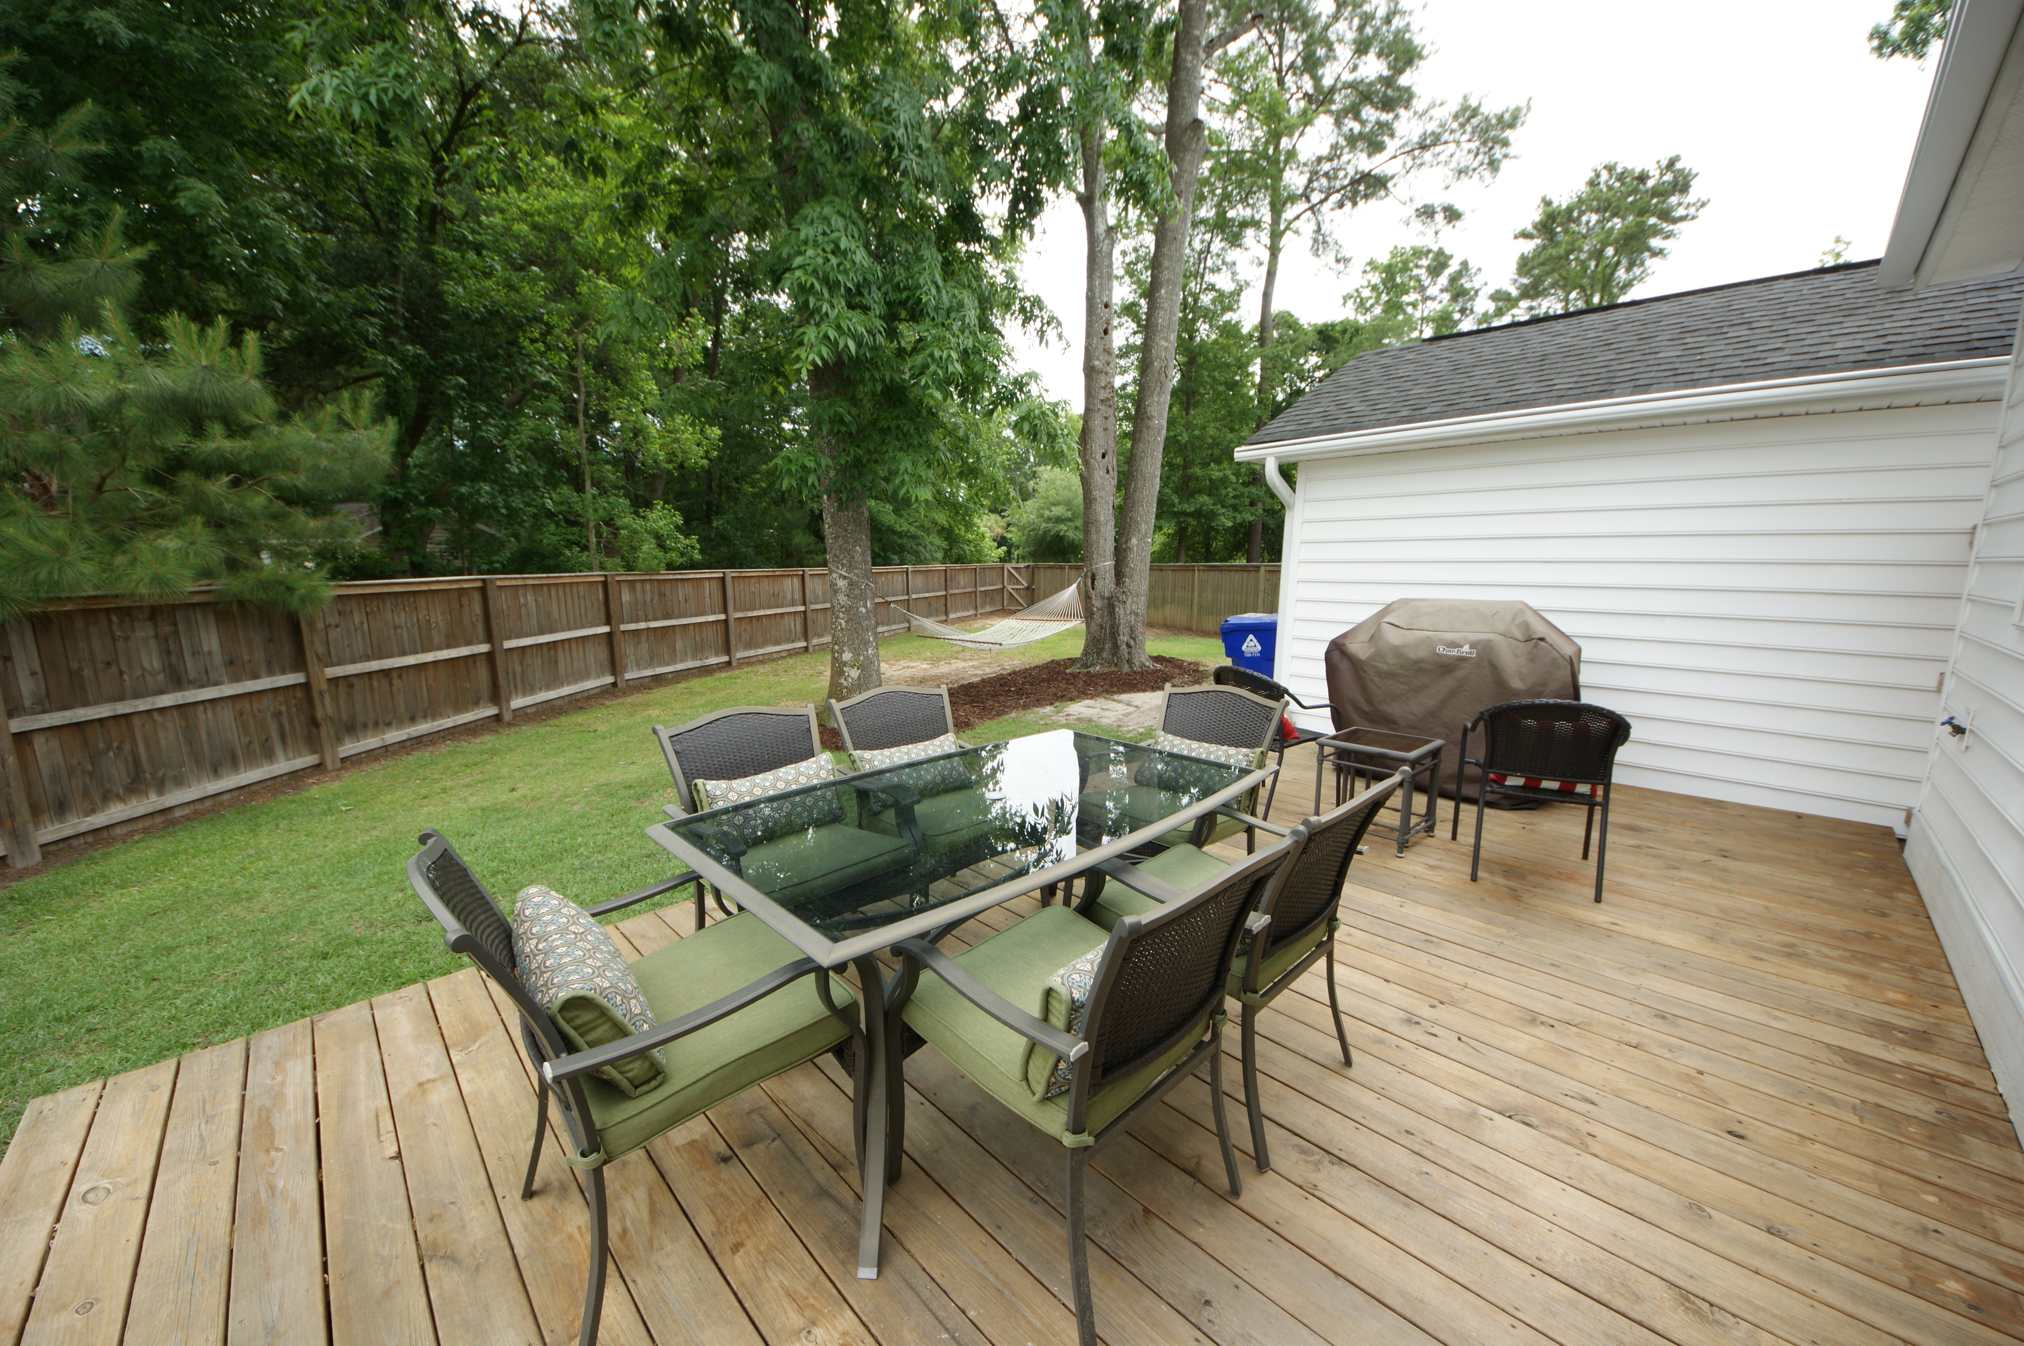


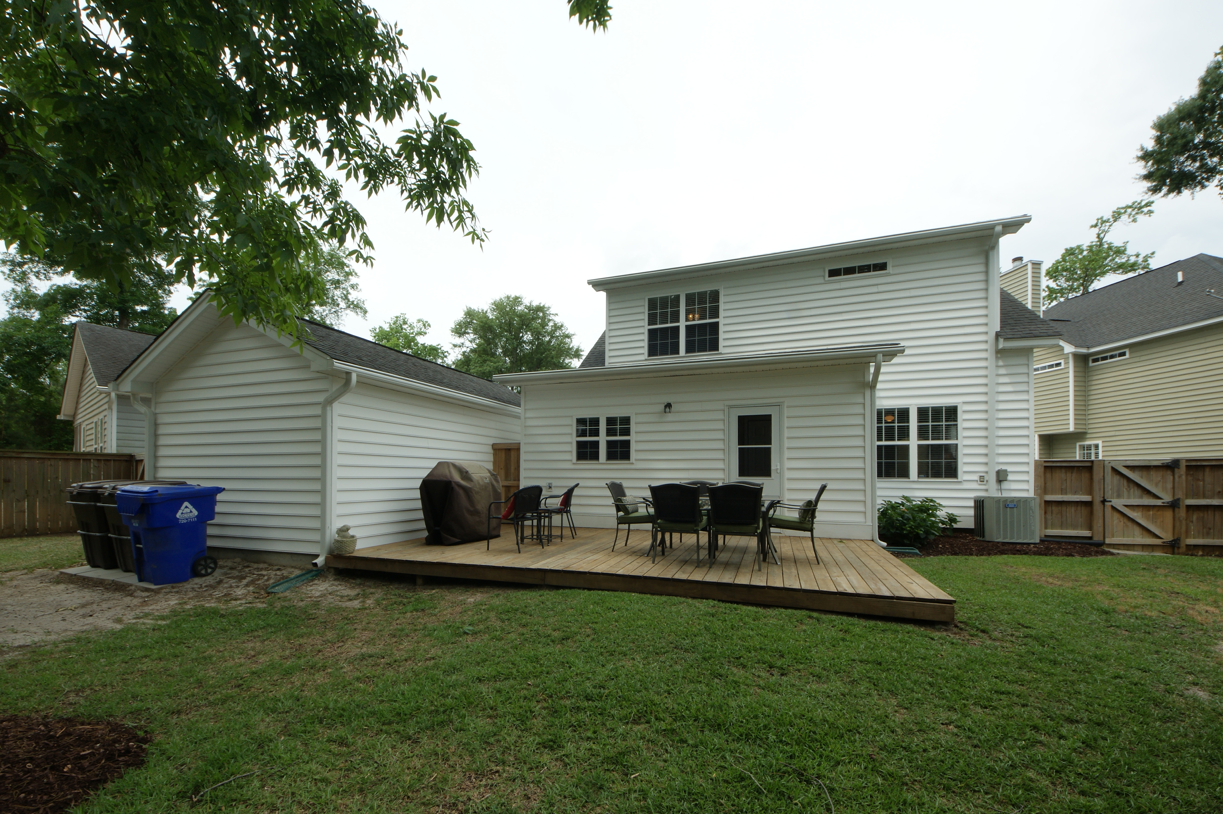
1263 Fallen Oak Drive Laurel Grove ~ Mount Pleasant, SC 29466 MLS# 16012571 ~ $339,000
Don't miss out on this charming, cozy home. Gleaming hardwoods greet you at the front door and welcome you throughout the downstairs, except for the master bedroom, which has comfy neutral carpeting. A soaring ceiling in the living/dining/great room gives a feeling of spaciousness you'll appreciate. This home has plenty of natural light and beautiful brushed nickel lighting fixtures. When the day ends, sit out on your front porch and meet the neighbors or relax in your own fully fenced, wooded backyard. This home has over $20,000 in upgrades, including tiled floor in the master bath & Kitchen, stainless appliances, large deck and privacy fenced yard. The convenient location will have you home, relaxing in no time.
Greg Flanagan
Broker/REALTOR/CLHMS
Luxury Marketing Specialist
Office: 843-952-4444 | Cell: 843-818-8867
www.FlanaganHomeTeam.com
Keller Williams Realty Charleston | 496 Bramson Ct Ste 200 | Mt. Pleasant, SC 29464

