Slide 1
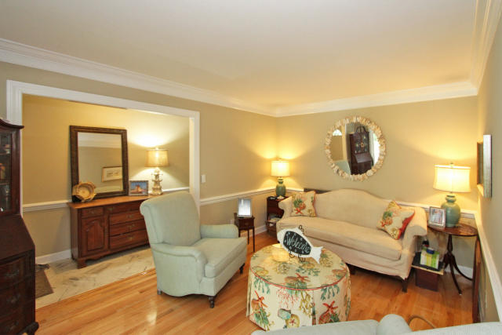
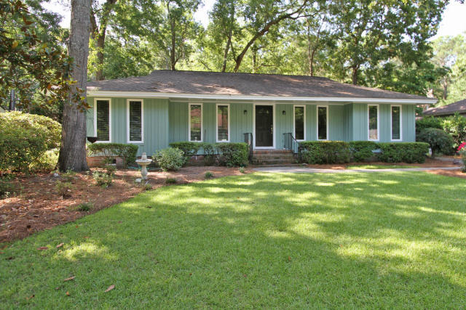
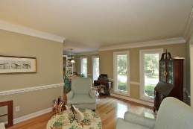
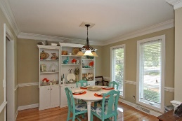
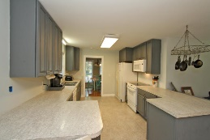
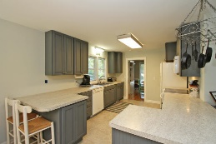
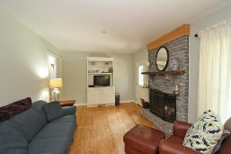
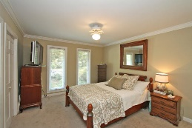
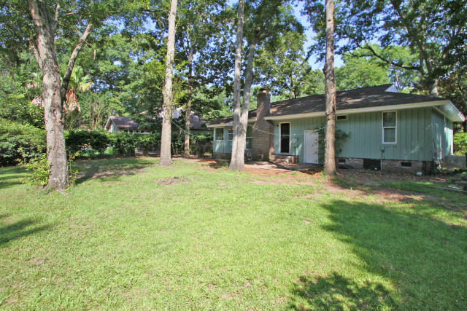
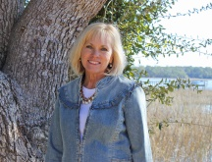

Close to the Ravenel Bridge!
1263 Oldwanus
Parish Place
Mount Pleasant, SC 29464
MLS# 15016453
$360,000
GREAT location & GREAT home in established Parish Place!
Imagine your yard with mature trees & landscaping. Shorten your commute time to just about anywhere! Award winning James B. Edwards School is right around the corner as is Senior Citizens Center, East Cooper hospital & Publix!
Renovations include new HVAC & ductwork under house, new windows, completely remodeled baths, updated kitchen cabinets, smooth ceilings & more! Wood floors in family, dining & living rooms. Beautiful wood burning Fireplace in family room. Breakfast nook with storage benches.
Ask your agent to add to your ''must see'' list today!
Sheila Romanosky
(843) 224-0242
sromanosky@carolinaone.com

