Slide 1


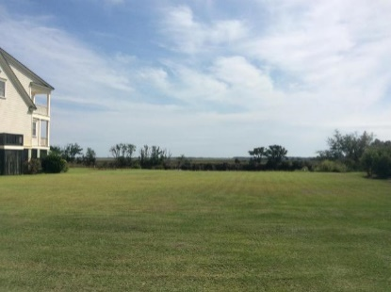
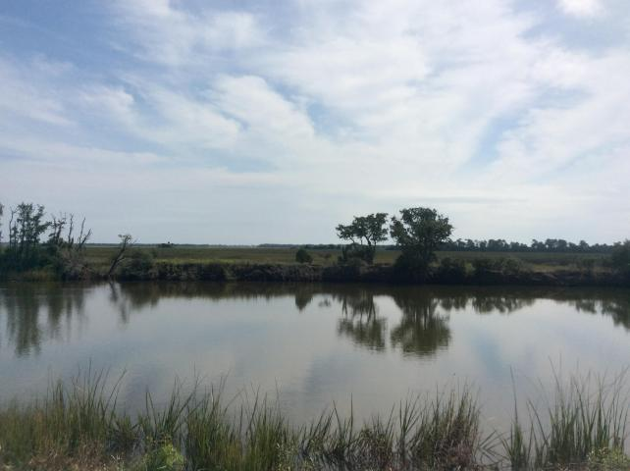
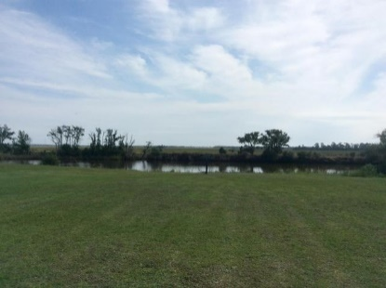
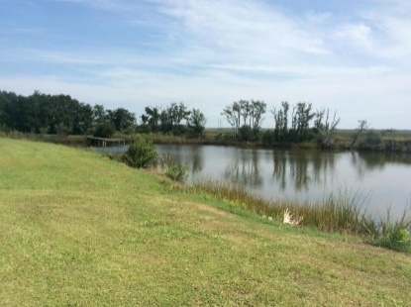
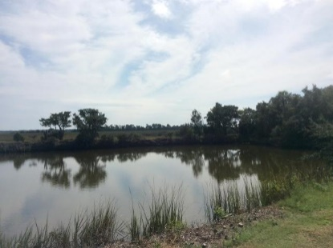
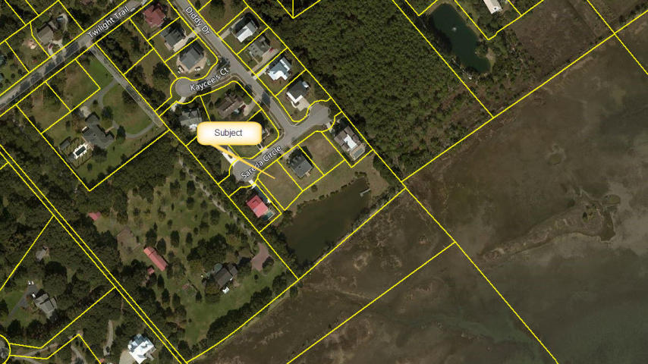
MLS# 16026129 ~ $495,000
Incredible Marsh Views!!
1263 Sareda Circle · Daybreak · Mount Pleasant, SC 29464
The last marsh view site in Daybreak.
This lot offers panoramic views of the marsh and the Intracoastal Waterway looking towards the Isle of Palms and Sullivan's Island. It also fronts on a community pond and a HOA community area. Daybreak is a small, quite community that is located off Rifle Range Road and is just minutes to the beaches, shopping and schools.
Atlantic Real Estate Services, LLC 1250 Fairmont Ave
Mt Pleasant, SC 29464
Michael Tawes
O (843) 654-7562 | M (843) 568-2401
mtawes@atlanticappraisals.com

