Slide 1
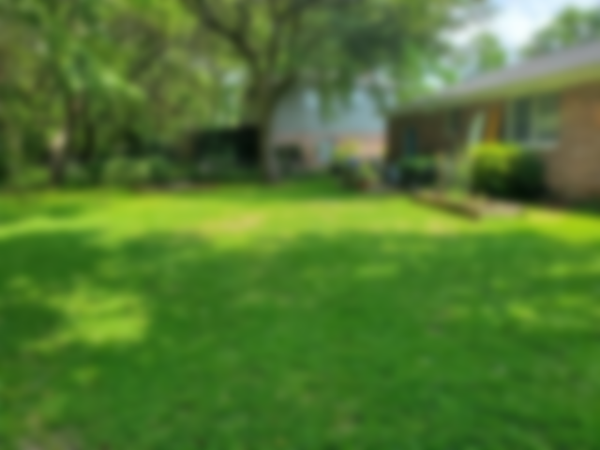
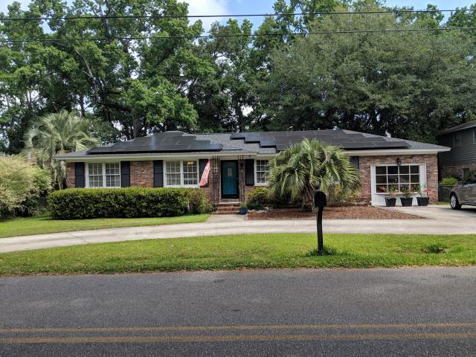
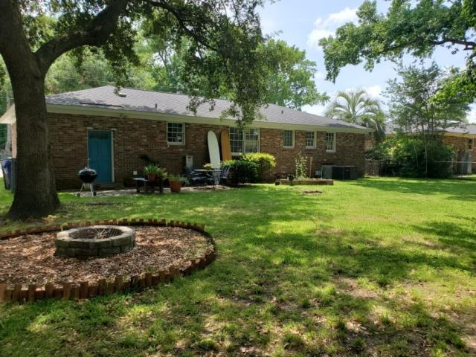
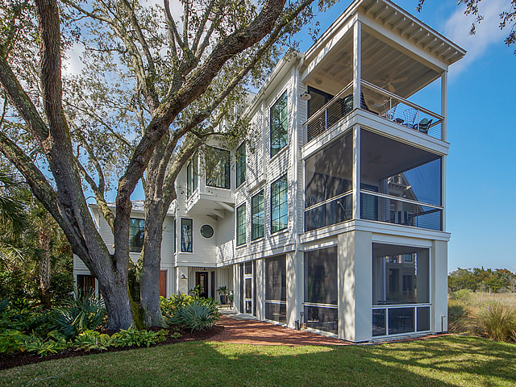
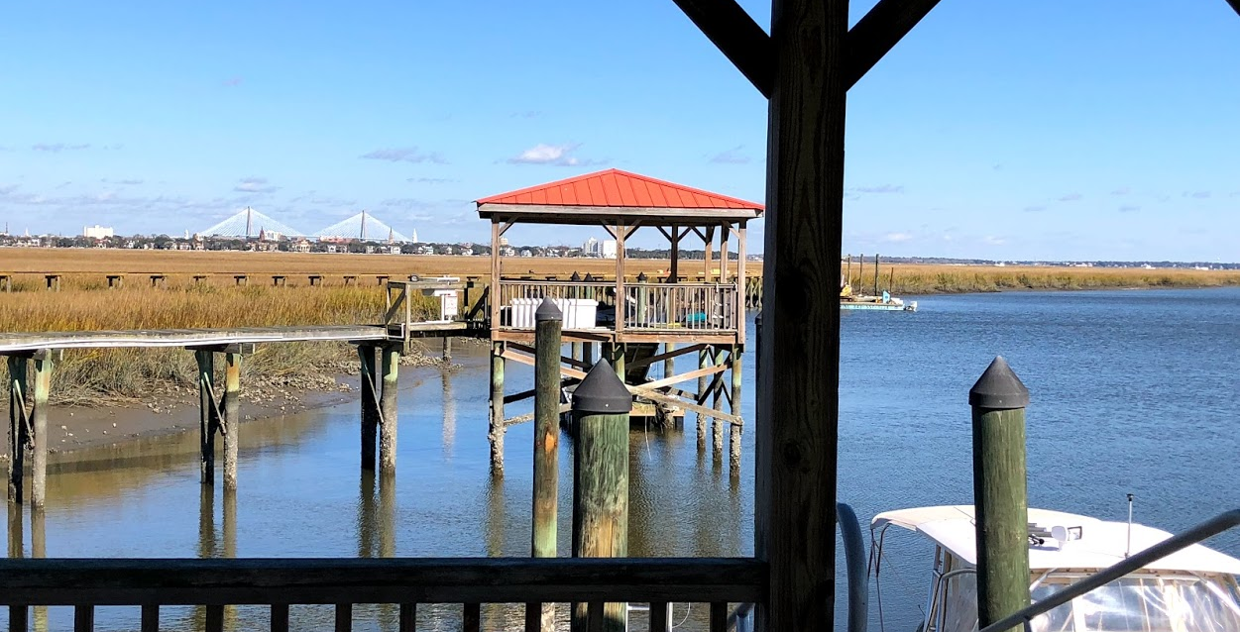
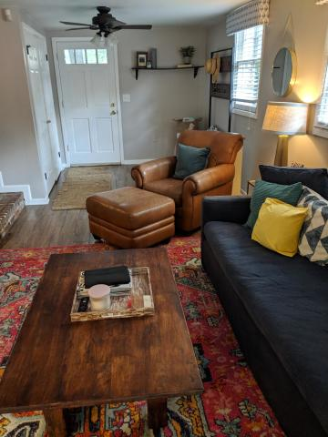
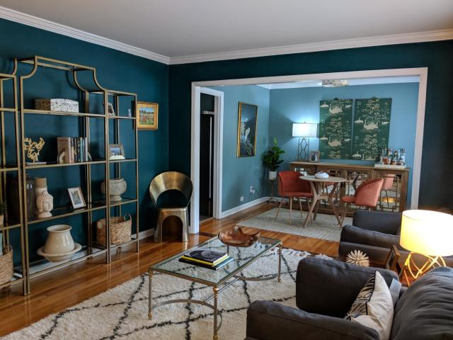
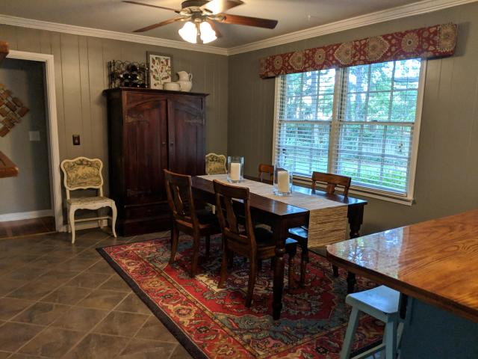
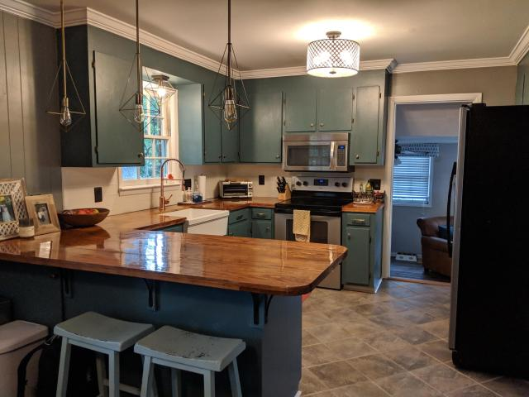
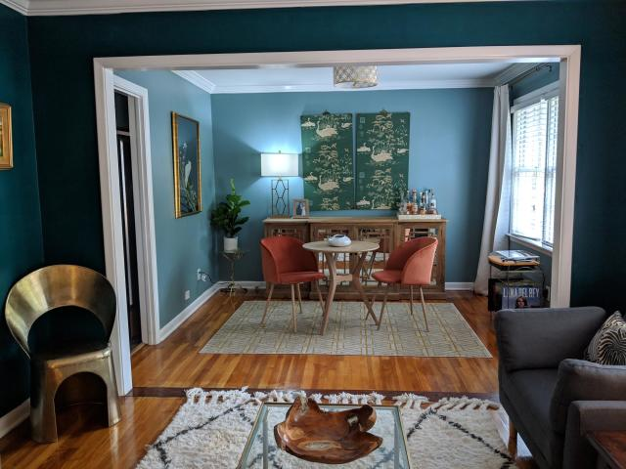
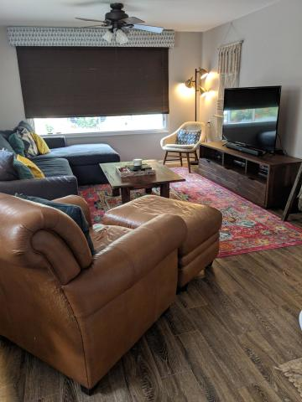
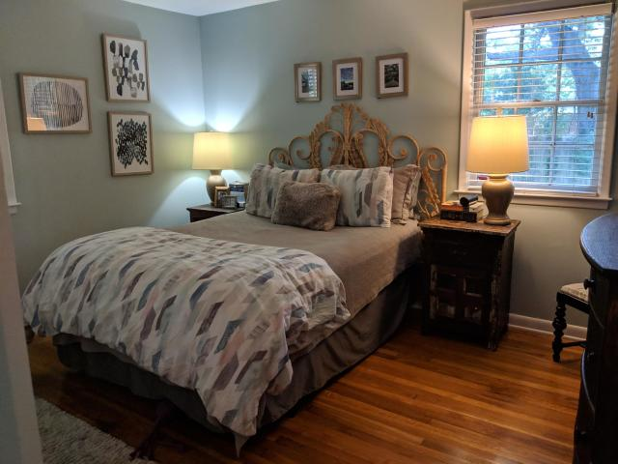
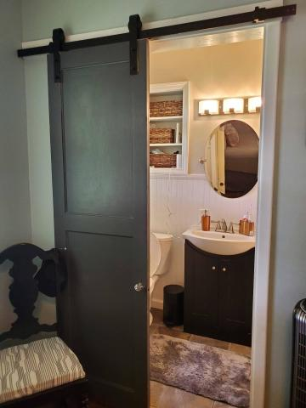
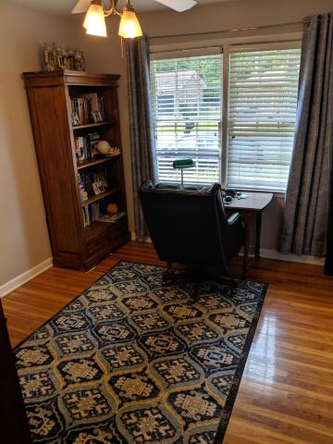
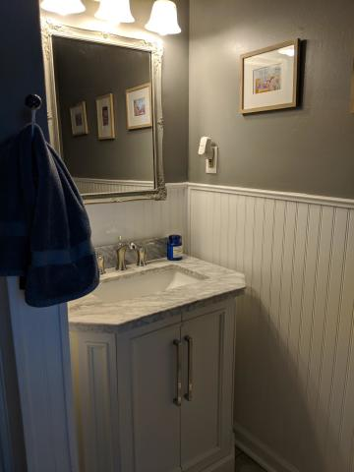

Solar Can Help You
Save Up To $150/Mo
1264 Marvin Avenue
Old Towne Acres ~ Charleston, SC 29407
MLS# 19013878 ~ $359,000
Updated one-story 3 Bedroom / 2 Full Bathroom ranch home (w/ Solar $) located in the Old Towne Acres neighborhood of West Ashley minutes from grocery stores and Avondale restaurants and nightlife (including the new Whole Foods Market and Starbucks). Updated kitchen and baths; enclosed garage used as a 2nd family room; original hardwood floors; not in a flood zone; washer/dryer included; large fenced backyard with patio and shed; $30K+ Solar Investment on roof (Save ~$1,800K/yr+); lots of parking with double entrance driveway; 10 minutes from MUSC / downtown Charleston; 5 minutes to I-26 and I-526.
Snizhana Penchev
(843) 530-5200
snizhana@hbrtwn.com
www.hbrtwn.com
Harbourtowne Real Estate
672 Marina Drive, Ste 110
Daniel Island, SC 29492

