Slide 1
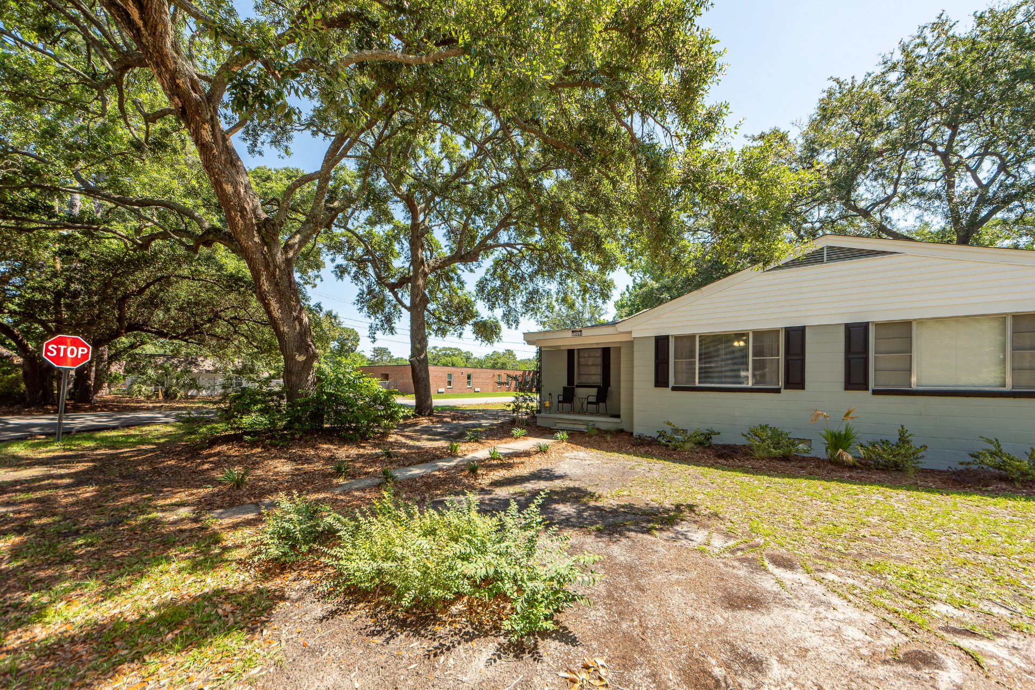
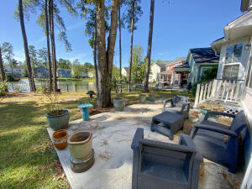
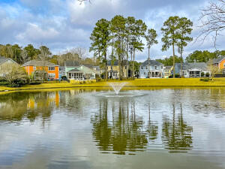
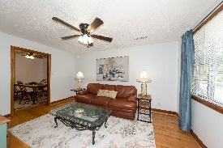
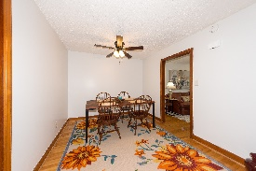
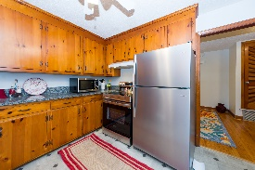
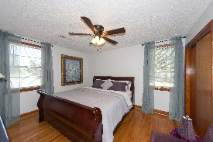
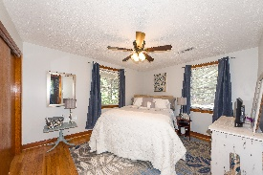
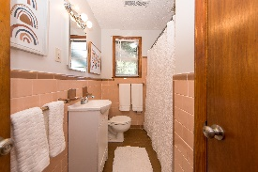


WEST ASHLEY SHORT TERM RENTAL AVAILABLE NOW
1264 Wisteria Road
Fairfield Pines | Charleston, SC 29407 | MLS# 22022702 | $2,500
CHARMING, pristine FURNISHED MONTHLY RENTAL. TURN-KEY 2bedroom/1bath duplex on oak-filled GORGEOUS large corner lot in a cozy quiet neighborhood. Fabulous location w/HUGE fenced backyard, perfect for WELCOMED PETS. Rent includes ALL utilities and home has been freshly painted, inside and out! All hardwood floors, new mini-blinds, ceiling fans with light kits in every room including the kitchen. There is a brand new STAINLESS STEEL STOVE and REFRIGERATOR, MICROWAVE convection oven, AIR-FRYER, Ninja Bullet, all dishes, utensils, cutlery, etc... Brand new full sized Amana washer and dryer. All linens for bedroom and bath also included. Home includes new 50'' SAMSUNG TV in living room and 2nd bedroom has brand new Vizio TV. Water, electric, lawn service, internet and cable INCLUDED.
Katherine Blakely
843-709-7355 | katherine@purpose-one.com
Purpose One Properties | EXP Realty LLC

