Slide 1
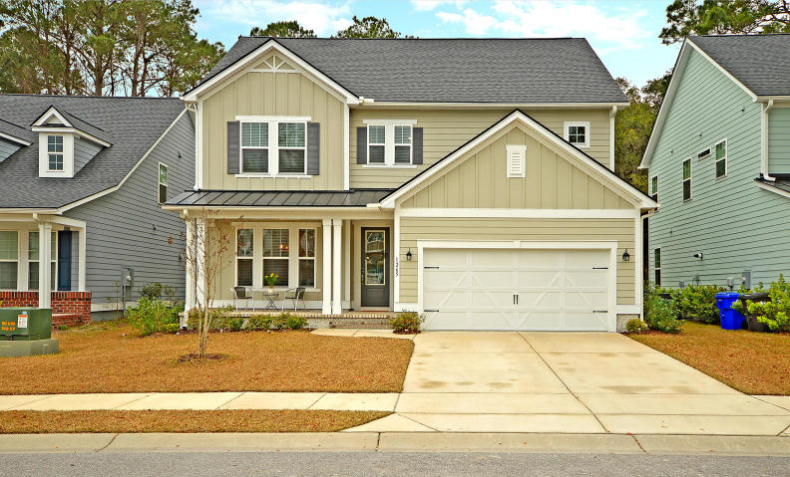
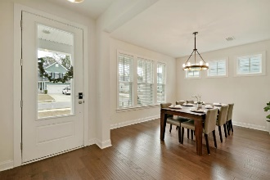
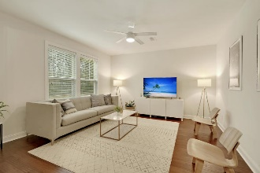
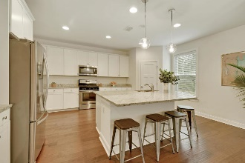
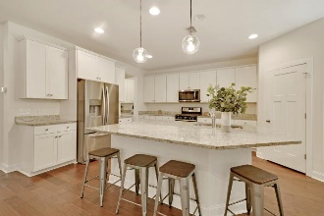
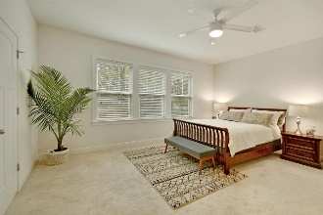
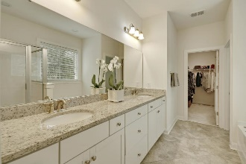
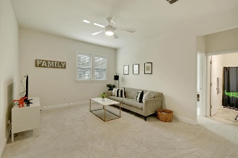
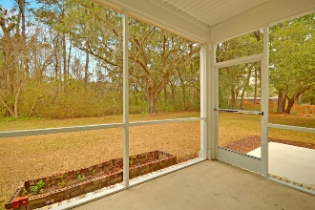
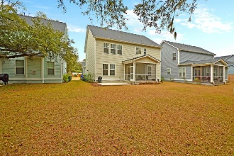


1265 Pearwood Court
Magnolia Village
Mount Pleasant, SC 29466
MLS# 19002298
$499,900
Welcome to 1265 Pearwood Court in Magnolia Village, a highly desired community located just 4 miles from Isle of Palms Beach, 2 miles from Town Center & close to schools. This beautiful & well maintained two story Cottonwood floor plan offers 4 nice sized bedrooms, each with a large closet. The master suite offers a separate shower and tub with double vanities. There is a large loft that can be used as a second living area, office, playroom or home theater. Downstairs, there is a formal dinning room, large family room open to spacious eat-in kitchen with a large Island. All hardwood floors throughout downstairs, screened in porch over looking beautiful oak trees. It's better then new. Please remove your shoes or wear the booties. This home is very clean Energy Star Certified Home.
Beautiful Home in
Magnolia Village in Mt. Pleasant
Cathy Rosenblum
843-817-7869
crosenblum@comcast.net

