Slide 1
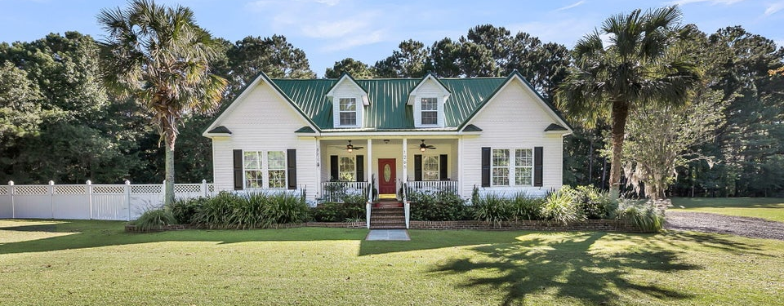

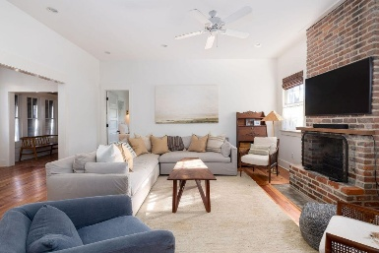
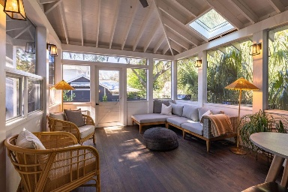
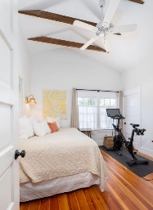
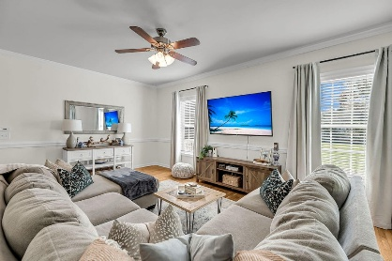
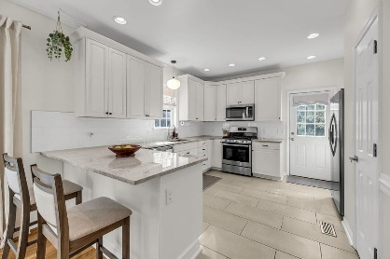
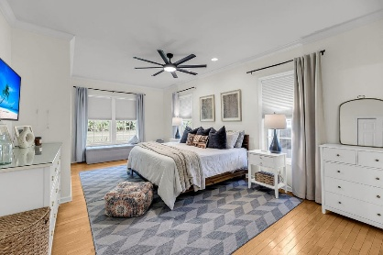
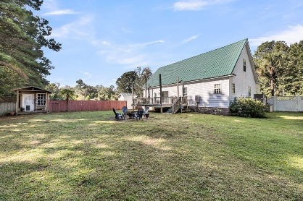

2.5% BAC + $10K Bonus For A Ratified Contract Before Sunday (11/23/25)
1265 Dogpatch Lane
Hickory Hill | Johns Island, SC 29455 | MLS# 25028520 | $675,000
Tucked away on a quiet, tree-lined dirt road, this charming Johns Island home offers the perfect blend of privacy, space, and scenic Lowcountry comfort. Set on 1.43 peaceful acres, this property provides a serene, wooded retreat without the constraints of an HOA. Built in 2003, the 2,368-square-foot home features a warm, inviting layout filled with natural light and thoughtful details throughout. The spacious living room is enhanced by bright windows, crown molding, and a comfortable flow that leads to a dedicated home office. The large kitchen is ideal for everyday living and entertaining, complete with an eat-in counter, gas range, pantry, and direct outdoor access.
The primary suite is conveniently located on the main floor, offering a walk-in closet and recently renovated ensuite bathroom. Upstairs, you'll find two additional bedrooms, another full bath, and a generous loft space.
Outside, enjoy your own private haven - a wooden fenced-in backyard, spacious deck, and plenty of room to relax. All this tranquility comes with the convenience of location - just 5 minutes to Johns Island restaurants and shops, and a short 20-minute drive to Downtown Charleston or the beach. Experience the best of both worlds: peaceful rural living with city and coast within easy reach. Schedule your showing today!
Greg Gelber
843-494-2354
greg.gelber@agentownedrealty.com
Kelly Snyder
843-457-5951
kelly.snyder@agentownedrealty.com
AgentOwned Charleston Group | 902 Savannah Hwy | Charleston, SC 29407-7802

