Slide 1
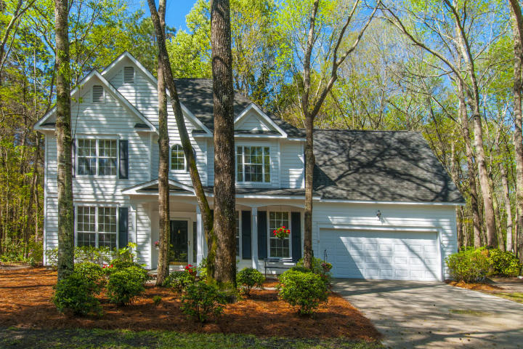
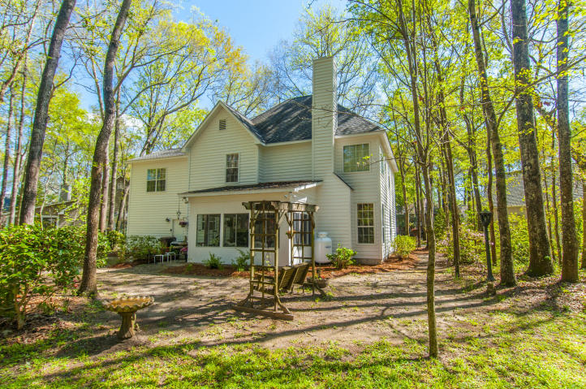
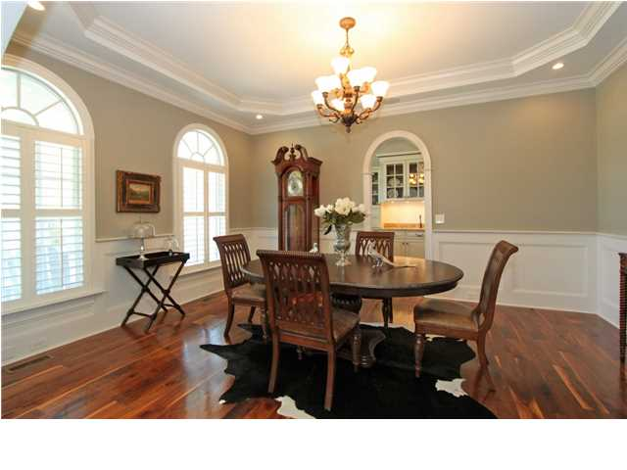
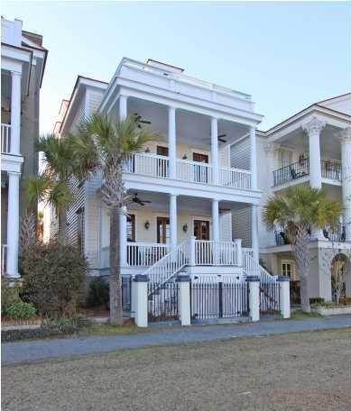
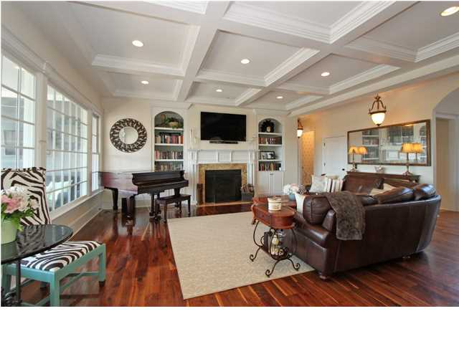
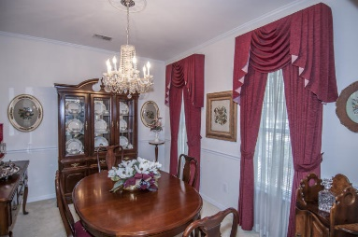
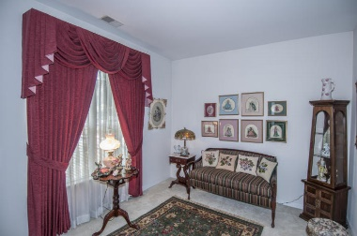
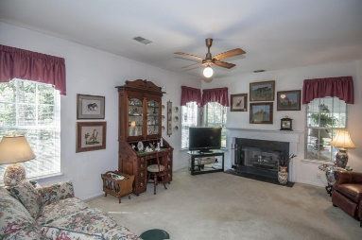
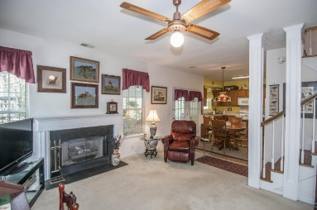
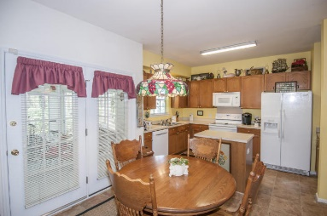
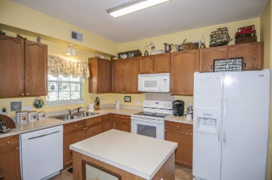
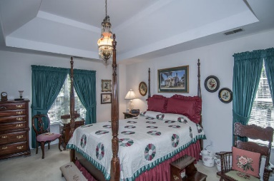
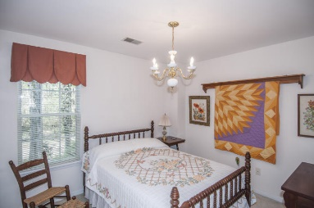
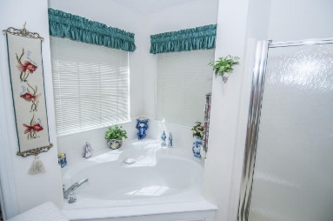
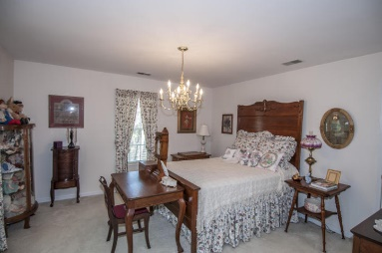
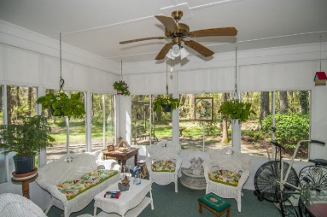
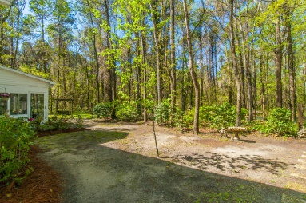
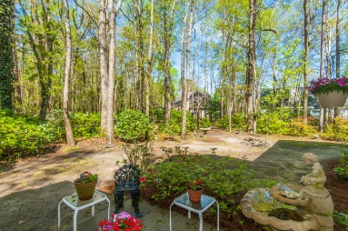
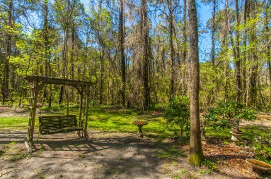


1266 Old Ivy Way Mount Pleasant, SC 29466 MLS# 16008270 $435,000
Just Listed in Brickyard - Magnolia Grove
Wonderful family home in Brickyard backing up to Boone Hall property on quiet cul de sac . This home is occupied by the original owners. Formal LR and DR , Family Room w gas fireplace open to the kitchen. Extend living area with large porch that has seasonal enclosures. Upstairs has large master bedroom with sitting area, bath has garden tub, separate shower and walk in closet. There are two additional bedrooms that share a hall bath plus a bonus room currently being used as fourth bedroom. Home has been recently painted, newer roof and appliances. Two car garage and lots of storage in closet eaves.
Clay Cunningham
O (843) 886-8110
M (843) 345-4647
clay@carolinaone.com
www.claysre.com
Carolina One Real Estate
1503 Palm Blvd Ste
Isle of Palms, SC 29451

