Slide 1
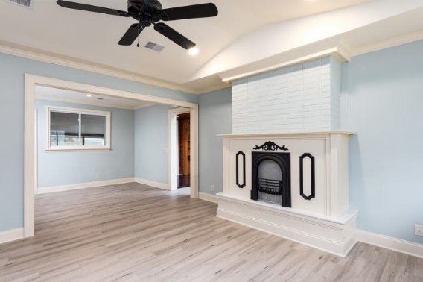
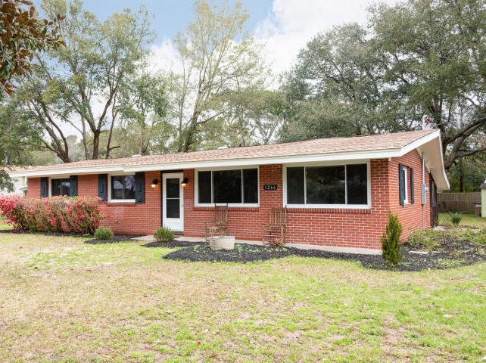
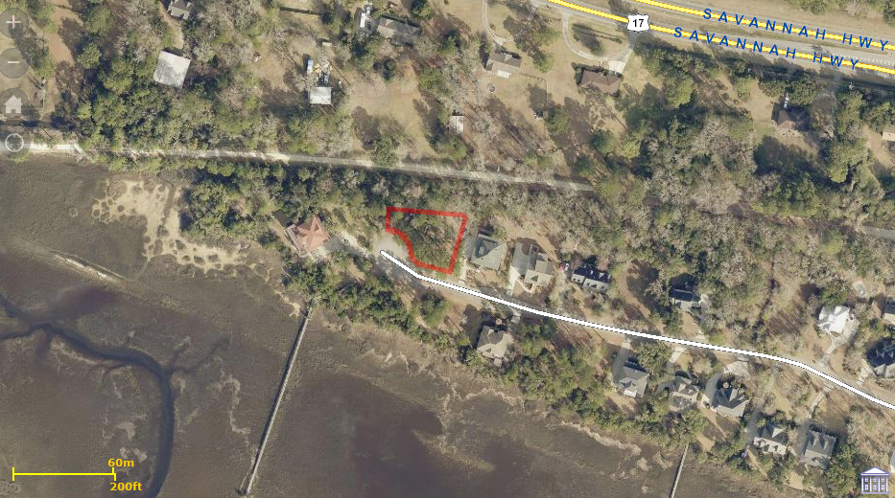
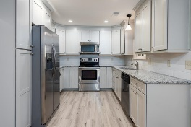
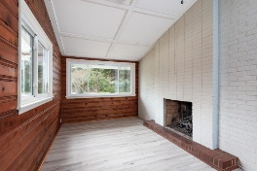
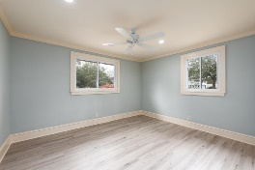
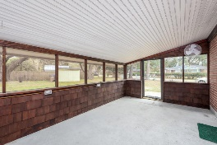
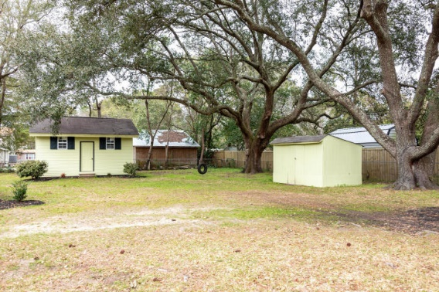
Beautiful Home in Paddock Point
!!! JUST REDUCED !!!
1266 Stone Post Road
Old Orchard | Charleston, SC 29412
MLS# 20005395 | $349,900
Beautiful home on sought after James Island this home has been Tastefully updated this is a must see for your clients when you enter the front of the house you will noticed the beautiful landscaping that has been done in the yard as you walk through this home you will notice all the attention to details that makes a home complete from the kitchen with it new cabinets new granite countertops to the stainless steel appliances. the refrigerator is brand new also there is a large half screened back porch and in the backyard you will find two storage buildings one of good size with many possibilities and two large grand oaks the yard is completely fenced in with a chain linked fence. The owner has spared no expense in the remodeling of the awesome home
Bruce Miller
charlestownehomes@comcast.net | (843) 813-4591 | www.charlestonlifestyle.com
Brand Name Real Estate | 4 Carriage Lane, Suite 106 | Charleston, SC 29407

