Slide 1
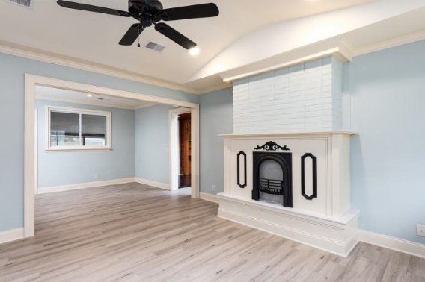
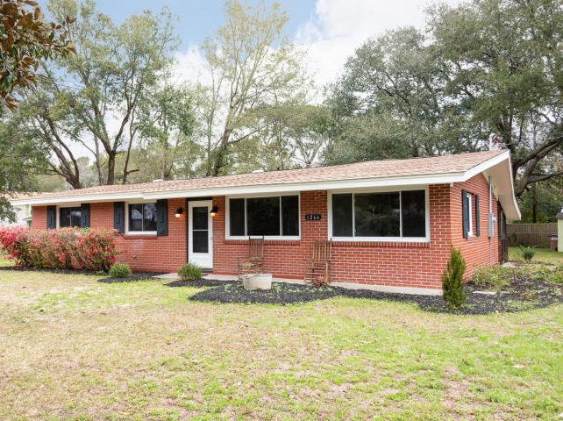
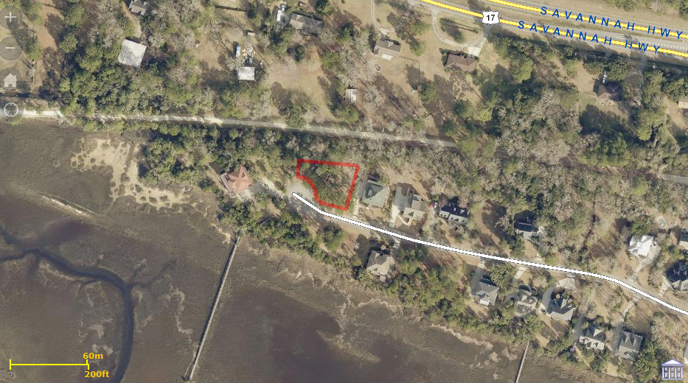
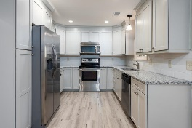
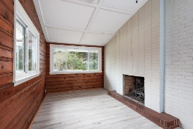
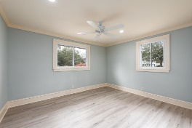
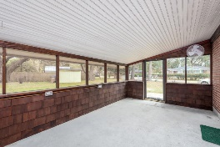
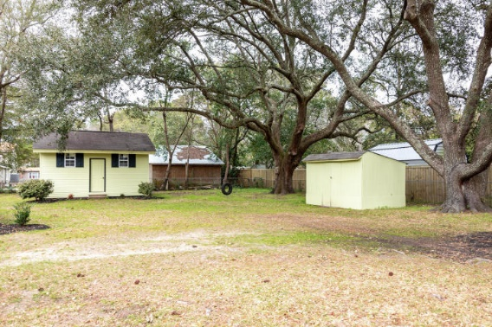
Beautiful Home in Paddock Point
PRICE REDUCED & COMMISSION INCREASED
1266 Stone Post Road
Old Orchard | Charleston, SC 29412
MLS# 20005395 | $344,500
Awesome home on sought after James Island this home has been tastefully updated this is a must see for your clients when you enter the front of the beautiful home you will noticed the beautiful landscaping as you walk through this home you will notice all the attention to details that makes a home complete from the kitchen with it new cabinets new granite countertops to the stainless steel appliances. the refrigerator is brand new also there is a large screened back porch and in the backyard you will find two storage buildings one which is 20.4 by 16.4 in size with many possibilities and two large grand oaks the yard is completely fenced in with a chain linked fence. The seller has spared no expense in the remodeling of the awesome home. The lovely home also has recess caned led lighting throughout the home the electric and wiring was updated new power gooseneck on roof. Very close to Folly Beach with lots of restaurants, shopping, and Parks the James Island County Park is just a few miles away with plenty of activities they have a very nice dog park also. So come and see the awesome home that is waiting for its new owner. !! Seller is motivated so bring us a Reasonable offer!!
Bruce Miller
charlestownehomes@comcast.net | (843) 813-4591 | www.charlestonlifestyle.com
Brand Name Real Estate | 4 Carriage Lane, Suite 106 | Charleston, SC 29407

