Slide 1
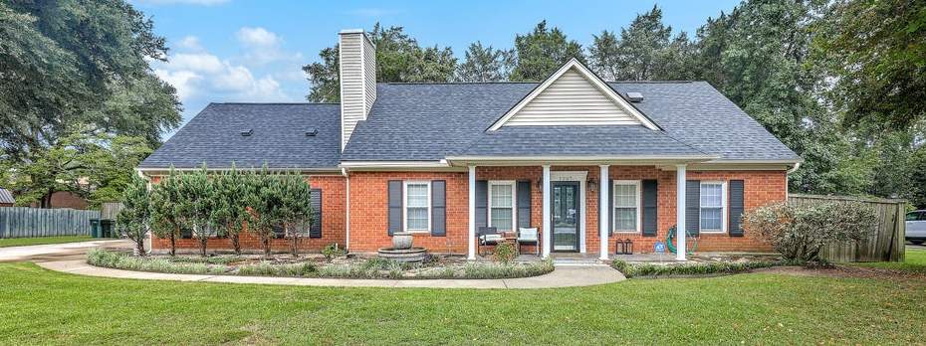
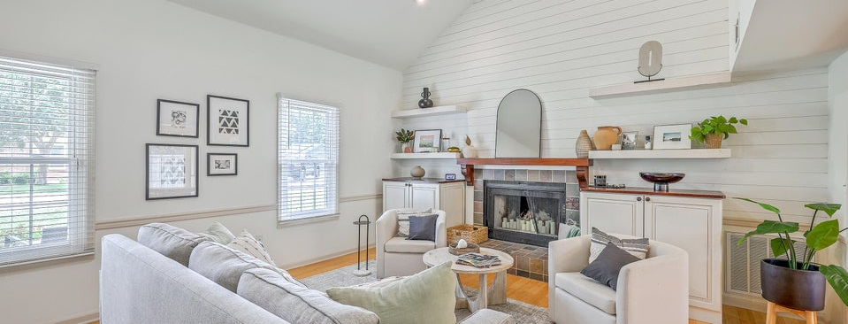
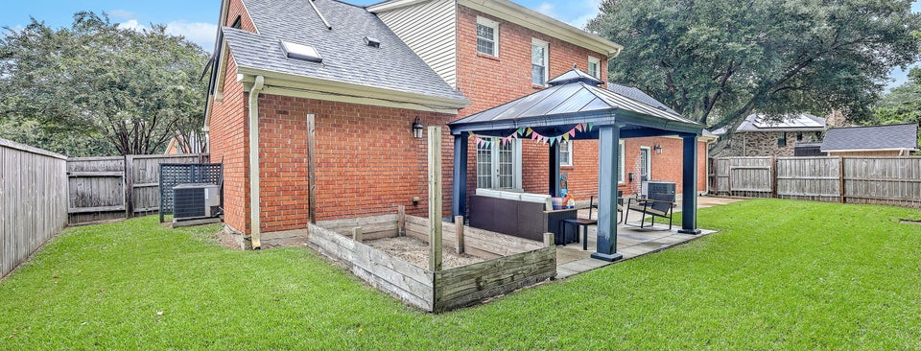

JUS
9714 ROSEBERRY STREE
MOTIVATED SELLER!
/
7
1/
ii
Just Reduced $35K
1267 Wespanee Place Court
Wespanee Place | Charleston, SC 29407 | MLS# 25023089
TAKE A VIDEO TOUR!
�
$865,000
4 BED
2½ BATH
2,301 SQ_FT
0.2 ACRES
Welcome to this beautifully updated 4-bedroom, 2.5-bathroom home tucked away on a quiet cul-de-sac in the heart of West Ashley (29407). Offering over 2,300 sq ft of living space and no HOA, this newer two-story home combines modern updates with convenience and charm, tucked away in an established community. The main floor features a spacious primary suite with a large walk-in closet and a stunning private ensuite bathroom. The open concept living area boasts smooth vaulted ceilings, shiplap accent walls, fireplace, a powder room, and a bright dining space. A versatile secondary living area or den provides the perfect spot for a media room, rec room, or home office. The kitchen comes fully equipped with stainless steel appliances, tile flooring and backsplash, custom cabinetry, and access to the back patio and yard.
Upstairs, you'll find two spacious bedrooms, a full hall bathroom, and a large bonus room that can serve as a 4th bedroom, playroom, or office. Just off the bonus room is a great little reading nook or desk space. Recent updates include a brand-new roof, ensuring peace of mind for years to come.
Outside, enjoy a fenced backyard with a large storage shed, ample off-street parking, and a one-car garage. The shed has power and is a great workshop or storage spot. This pocket neighborhood offers rare privacy while being just minutes from Downtown Charleston, Avondale, Charlestowne Landing, the new County Park, and the exciting Ashley Landing redevelopment that will become a sought-after gathering hub featuring a new Publix, and many restaurants and shops. Come check this one out today!
Scott Baskin
THE SCOTT BASKIN TEAM
843-324-4139
scott@explorecharlestonrealestate.com
SCOTT BASKIN TEAM

