Slide 1
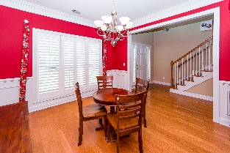
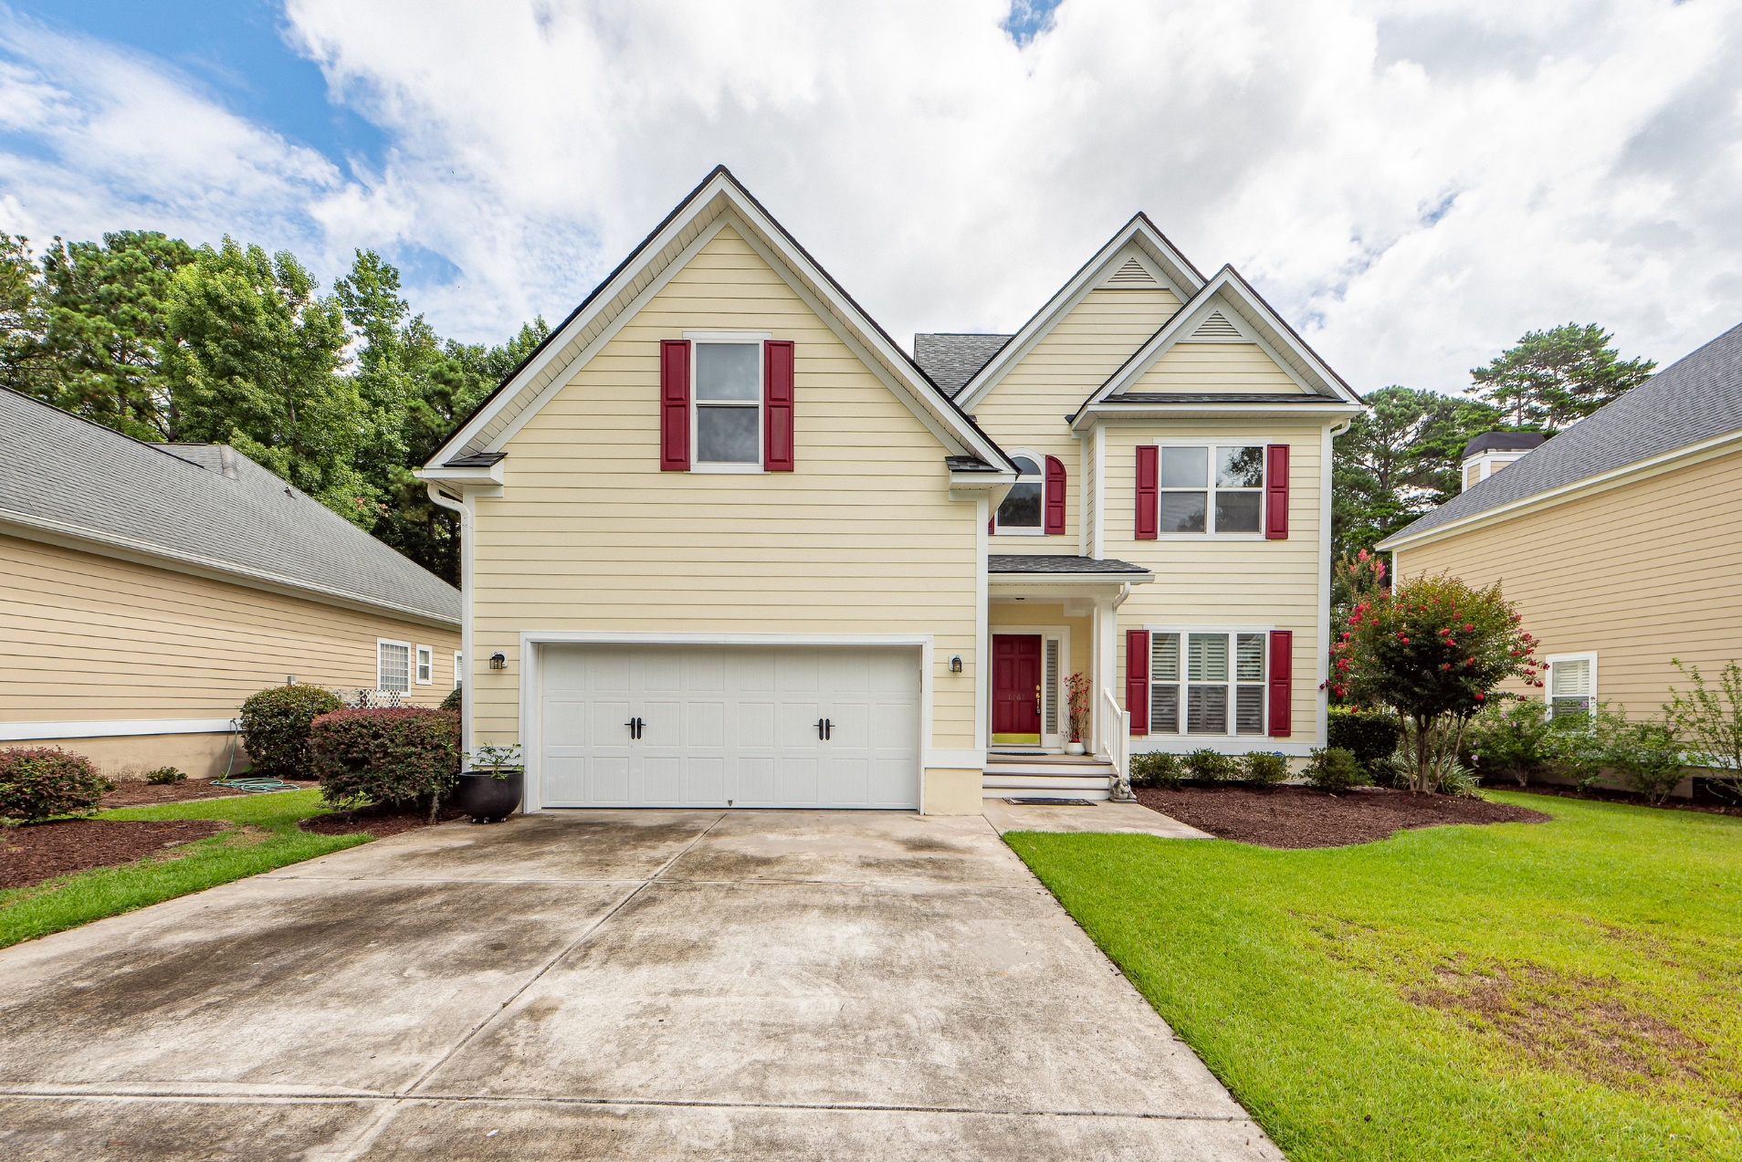
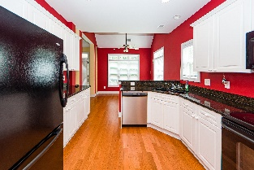
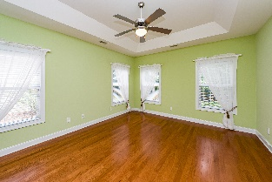
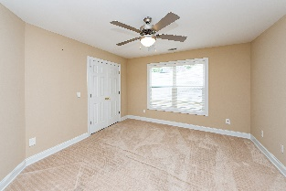
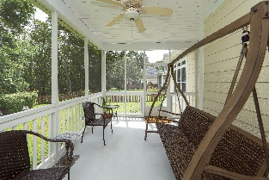
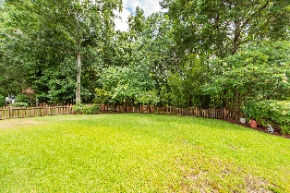

William S. Smith, Broker wssmith@hartnettrealty.com 843-906-5620
Price Reduction in Hunt Club
1267 White Tail Path
Hunt Club Phase II | Charleston, SC 29414
MLS# 22017595 | $588,000
STUNNING 5 Bedroom, 3.5 Bath Home in the Hunt Club Section of West Ashley. This Meticulously Maintained Home Boasts of Newer 3/4'' Hardwood Flooring Throughout the Main Level, Remodeled Bathrooms, Fresh Exterior Paint, New Roof (December 2021). Enjoy this Sophisticated Suburban Residence with a Serene Park-like Backyard Situated on a 12,818 sq. ft. Lot. Highlights of the Home include Cathedral Ceilings, Dual Zone Central AC, Formal Dining Room, Great Room, Breakfast Nook, Two Pantries, Fire Place, Screened-in Rear Patio, Two Car Garage with Interior Access and much more.
PO Box 2538
Mt. Pleasant 29465

