Slide 1
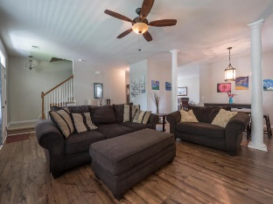
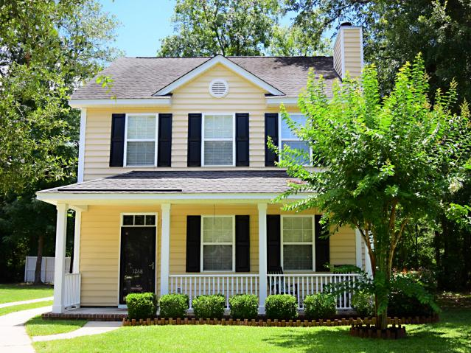
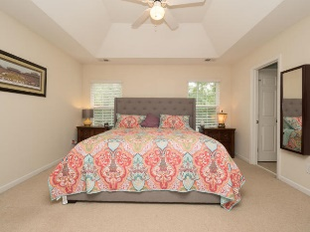
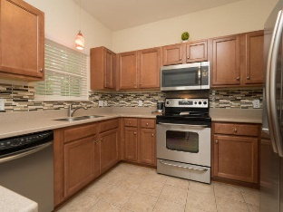
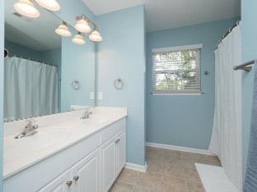
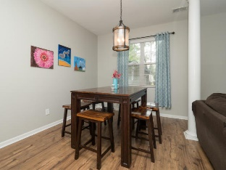
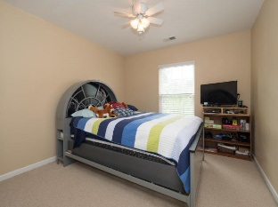
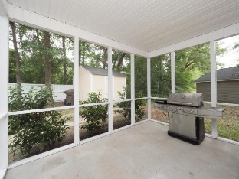
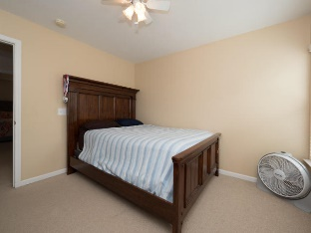

1268 Fallen Oak Drive Mt Pleasant | MLS# 17017344 | $339,000
Price reduced!
Cul-De-Sac home for $339k in Mount Pleasant!
Wonderful home in a charming community with tree-lined streets and picket fences!
3br / 2.5 ba / 1700 sf
NEW hvac system
NEW flooring
Fireplace
Upstairs laundry
Screened in porch and full front porch
Minutes to beaches and down town
Walking distance to shopping, restaurants, doctors, dentists, and more
X flood zone – no flood insurance required
Zoned Laing Middle (#1 STEM) and Jennie Moore Elementary
Beth Ryan
(843) 375-2776 - O
(843) 214-5063 - M
beth.ryan@cbcarolinas.com
Coldwell Banker Residential Brokerage
1127 Queensborough Blvd
Suite 103
Mt Pleasant, SC 29464

