Slide 1
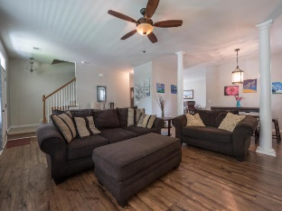
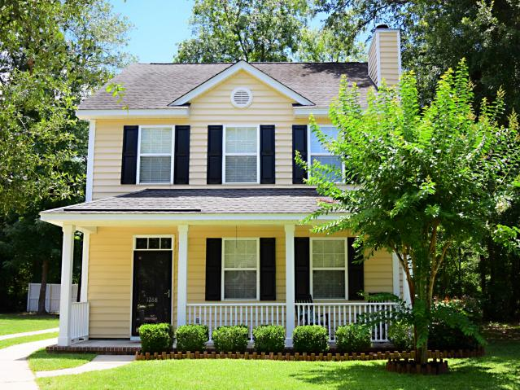
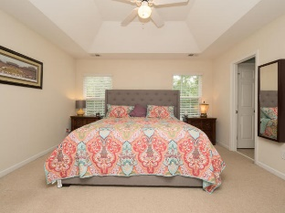
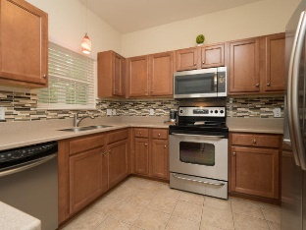
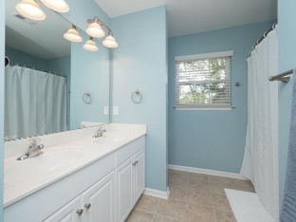
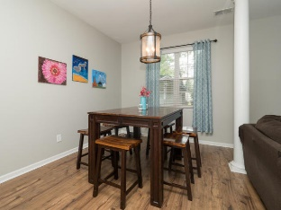
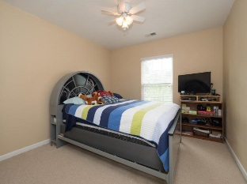
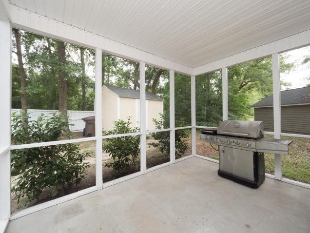
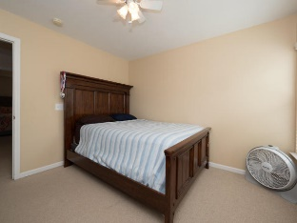

1268 Fallen Oak Drive
Mt Pleasant | MLS# 17017344 | $331,500
Price Reduced!
Cul-de-sac home in Mount Pleasant $331,500!
Charming community with tree-lined streets!
Laurel Grove in Mount Pleasant
3br / 2.5 ba / 1700 sf
NEW HVAC system
NEW flooring
Fireplace
Upstairs laundry
Screened in porch and full front porch
Walk to shopping, restaurants, doctors, dentists, and more
Minutes to beaches and down town
X flood zone – no flood insurance required
Zoned Laing Middle (#1 STEM) and Jennie Moore Elementary
Beth Ryan
(843) 375-2776 - O
(843) 214-5063 - M
beth.ryan@cbcarolinas.com
Coldwell Banker Residential Brokerage
1127 Queensborough Blvd
Suite 103
Mt Pleasant, SC 29464

