Slide 1
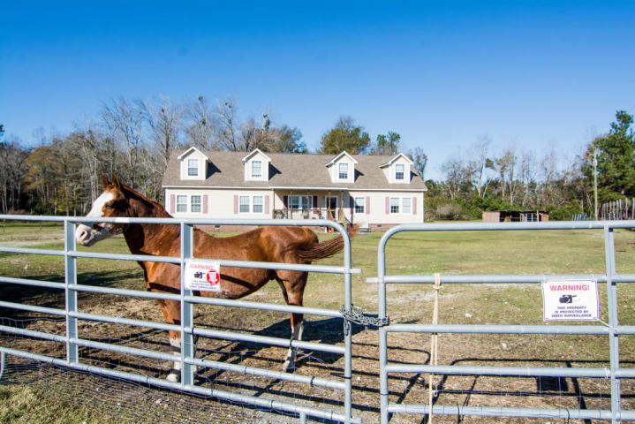
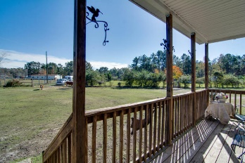
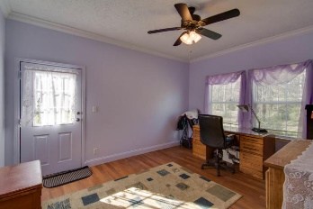
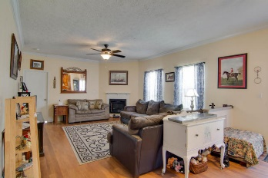
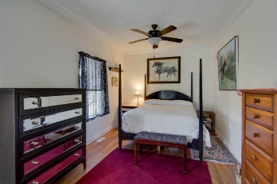
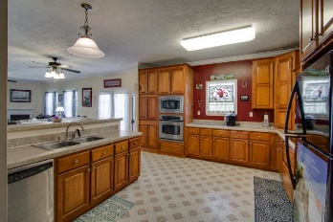
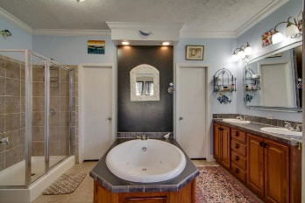
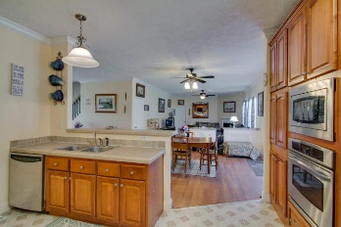
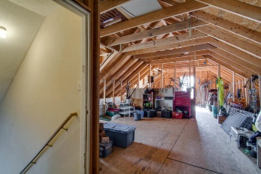
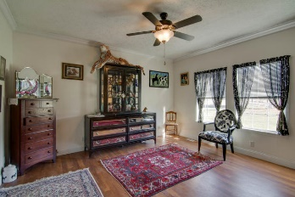
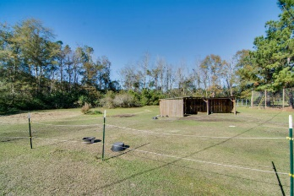


126 Brown Loop
Shortcut R
Harleyville, SC 29448
MLS# 15030271
$236,000
3 Bedrooms | 2 Baths | 2,337 Sq Ft
Charming & Comfortable Living
Available
Nov 1st!
If you love open space both inside and out then you have to come see this 5 (2 acres are cleared) acre /2337 square foot modular home for it is truly a unique piece of property. As you approach the home, a wide and long driveway greets you, yet notice how secluded it is. As you enter this 3 bedroom house see how easily it flows from one room to the next. The kitchen is fabulous! The master bedroom and bath is luxurious. Fireplace is in the family room. Big living room as you come in. If 2300 sq. ft. isn't enough on one floor, there is a second floor ready to be finished - plumbing and electrical are there and ready to be finished. So bring the family and pets and enjoy the space and solitude that this property delivers. Metal gates in the back do not convey. Property sold "as is".
Liz & Bob Simonds
843-437-9696
lizandbob@agentowned.com
AGENTOWNED REALTY CO. PREMIER GROUP, INC.
141-A N. MAIN STREET
SUMMERVILLE, SC 29483

