Slide 1

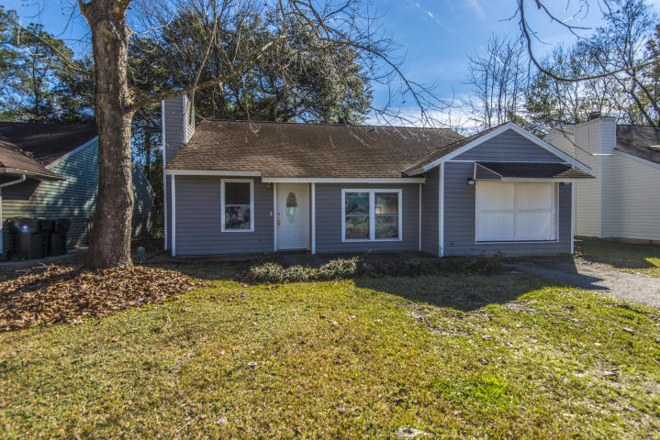
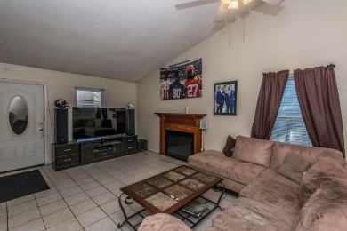
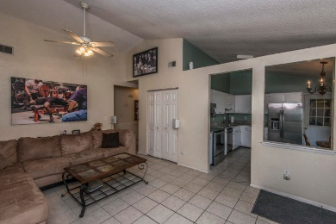
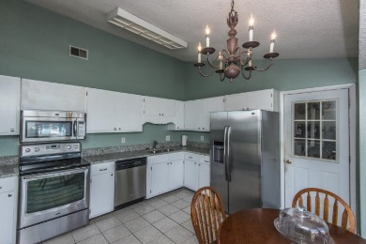
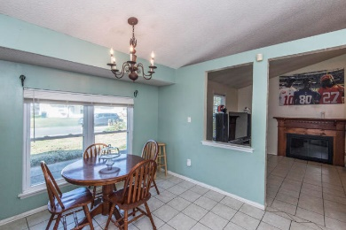
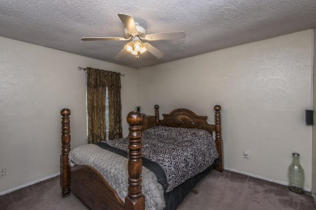
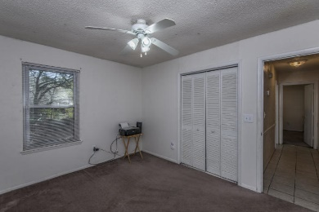
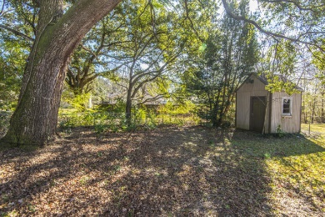
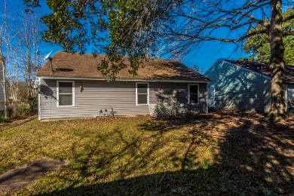


New Listing in Dorchester II
126 Mickler Drive
Moss Point ~ Ladson, SC 29456
MLS# 19001076 ~ $155,000
No HOA! Convenient location!! Close to Boeing, Bosch, Airport. Sought after DDII schools! Ashley Ridge HS, Eugene Sires Elementary, Oakbrook MS! One story living! Brand new siding! New granite in kitchen! Enter this low maintenance home into the family room with fireplace for cozy gatherings, vaulted and spacious for entertaining. Open to the roomy, eat-in kitchen, with new granite counter tops, stainless steel appliances, new hardware on freshly painted cabinets. Enter the garage area from the kitchen. Garage has an operational garage door, but is being used as a workout area. Laundry is also located in garage. Could be converted back to a full garage if wanted to park a car. Back inside find 3 nice size bedrooms. Master bath has walk-in closet and full bath, very spacious.
Hall bath and linen closet found off secondary bedrooms. Backyard is fenced and has a shed that will convey As Is. Call today for a showing!
Laurie Loparo ((843) 442-1290 | laurieloparo@gmail.com
www.lauriesellscharleston.com
Carolina One Real Estate | 873 Orleans Road, Ste 102 | Charleston, SC 29407-5753

