Slide 1

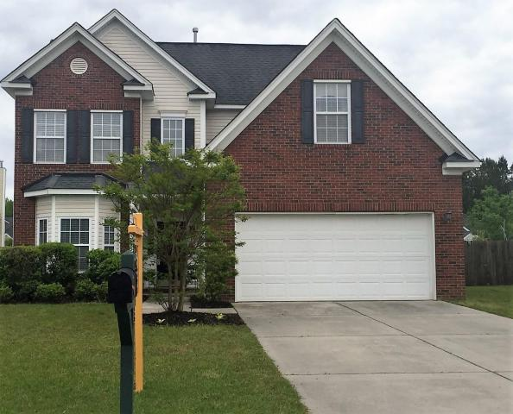
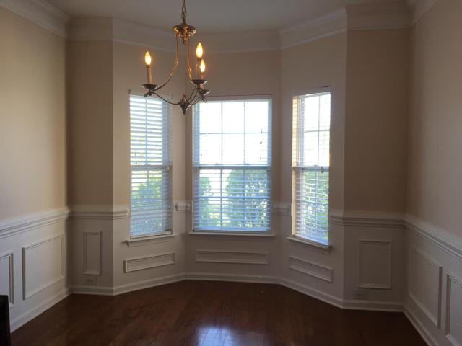
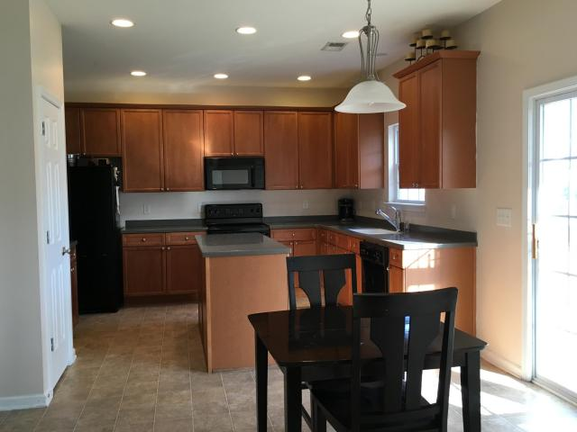
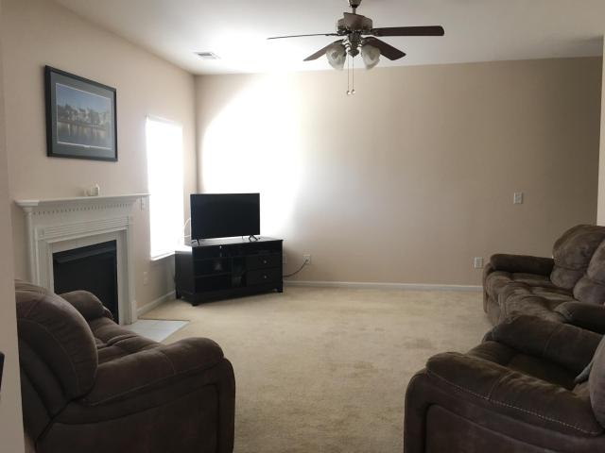
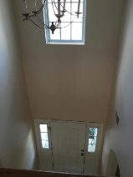
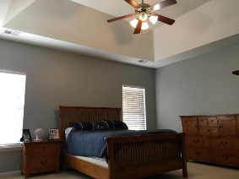
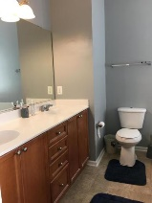
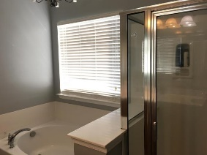
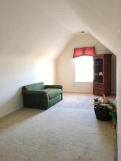
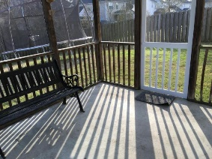
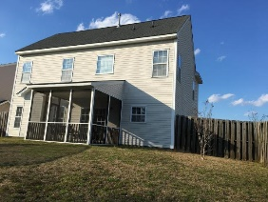

Pam Bass
Realtor
M 843-259-4926 | O 843-871-2121
www.pambassproperties.com
pbass@century21properties.com
Price Reduced
126 Rosario Drive | Plum Creek | Summerville | MLS# 16005590 | $220,900
Priced reduced and owner is motivated! Beautiful 4 bedroom 2.5 bathroom home with 9'smooth ceilings and 2 car garage - built by Lennar. Home features large kitchen with center island, Corian counter tops, a butler's pantry and an eat-in breakfast area. There is also a separate formal dining room. Open floor plan with nice size family room with gas fireplace. The master bedroom is upstairs and has 2 walk in closets, a garden tub with separate shower. Huge Bonus room can be 4th bedroom. Relax outside on the screened porch. Home also has 6' privacy fence and irrigation system. Located in desirable Dorchester 2 school district. Close to schools, restaurants and shopping. Neighborhood has a Jr. Olympic pool, pavilion and play park. Refrigerator to convey

