Slide 1
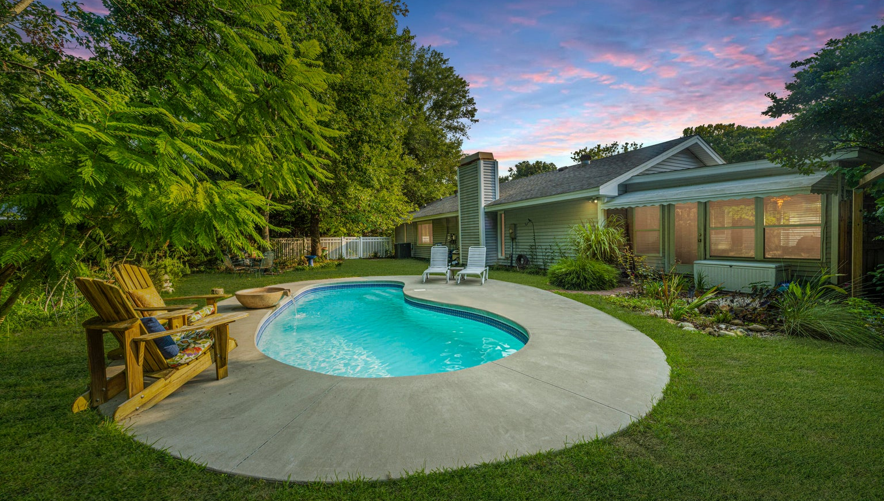
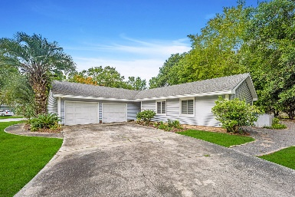
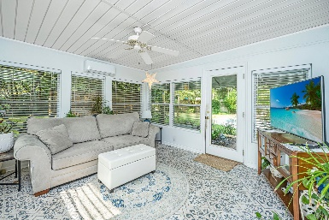
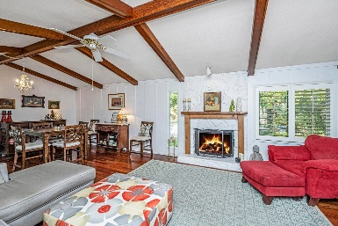
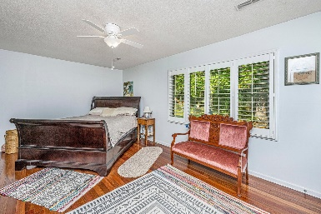
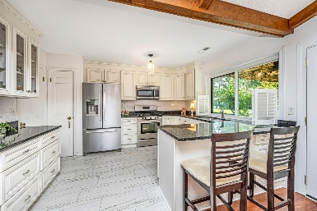
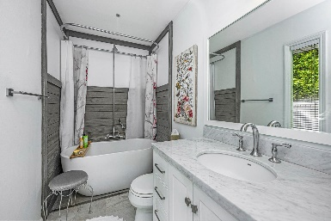


1270 Old Colony Road Heritage | Mount Pleasant, SC 29464 MLS# 24012308 | $895,000
HUGE Price Correction in Mt Pleasant South!!
Welcome to 1270 Old Colony!! This renovated one story corner lot home is located in one of the most sought after neighborhoods in Mt Pleasant, Heritage. It sits on almost half an acre & offers an in-ground pool, glassed in sun porch, gorgeous hardwood floors throughout, open kitchen w/ stainless steel appliances, dining room, vaulted & beamed ceilings w/ a wood burning fireplace in the family room, master suite, laundry room, new roof, new HVAC system, garage, and work area in the garage. Perfect location to bike over to Sullivan's Island to spend the day at the beach and is minutes to upscale shopping & dining, Shem Creek, Coleman Blvd, Isle of Palms, I-526 & downtown Charleston. This home has been lovingly and organically cared for years. This is the perfect home to escape the busy-ness of life as you sit in your backyard oasis listening to the tranquil sounds of the pool and pond fountain. Enjoy hummingbirds year round and other types of birds as you sip your morning coffee in the bright and radiant sunroom. The back yard is also very private with surrounding trees, plants and landscape. Come feel the peace and serenity of 1270 Old Colony Rd.
Drake Herrin 843-729-4692
dherrin@carolinaone.com
www.DrakeHerrin.com
Carolina One Real Estate
873 Orleans Road, Ste 102
Charleston, SC 29407-5753

