Slide 1
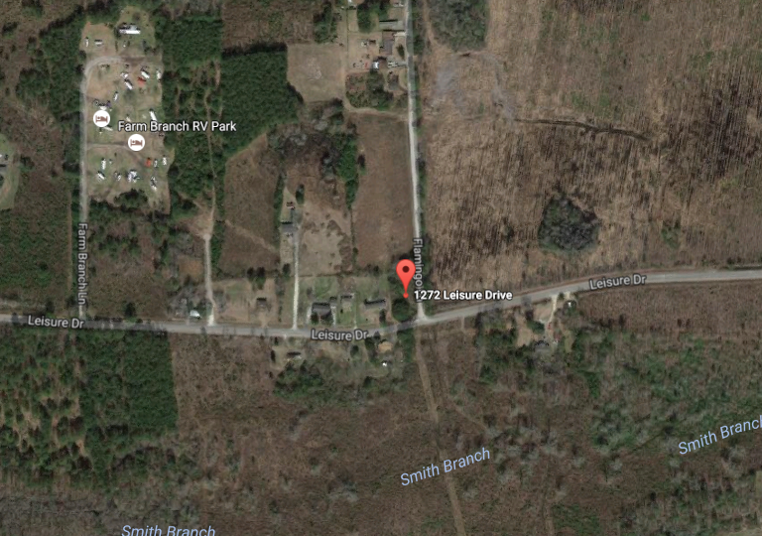
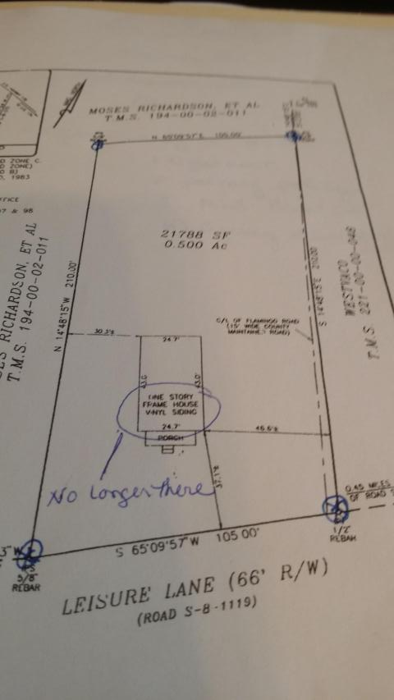


Half Acre in the Booming Area of Cane Bay.
Motivated Seller!
All Gussied Up and ready for a new Beau!
1272 Leisure Drive
Sheep Island ~ Summerville, SC 29483
MLS# 16017437 ~ $45,000
A half acre lot in the Cane Bay school district. Property has a 50 foot well and a septic system where an abandoned home site was. Listing agent and seller do not warrant their functioning. Buyer is responsible for verifying any items deemed important, including but not limited to zoning, septic and well permits and acreage.
Liz & Bob Simonds
843-437-9696
lizandbob@agentowned.com
AGENTOWNED REALTY CO. PREMIER GROUP, INC.
141-A N. MAIN STREET
SUMMERVILLE, SC 29483

