Slide 1
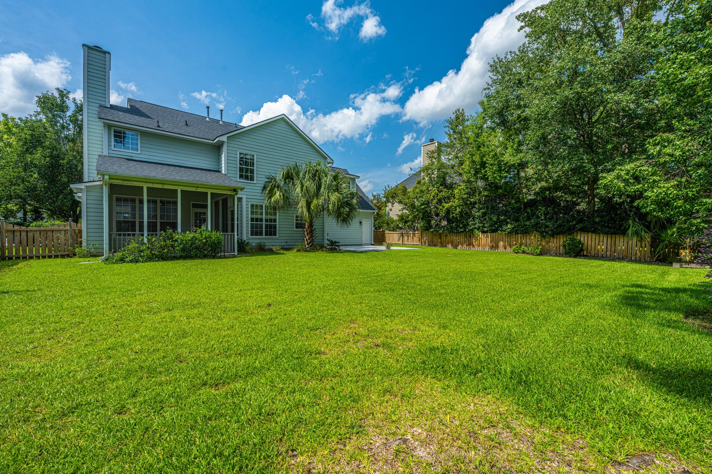
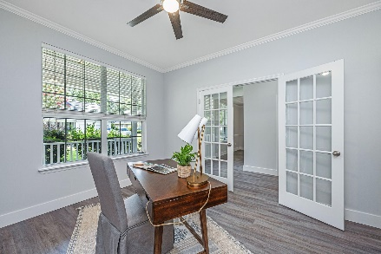
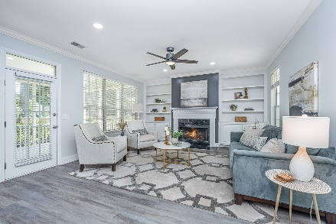
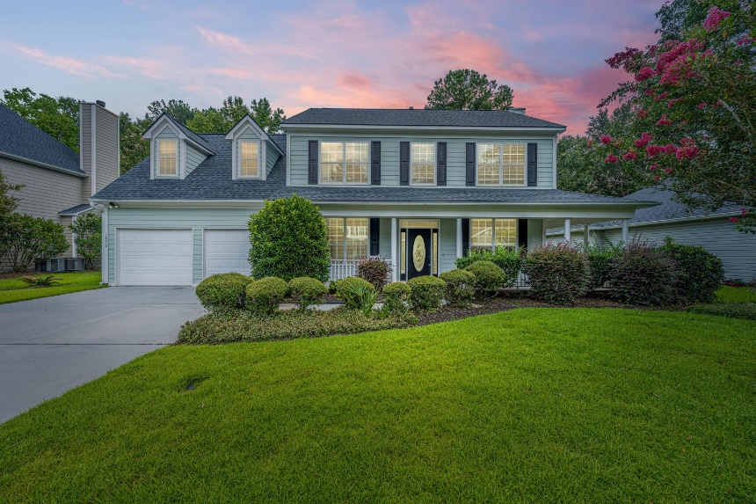
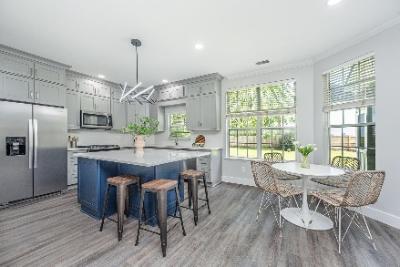
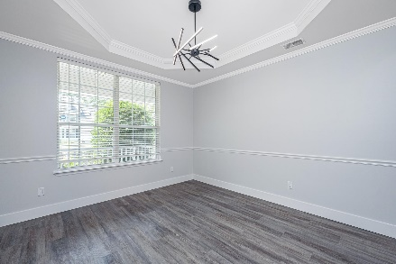
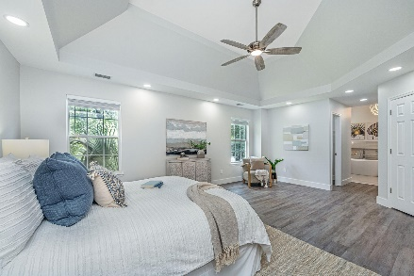
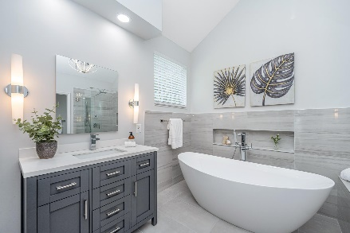
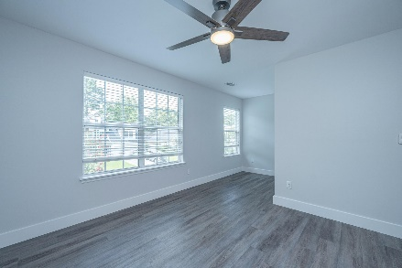
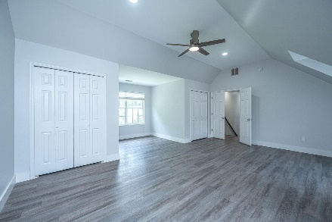
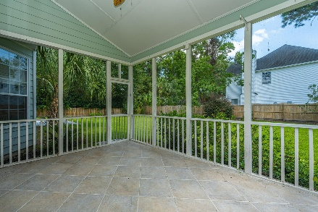
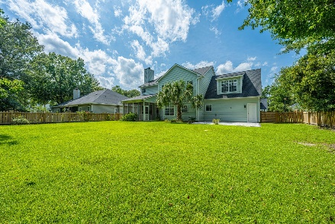
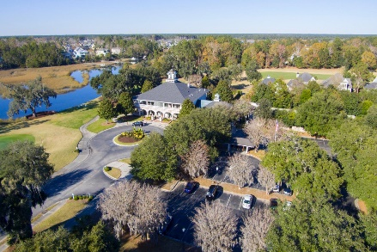
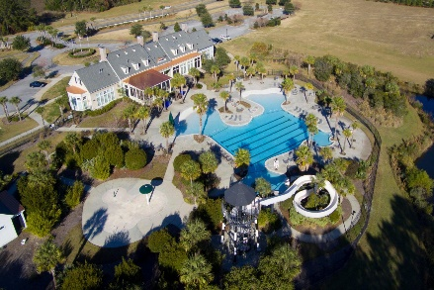


1272 Hermit Crab Way Dunes West Mount Pleasant, SC 29466 MLS# 24016069 | $839,000
Price Reduced
Total Upgrade
Behind the gates of Dunes West, this completely renovated and updated southern charmer is nestled into a large lot lush with mature landscaping and palmettos. A classic wrap around porch welcomes you home and is just perfect for relaxing in a rocking chair on a summer afternoon. Step inside the foyer where you'll immediately notice details such as the brand new hard flooring in driftwood tones, fresh paint in cool, coastal shades and plenty of custom millwork such as crown moulding and tall baseboards. Just off the foyer is a study/home office set behind glass paned french doors. This flex space is ideal for anyone works from home, takes online classes, or simply wants an area to conduct the business of life. Opposite the study is a large formal dining room featuring chair rail and a tray ceiling. Large enough to accommodate friends and family for those special occasion dinners or, if formal dining isn't a priority, create the latest trend in home spaces by turning it into a cocktail lounge! Either way, entertaining a breeze as the kitchen is adjacent this space. The kitchen is a cook's delight with new custom cabinetry in muted coastal tones, stainless appliances, white tile backsplash, and gleaming white quartz countertops. A large center island provides extra prep and storage space as well as a great area for friends to perch on a stool and chat while you prepare the evenings treats. Open and airy, the kitchen flows through a sunny casual dining nook into a spacious living room. A gas fireplace featuring custom mantle and surround is flanked by built-ins and serves as the focal point of the elegant space. Upstairs, you'll find a very generously sized owner's suite with deep tray ceiling, accent lighting, walk-in closet, and a stunning luxury en-suite bathroom. This spa-like bath is an absolute dream! The complete renovation of this bath boasts dual furniture styled vanities with quartz countertops, custom glass and tile shower with rainhead and hand-held fixtures, as well as a gorgeous free standing soaker tub and private water closet You may never want to leave the comfort and luxury of this bathroom! Two secondary bedrooms and a full bathroom, renovated in a similarly appointed style as the primary bath with custom tile, quartz counters, and new vanity, all create welcoming and comfortable areas for children or guests. A huge fourth bedroom could be used as home gym, playroom, teen-retreat, man-cave, or secondary family room. This home also offers plenty of opportunity for enjoying the Lowcountry outdoor lifestyle. In addition to the front porch, there is a large screened-in porch where you'll find yourself enjoying morning coffee, an evening glass of wine or dining alfresco on those warm spring nights. A paver patio is perfect for sun lounging or grilling up dinner while the kids or dogs play in the fully fenced yard. All of this and located in one of Mount Pleasant's premier gated communities. Dunes West offers an award winning golf course and club house, pools, tennis club, and neighborhood walking paths. Dunes West is conveniently located close to the beaches, shopping, dining, minutes from the new Roper St. Francis hospital and a short drive to the world class dining and shopping of historic downtown Charleston.
Don Dawson 843-514-0452 ddawson@carolinaone.com Carolina One Real Estate • 2713 Highway 17 North • Mount Pleasant, SC 29466
www.TeamDawsonSC.com

