Slide 1
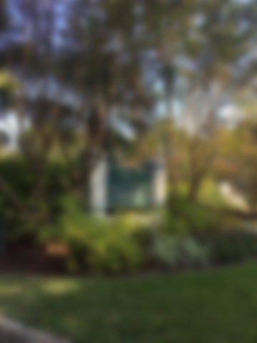
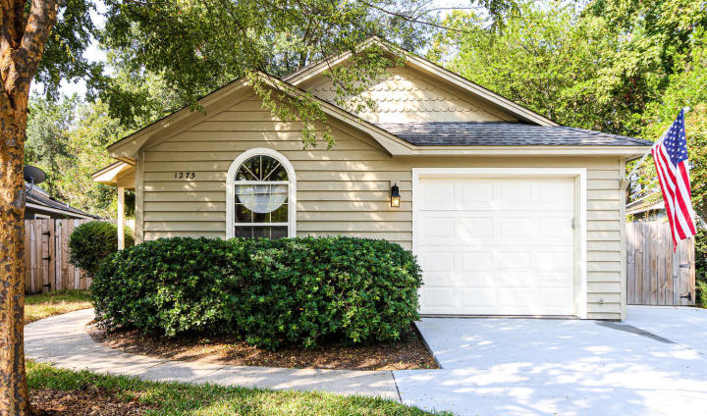
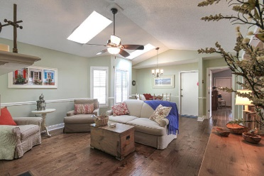
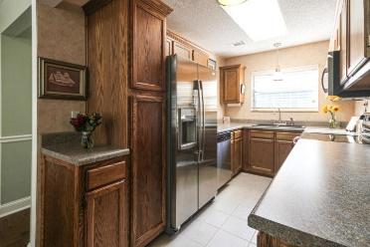
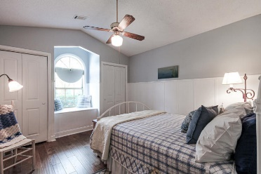
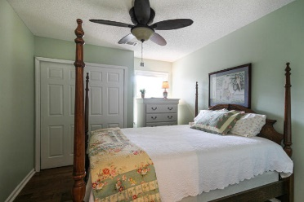
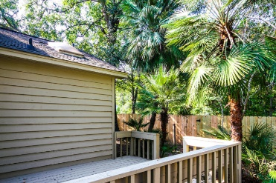

OPEN HOUSE SUNDAY FROM 11AM to 2PM
**DRAWING FOR A $25 HOME DEPOT GIFT CARD**
1273 Llewellyn Road
Chelsea Park | Mount Pleasant | MLS# 19027511 | $380,000
Adorable & charming home just a mile from Sullivan's Island beaches and in the heart of Mt. Pleasant. This one-story, 3 bedroom home with vaulted ceilings has been meticulously cared for by one owner since it was built. Recent updates include, new stainless steel appliances in kitchen, new GORGEOUS engineered hardwood floors in perfect condition, upgraded bathroom vanities, granite in the bathrooms, new fixtures, new wood fence for privacy, his & hers closets and a built-in storage bench/ window seat in the master. The large deck can easily be converted to a screened-in porch or sunroom and additional fenced parking on the side of the house is perfect for storing your boat! You'll also enjoy the private fenced back yard which backs up to the creek.
Take a quick walk towards Rifle Range Road and enjoy views of the neighborhood pond. The driveway was recently professionally re-poured/ re-paved & the garage has been meticulously kept.
Andrew Tackitt
(843) 437-8726
andrew@radekopf.com
1563 Meeting Street Road
Charleston, SC 29405
Phone: (843) 579.2217
Erin Quinn Hanhauser
(843) 743-8204
erin@radekopf.com

