Slide 1
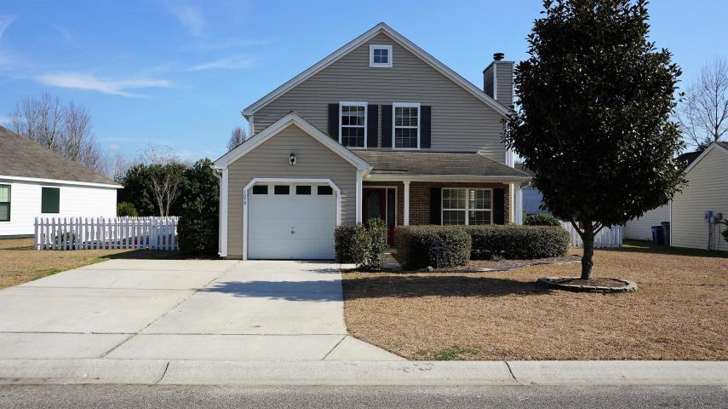
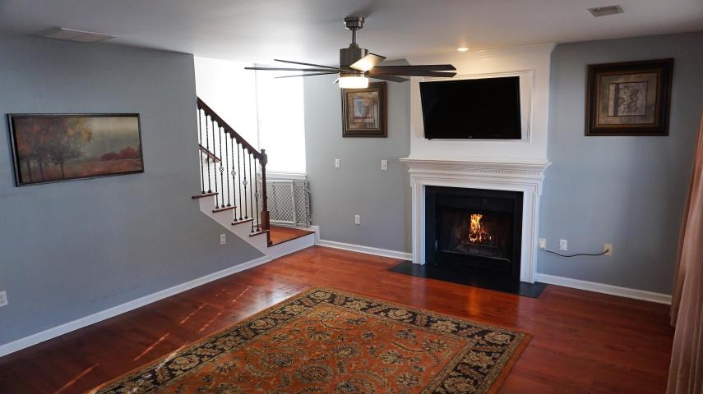
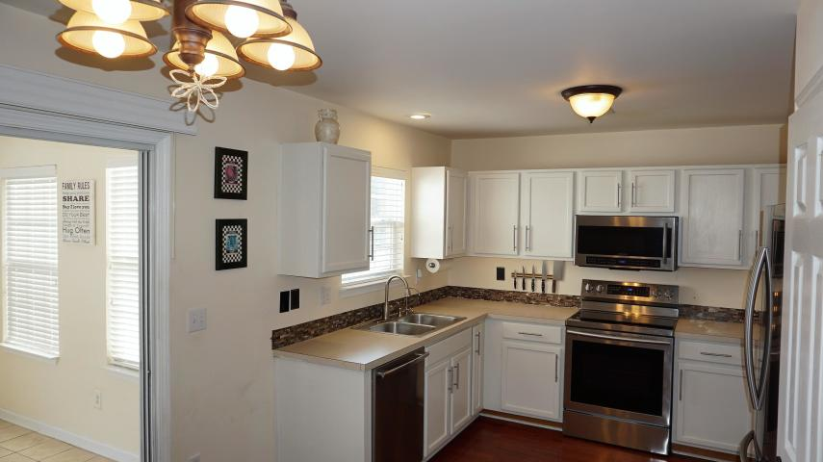
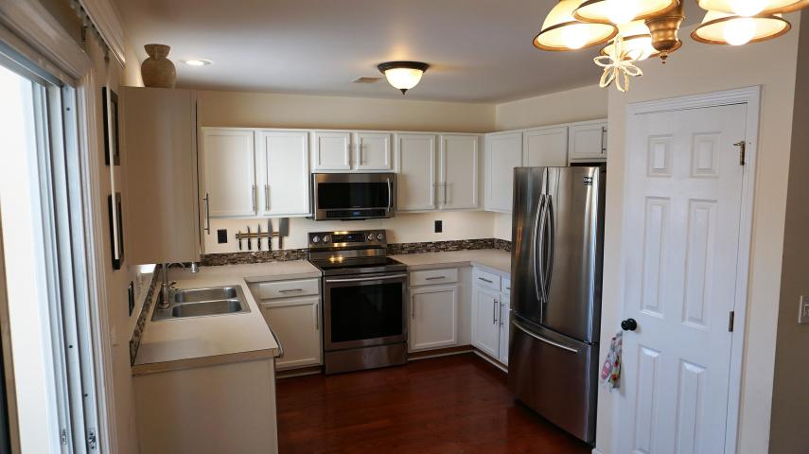
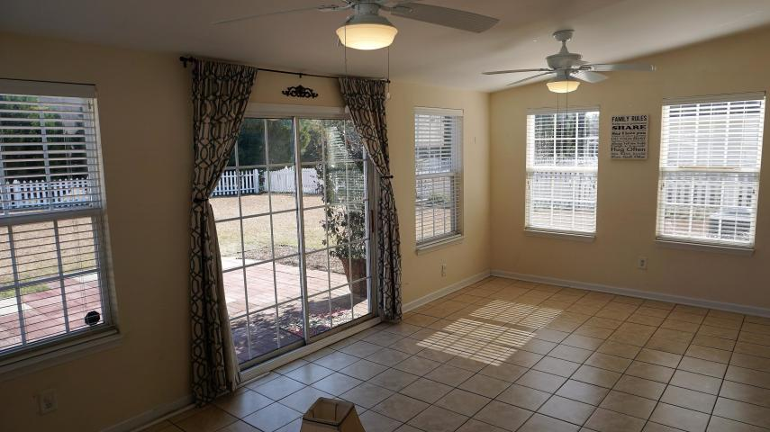
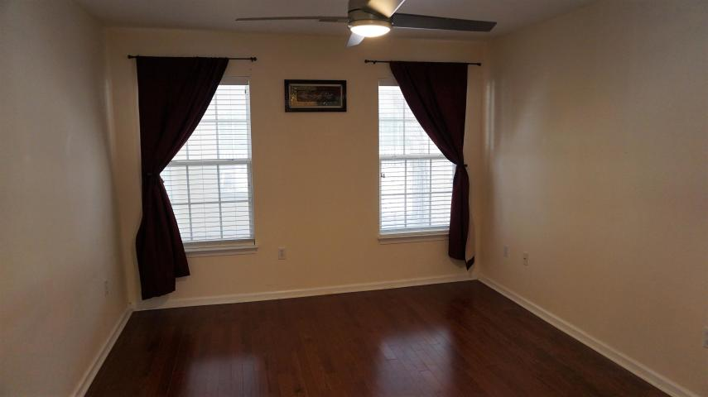
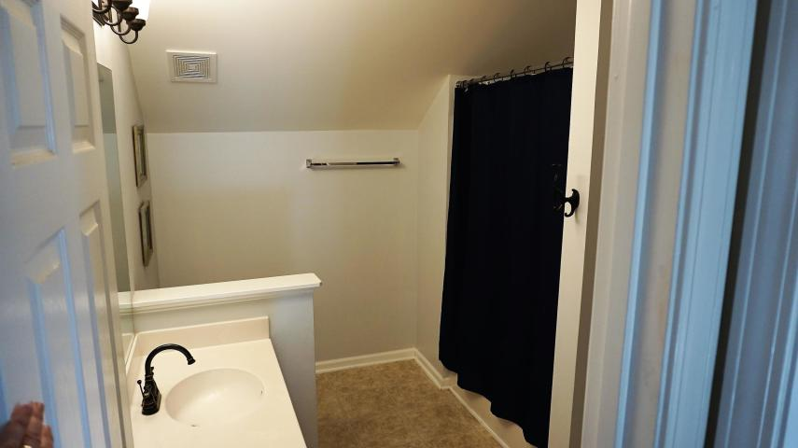
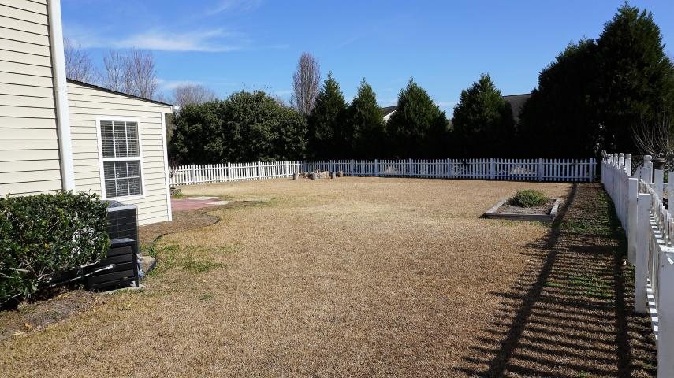
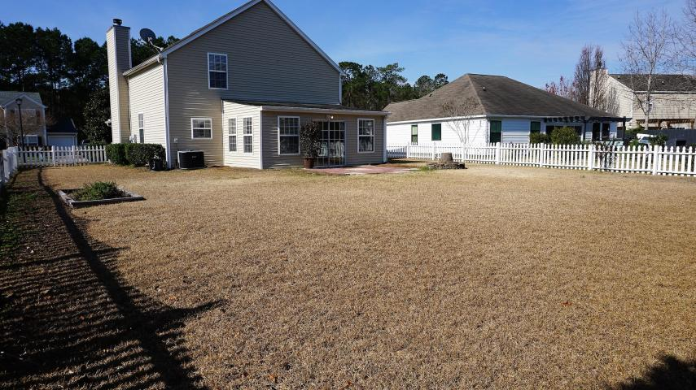


Welcome home!
1275 Palm Cove Drive
The Peninsula ~ Charleston ~ MLS# 19003838 ~ $312,000
Brand new updated kitchen with stainless steel appliances and backsplash!
A new HVAC unit was installed in 2018! This great 4 bedroom, 21/2 baths has a master bedroom downstairs, with 3 large bedrooms upstairs! Brand new ceiling fans in all rooms. Features hardwood floors downstairs, and a heated and cooled sun room, looking out to an enormous fenced backyard!
You will love this location in a beautiful subdivision with two neighborhood pools, clubhouse and 2 play parks! Brand new schools with a new shopping center including a Publix grocery store and retail shoppes, minutes to the beach and downtown area!
Marilyn Stewart, Realtor
Realtor of Distinction
843-297-4098 M
843-416-2200 F
marilyn@charlestonsells.com
Keller Williams Realty
496 Bramson Ct Ste 200
Mt. Pleasant, SC 29464

