Slide 1

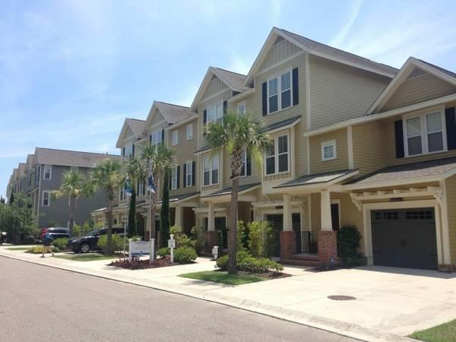
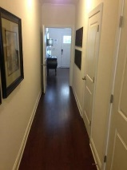
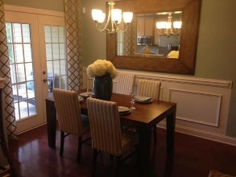
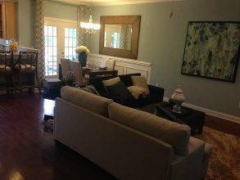
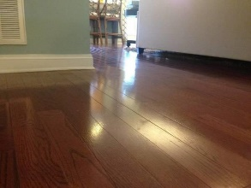
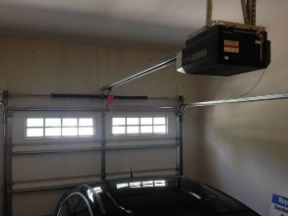
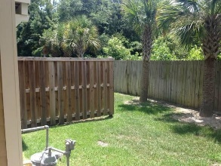
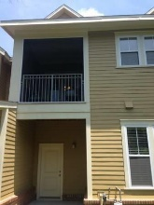

Executive Rental In Mt. Pleasant
$300 Tenant Agent Bonus
4br & 2.5ba, 2,464 Sq Ft.
1279 Dingle Rd
Royal Palms ~ MLS# 18015191 ~ $2,200/mo
LIKE NEW Executive Rental in great condition!
Energy Efficient and in excellent condition! 4 BedroomS, 2.5 bathroom townhome in the heart of Mt. Pleasant available JULY 1st, 2018. Hardwood floors throughout main floor, granite countertops in the kitchen, Moen faucets, recessed lighting, gas range, upgraded crown molding and spacious porches. The fourth bedroom can be used as a home office Spacious Samsung washer & dryer in unit. Children can walk to school which is located just steps from your back door! Partial privacy fence and low maintenance/ no mow yard. Bring your grille and enjoy views of palm trees off the back yard patio. Easy access to HWY 41 & I-526. Just minutes to Isle of Palm and Sullivans Island Beaches! Pets ok with deposit. Shorter or longer term rental is negotiable.
Andrew Tackitt
(843) 437-8726
andrew@radekopf.com
1205 Two Island Court, Suite 201
Mount Pleasant, SC 29466
Phone: (843) 579.2217
Fax: (843) 971-0281
Erin Quinn Hanhauser
(843) 743-8204
erin@radekopf.com

