Slide 1
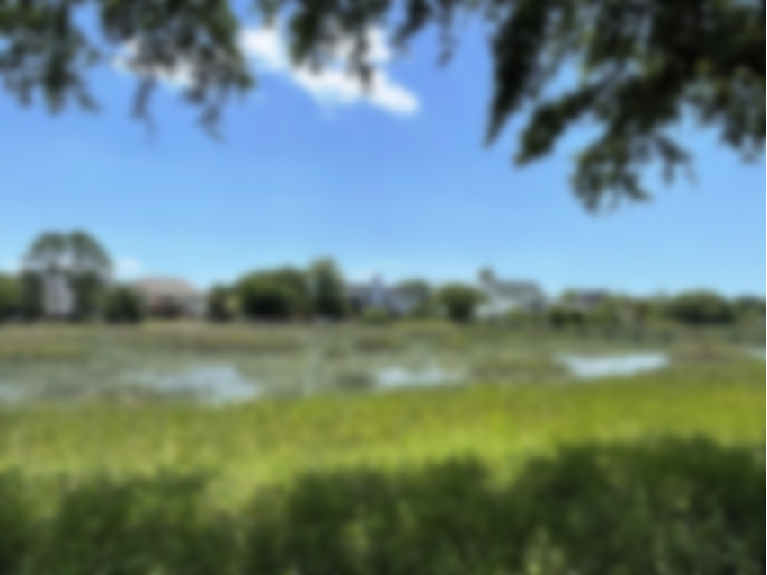
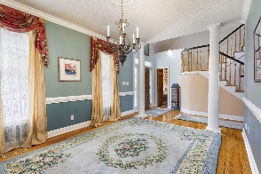
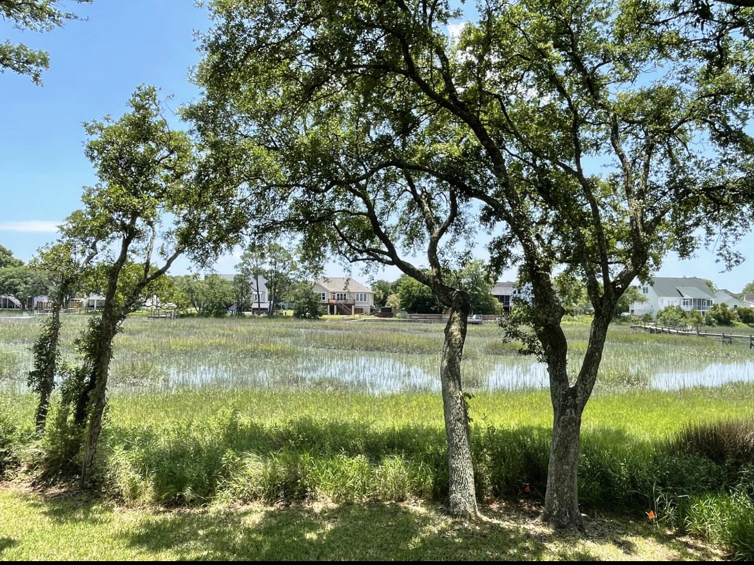
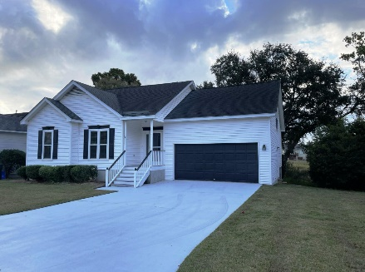
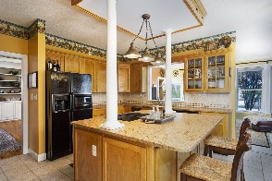
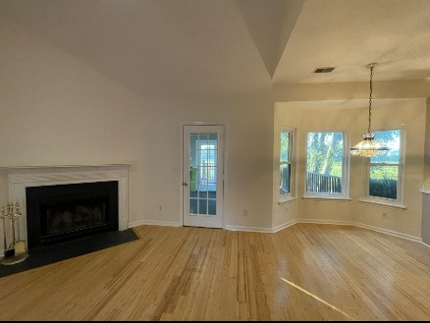
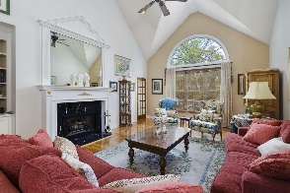
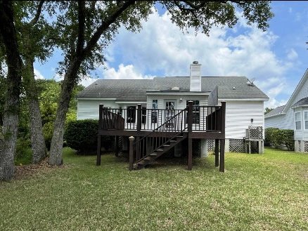
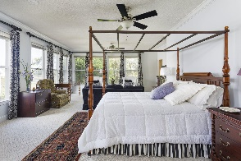


1279 Lakefront Drive Egrets Pointe | James Island, SC 29412 | MLS# 24013480 | $695,000
James Island Waterfront
SCHEDULE YOUR SHOWING TODAY!
Great tidal creek home in Seaside Plantation, Egret's Pointe on James Island. 1650sqft+/- 3br 2bth w 2 car gar. Great views & breezes! 2020 30 yr arch shingles, Nice sunroom added 5-7 yrs ago overlooking the marsh & creek! Nice yard w oaks lining the creeks edge! Freshly stained back deck perfect for afternoon cookouts overlooking the water! New hurricane windows installed 5 yrs ago! 2yr old 5 ton 14 seer split heat pump heating & AC unit! Wood burning FP serviced recently w new stainless steel cap & fire insert! Frig, stove, washer, dryer, toilets replaced last 5 years! New gar door! Approved plans to extend the gar & rm over gar! Freshly sanded & refinished Bamboo floors! All new plumbing pipes installed throughout house 9.1.24. Interior freshly painted & popcorn ceiling removed 9.27.24
Rhett Brownlee
(843-209-7755
rhett@rhettbrownlee.com
www.RhettBrownlee.com
Edwards & Assoc
6251 Hwy 162 Ste C
Hollywood, SC 29449

