Slide 1
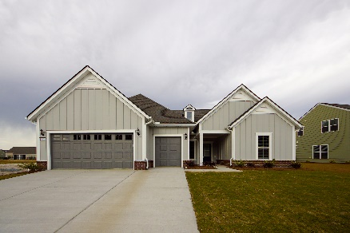
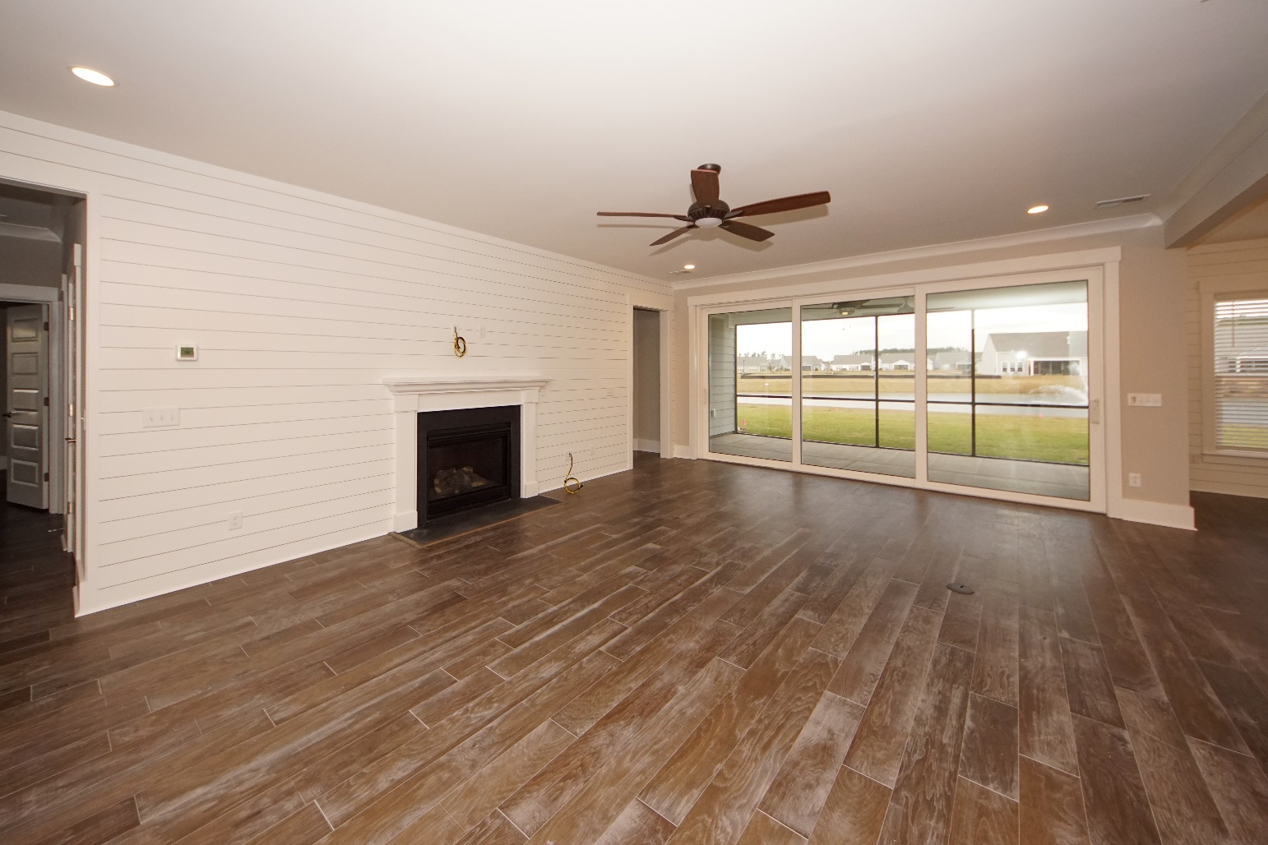
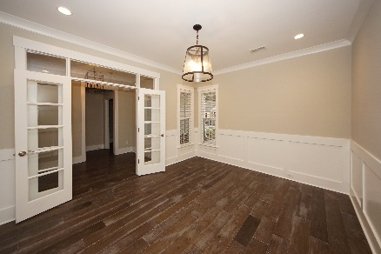
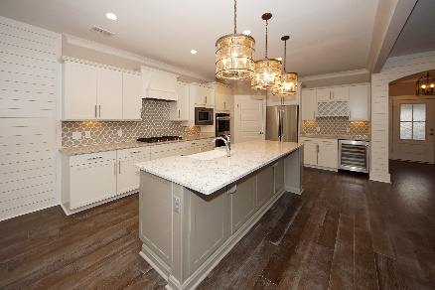
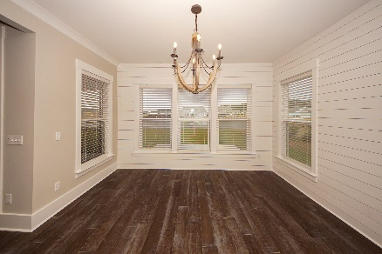
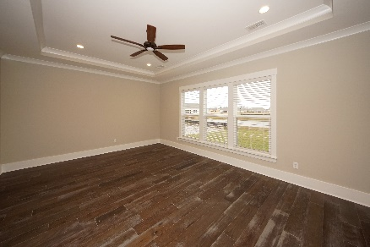
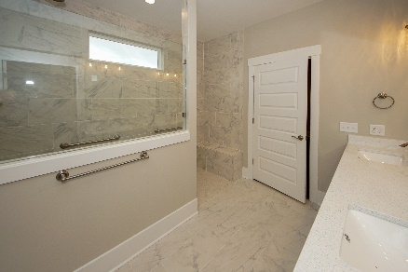
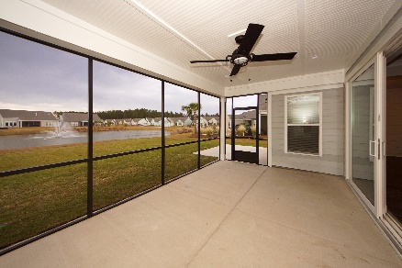


Be The First!
New Construction ~ Never Lived In ~ Move Right In!!
127 Camelia Park Lane
Del Webb @ Nexton | Summerville, SC 29486
MLS# 19032375 | $586,500
FINISHED AND MOVE-IN READY!!!
Wonderful Dunwoody Way floor plan! 1-story 3 BR/3BA home in Del Webb gated community in Nexton. Lovely lagoon view from all the back of the house. Master bedroom is large with huge walk in closet. Large walk-in shower and rain shower head. Nice screened in porch to enjoy the view. Lawn maintenance is taken care of for you so you'll have more time to enjoy shopping and dining in the Nexton center. 2-car garage PLUS Golf Cart bay too! Walk up storage gives additional area for storage too. KITCHEN 2 built- wall ovens, gourmet wine cooler and beverage center. Extended length island with beautiful quartz counter top...long enough for 4-5 bar stools. Elegant light fixtures and fans in each room. An additional large room with French doors that can be used as an Office/Music Room or Library. This home is ready to enjoy with all the upgrades you can think of. Ship Lap in the living and dining room! Wood floors throughout except tile in the bathrooms. Upgraded wood trim package. Tray ceiling in the Master Bedroom. Gas logs in the fireplace. Tankless hot water heater. Double wall ovens. Wine cooler and beverage center. Luxury tiles bathrooms. Gorgeous light fixtures and fans. Walk up attic and storage area. Large Laundry room with sink and decorative drop place for coats and storage.
This home is ready to move into right NOW!
Susan Weeks
(843) 813-0495
susanweeksdesign@gmail.com
www.copperroofproperties.com
Copper Roof Properties, LLC
13 Yeamans Rd.
Charleston, SC 29407

