Slide 1
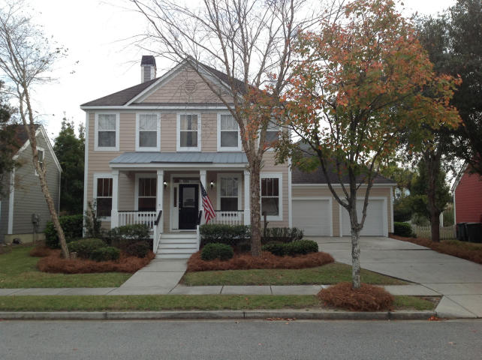
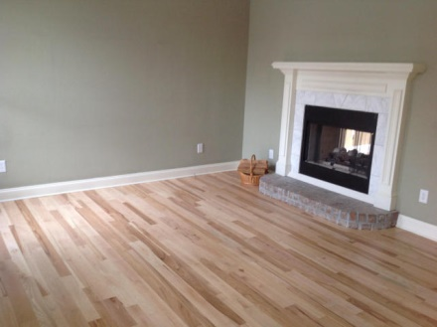
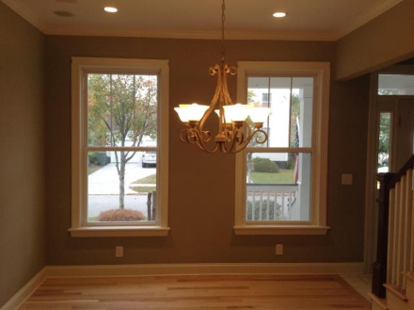
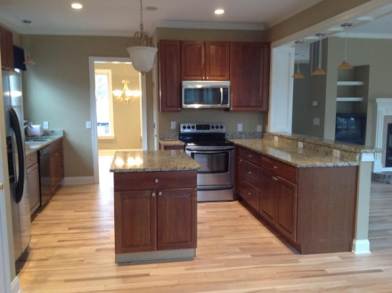
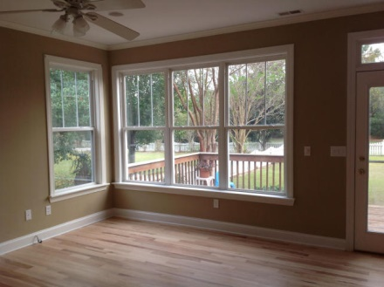
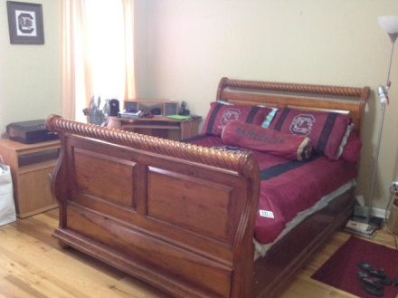
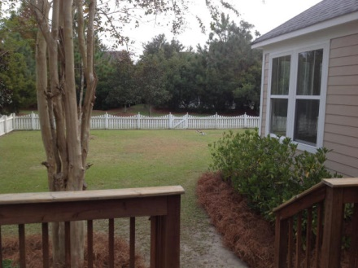
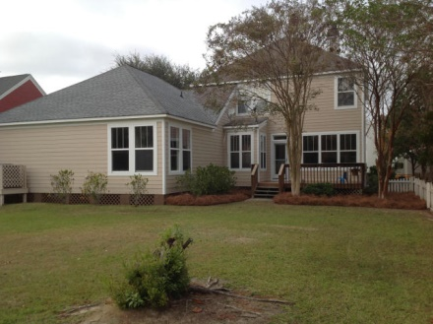
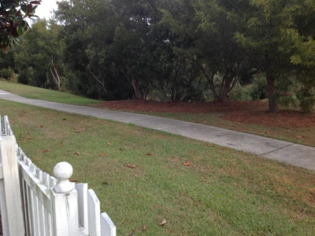

127 Cartright St Etiwan Park @ Daniel Island Charleston, SC MLS# 14029540 $565,000 4 Bedrooms | 3½ Baths | 2,600 sf
Open House Lunch ~ Friday, Oct 3 from 11 - 1
Handyman Special… Bring your hard hats!
Open House ~ Saturday, Nov 22 ~ from 1-4
This beautiful home, with great curb appeal and a cozy front porch, is offered this holiday season, just in time to ring in the New Year! Your guests are greeted through the front door into a formal living room and dining room. The double-sided gas fireplace, with built-in bookshelves in the great room, connects the living room and great room is the perfect place to warm your toes for the holidays. The extra large windows in the great room overlook the beautiful fenced in backyard, which backs up to a pond and walking trails. Crown moldings, 9-foot ceilings, ceiling fans, and a surround sound stereo system are just a few extras. Not to mention three and a half baths, a dual zone heating and air conditioning system, and the eat-in kitchen lined with granite counter tops, wood cabinets, an island and pantry. With a freshly painted downstairs interior and exterior, as well as the newly refinished hardwood floors, this house won't last long at $565,000.
Susan Day
843-900-0477 charlestonbyday@gmail.com
Melissa Schatz 843-442-0559
coolchangeproperties@gmail.com
AgentOwned Preferred 824 Johnnie Dodds Blvd | Mt Pleasant, SC 29464
Keller Williams Realty Charleston
496 Bramson Ct Ste 200 | Mt. Pleasant, SC 29464

