Slide 1
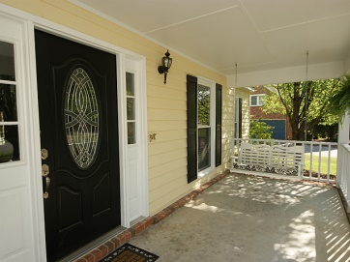
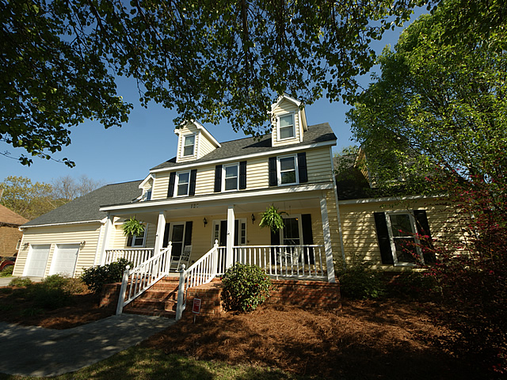
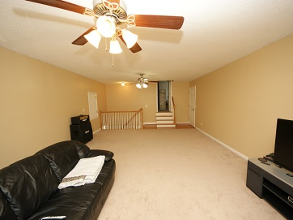
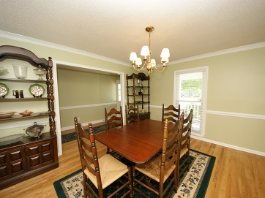
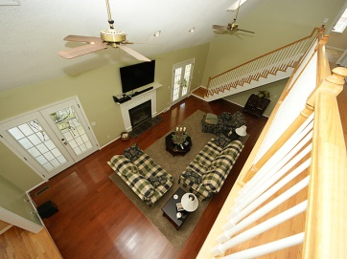
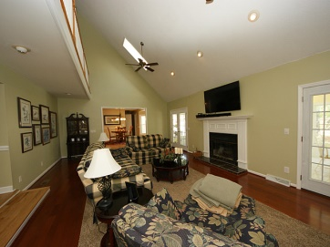
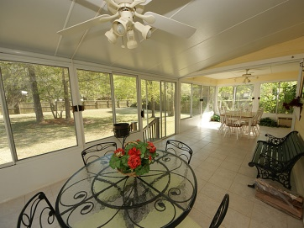
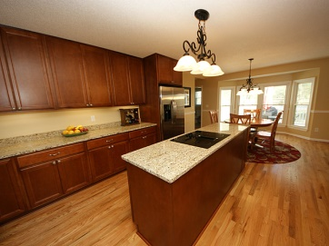
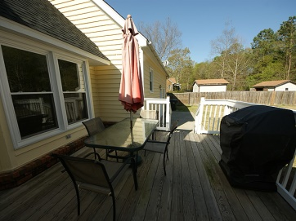
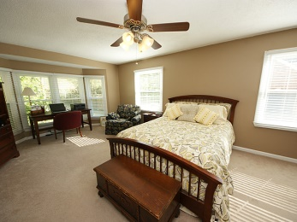
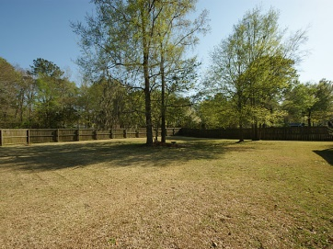
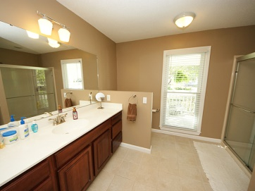
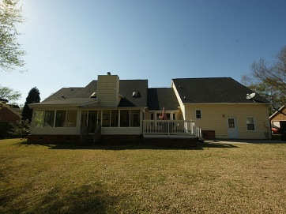


127 Londonderry Road
Crowfield Plantation
Goose Creek, SC 29445
MLS# 15007995 ~ $369,900
Executive Home, Totally Renovated!
Large Beautifully Updated Home on one of the Largest Lots in the area. Large Kitchen w/new SS Appliances and Granite. All new Windows, new Kitchen Cabinets, Hardwood Floors in Kitchen and Great Room.
Master Down, w/updated Tub and large walk-in Shower. FROG is huge and there’s room that a Full Bath could be added if desired. Office upstairs off the playroom, along with full bath and two bedrooms. Upstairs has the possibility of 4 Bedrooms.
Extensive work has been done to upgrade this home including major work on crawlspace. This is a great home and sellers are motivated.
John H. Beckroge
ABR, EPRO
jbeckroge@gmail.com
Mobile 843-367-3196

