Slide 1
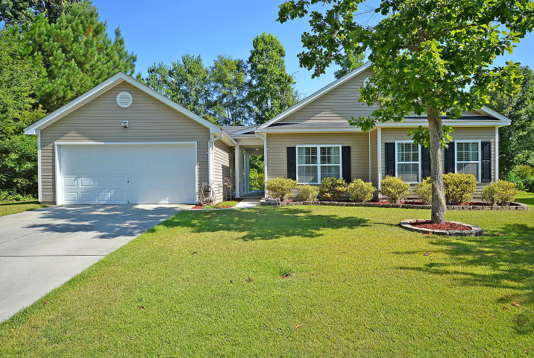
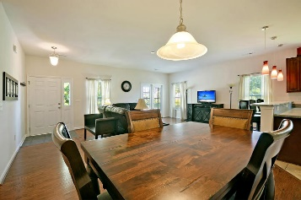
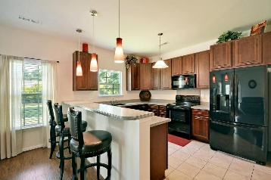
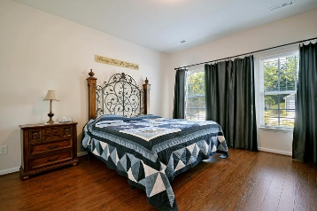
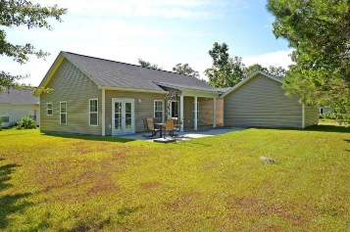
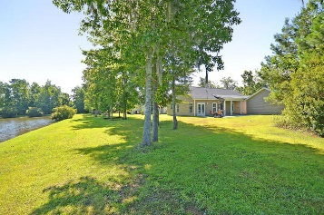


Magnificent One-story Home!
127 Pacolet Street
Lakes of Summerville
Summerville, SC 29485
MLS# 16018469
$185,500
This magnificent one story home is located in the Lakes of Summerville and sits on a spacious wooded pond lot. The interior of the home offers a large open family room with eating area, open kitchen with silestone counter tops, smooth top range, built in microwave, laundry room/pantry with built in shelves. The master bedroom retreat is spacious offering wood laminate flooring, the master bath offers ceramic flooring, dual sinks with marble counter tops and a walk in closet. The other two bedrooms are the perfect size any uses. There is wood laminate flooring thru out the family room, hallway, & master bedroom, ceramic tile in the kitchen & bathrooms. For out door enjoyment there is a large patio that overlooks the private side yard, back yard and pond. There is also a two car detached garage with a covered walk way. Age, sqft, acreage, HOA fees, schools and taxes are approx. Buyers to verify all information deemed necessary.
Mason Thurber
(843) 709-5109
mason@theeverettgroup.net
RE/MAX Pro Realty, 9209 University Blvd, Charleston, SC 29406

