Slide 1
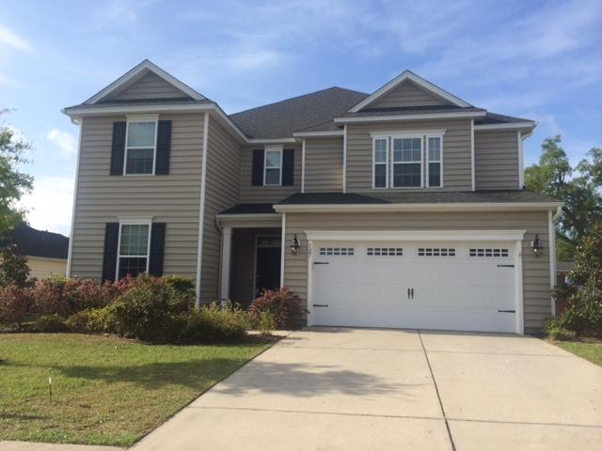
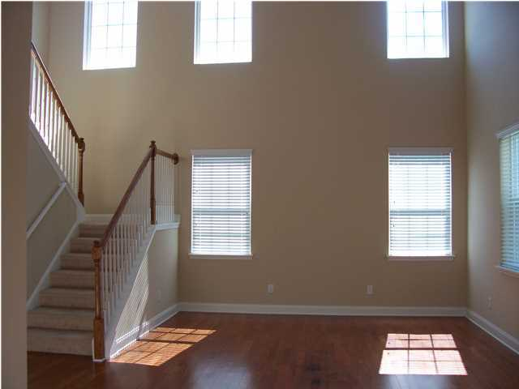
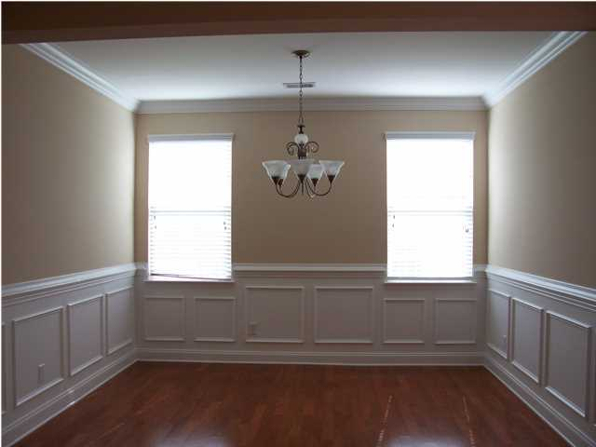
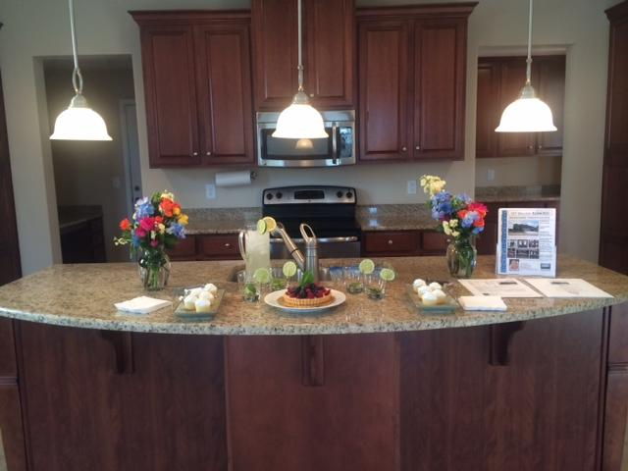
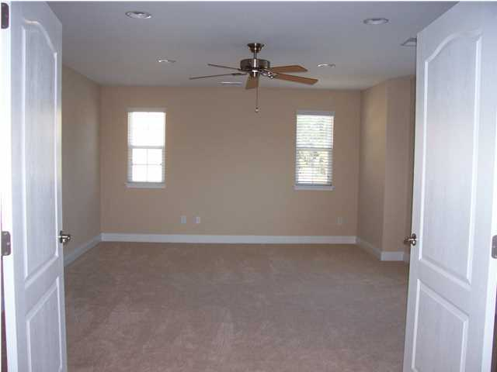
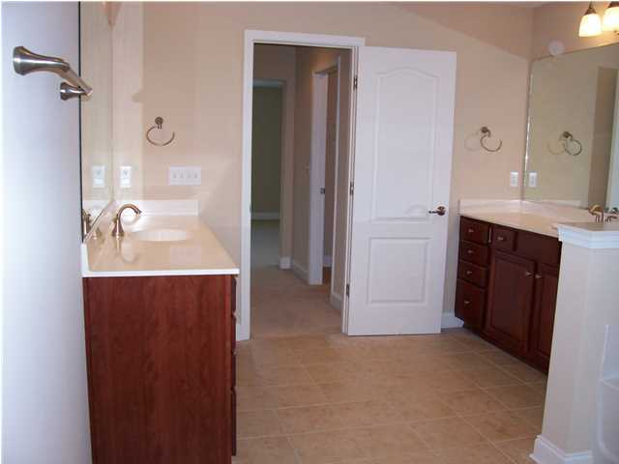
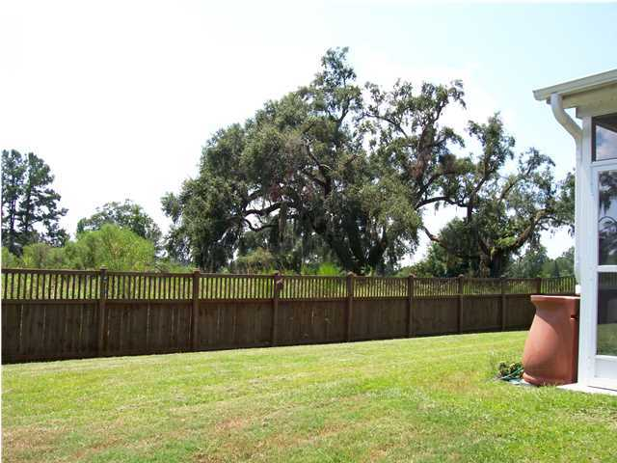
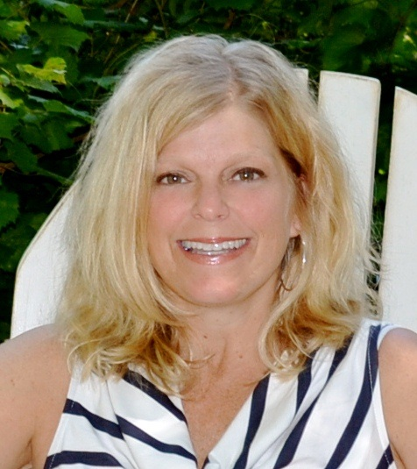

127 Saluda Drive
Moncks Corner ~ MLS# 17020470 ~ Price Reduction $311,900
Largest Resale Home Available in Foxbank Plantation.
One of the lowest priced homes $$/SQFT ~ Move-in Ready!
5 Bed / 3 Bath
3,566 Sq Ft
Bonus Room
Eat-in Kitchen
Wet Bar
Spacious FROG
Great Backyard
WHY WAIT TO BUILD, WELL CARED FOR HOME, ONE OF THE LARGEST, MOST SPACIOUS HOMES IN ALL OF FOXBANK PLANTATION. This 2010 LENNAR BUILT home offers a light, bright and open floor plan. The entire first floor offers hard wood flooring and ceramic tile as well as one guest bedroom. The kitchen is a gourmet cooks dream with an extra large pantry, a butler's pantry, granite counter tops & upgrade stainless GE appliances. The upstairs offers 3 additional spacious bedrooms with plenty of closet space and a large FROG/BONUS room which could be used as a 5 bedroom. The entire house is painted in a neutral color. There's a nice screened porch off the back as well as a fully fenced yard. The home has newly installed gutters and in ground sprinkler system as well. Tenant occupied.
Leah M. Rust
843-709-9211 Mobile
843-856-8800 Office
leahmrust@gmail.com
Coldwell Banker RESIDENTIAL BROKERAGE

