Slide 1
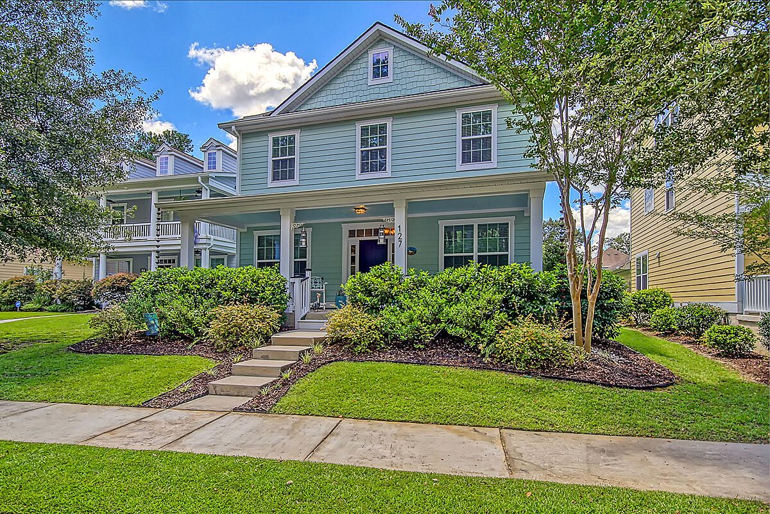
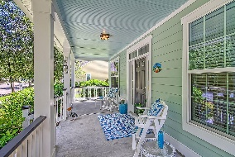
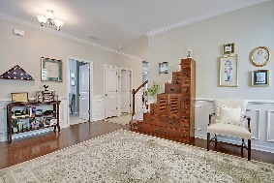
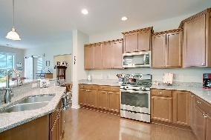
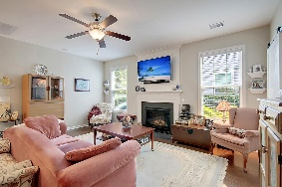
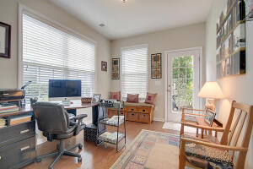
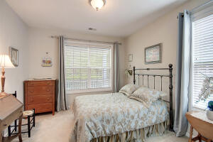
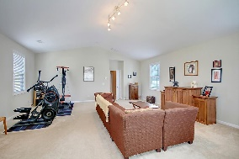
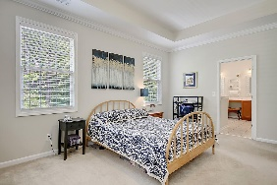
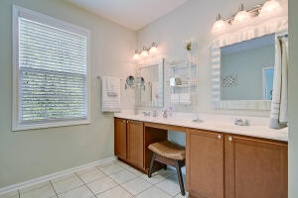
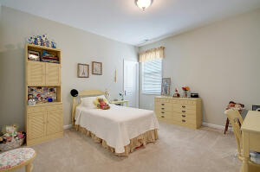
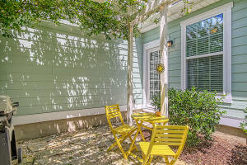
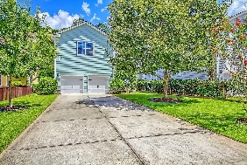


Open House in The Ponds ~ Saturday from 10-1
127 Lotz Drive
The Ponds
Summerville, SC 29483
MLS# 22021402
$544,900
4 Bedrooms | 3 Baths | 3,117 sf
Why wait for new construction?!? This is the house you've been waiting for! Welcome to 127 Lotz Drive in the beautiful Ponds neighborhood! This stunning home is move in ready!! A great front porch welcomes you! Step inside and you'll find a flex room, that can be used as a dining room, formal living or home office. To your left is a first floor guest bedroom with a full bath. This would be a great mother-in-law suite! The kitchen overlooks the family room and has granite countertops, tons of cabinetry, gas cooktop, island with bar seating, eat in kitchen area and a large pantry. Off of the kitchen is the access to the two car garage and unlike most of the homes in the neighborhood, this home has a huge driveway in the back of the home! A home office is off of the family room.
Head upstairs to find the large primary bedroom with a tray ceiling. The primary bathroom has a dual vanity, large shower, separate tub and water closet. Down the hall from the primary are two good sized bedrooms with large closets, the laundry room and the HUGE bonus room. This room has tons of possibilities! It can be a 5th Bedroom, a Media room, workout room, game room...it's so big it can be all four! The Ponds is a lovely sidewalk lined community with a clubhouse, awesome pool and play area, walking trails, ponds for fishing, a YMCA located in the neighborhood. Dorchester District 2 schools service this neighborhood. This is the kind of home and neighborhood you dream of living in!
Larry & Kathy Mazalatis
Larry Cell 843-693-0529
Kathy Cell 843-693-0159
Office 843-871-9133
AGENTOWNED PREMIERE GROUP | 1800 TROLLEY RD | SUMMERVILLE, SC 29485

