Slide 1
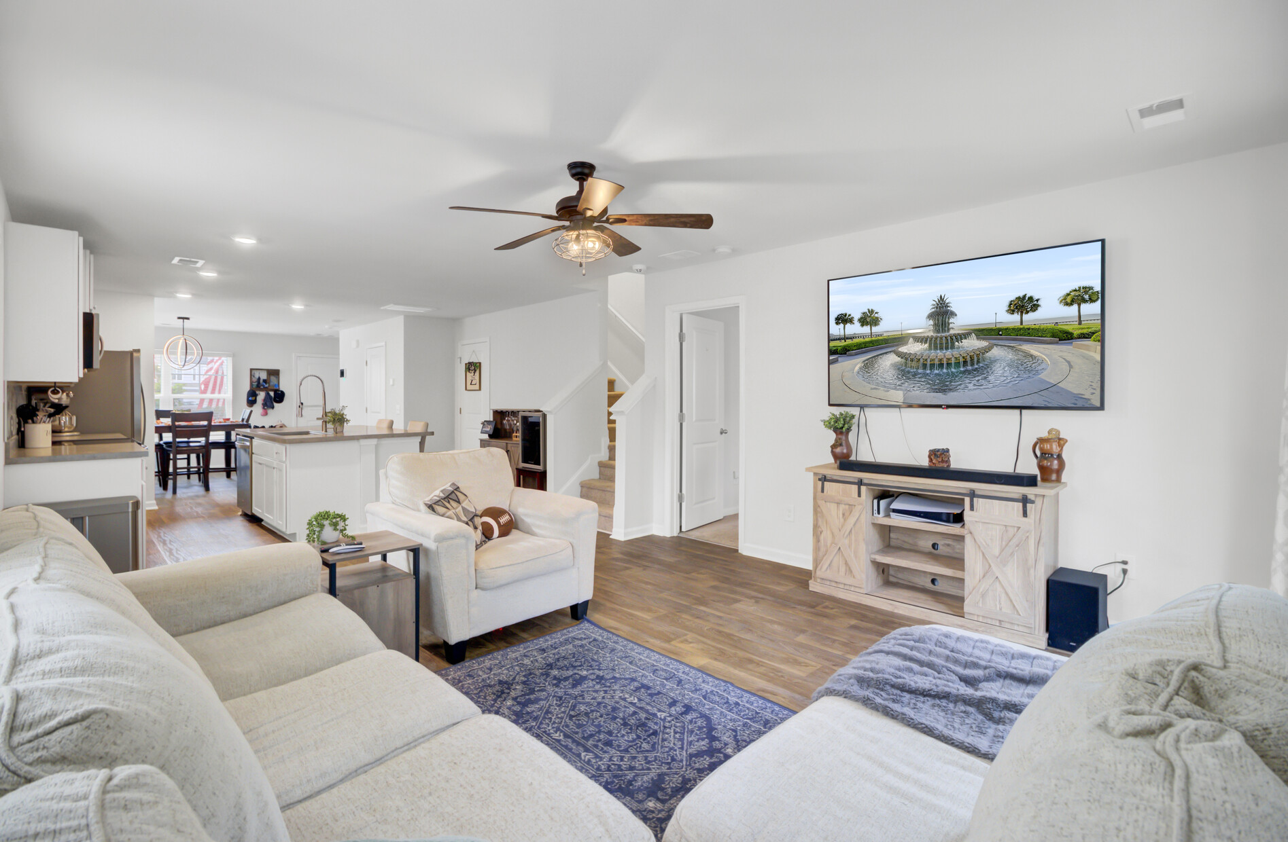
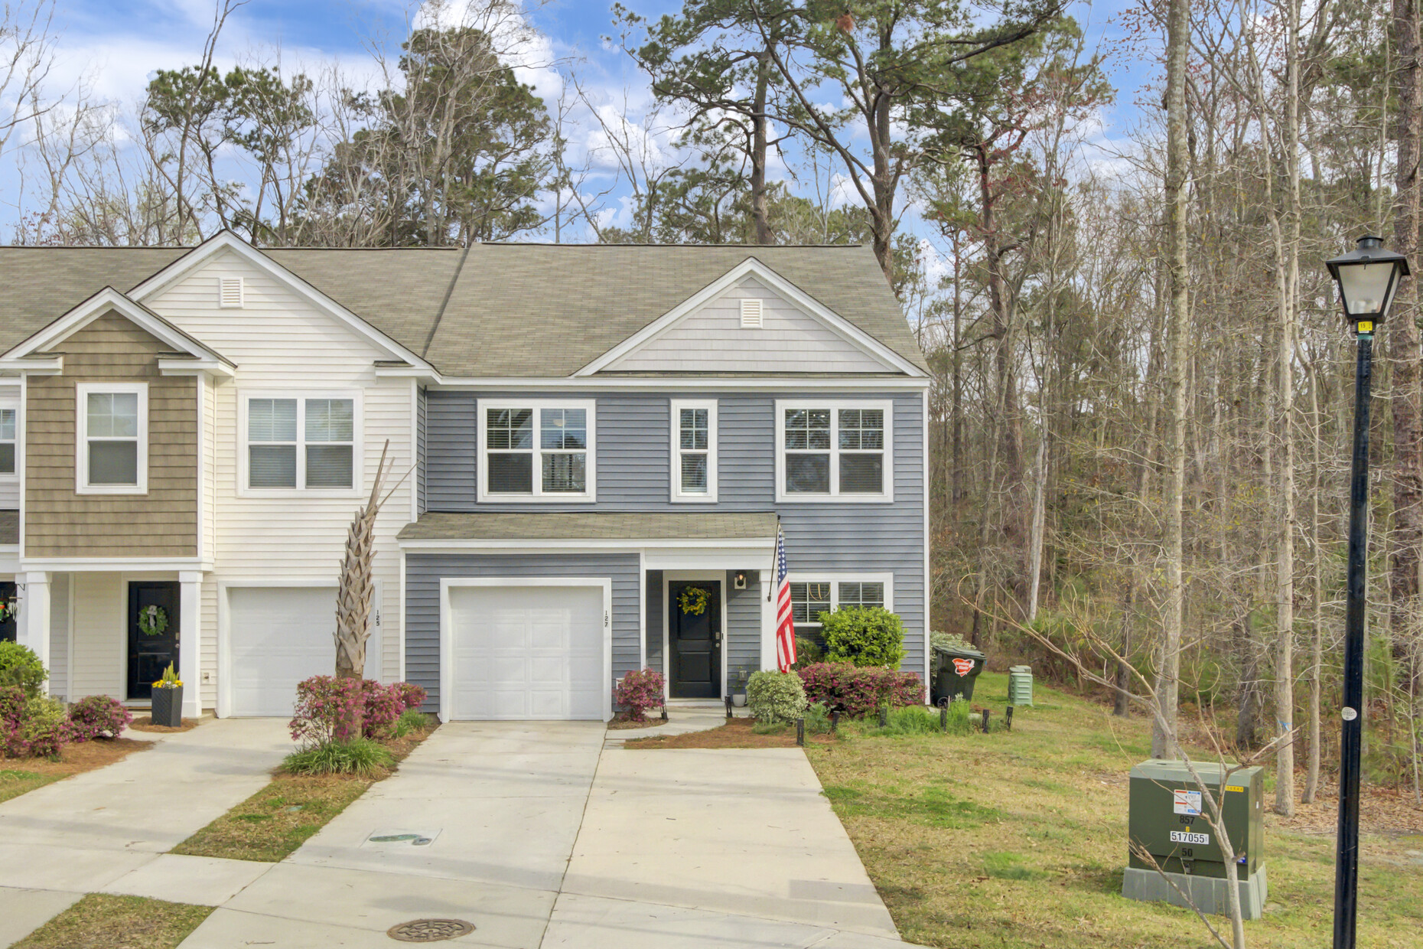
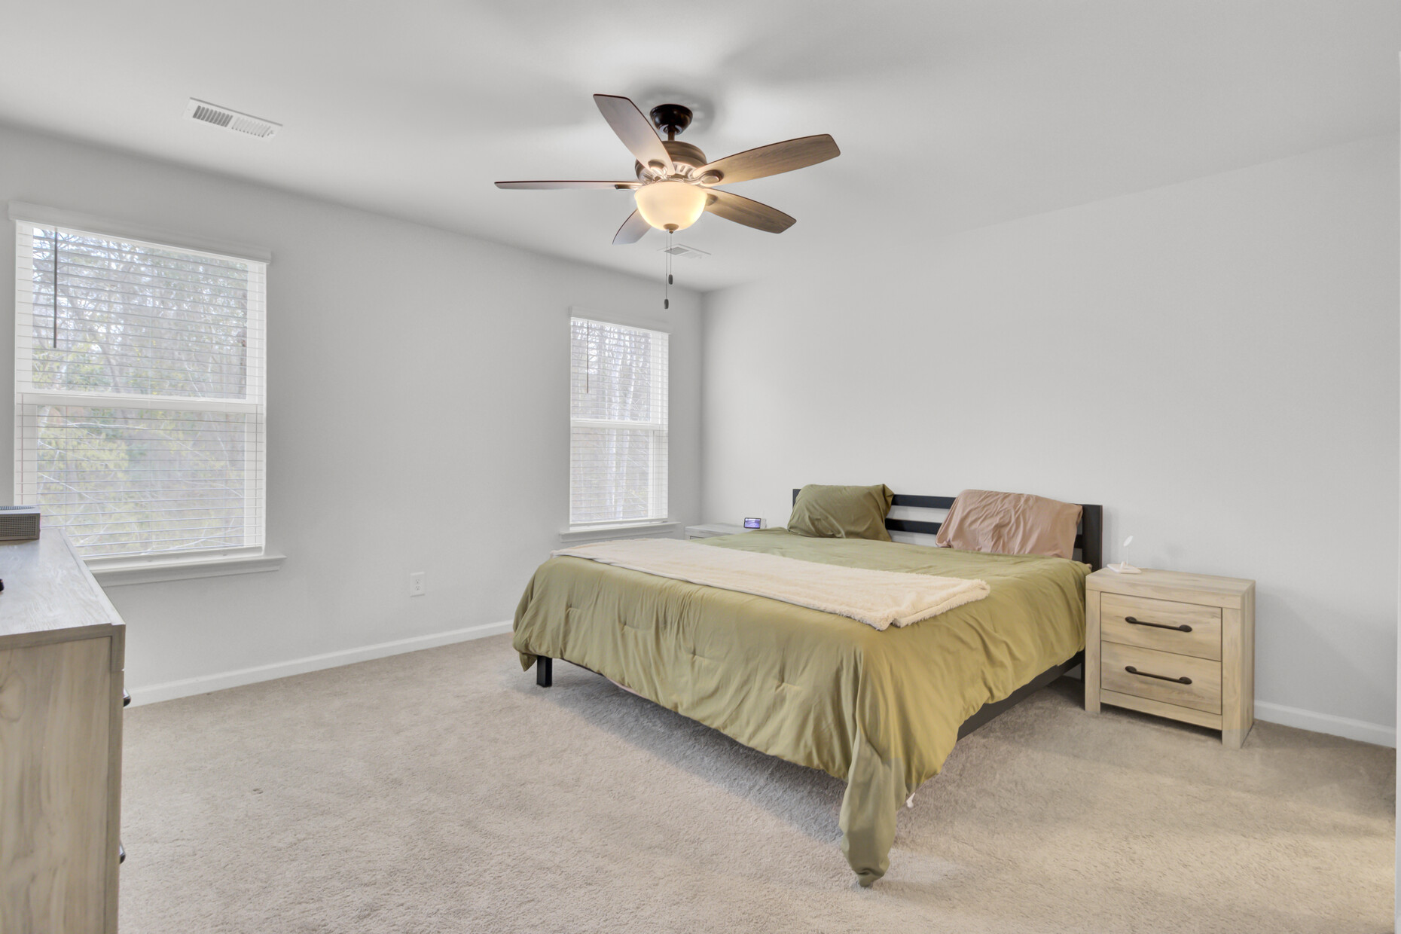
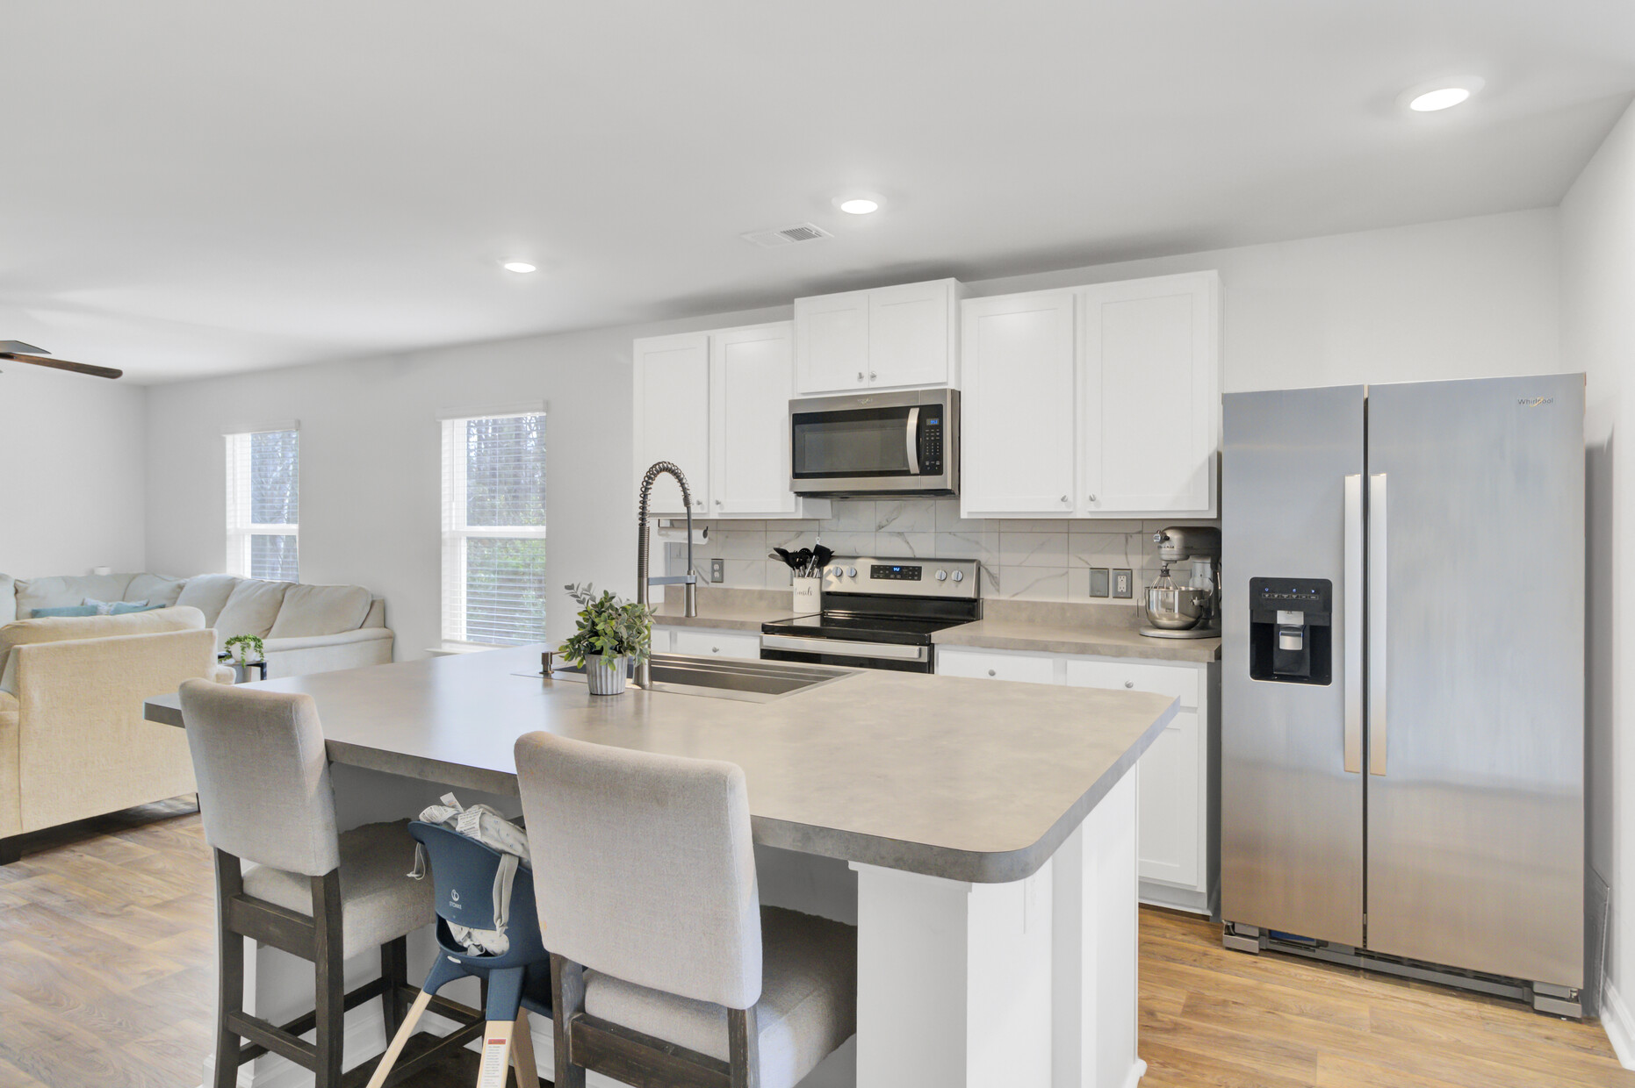
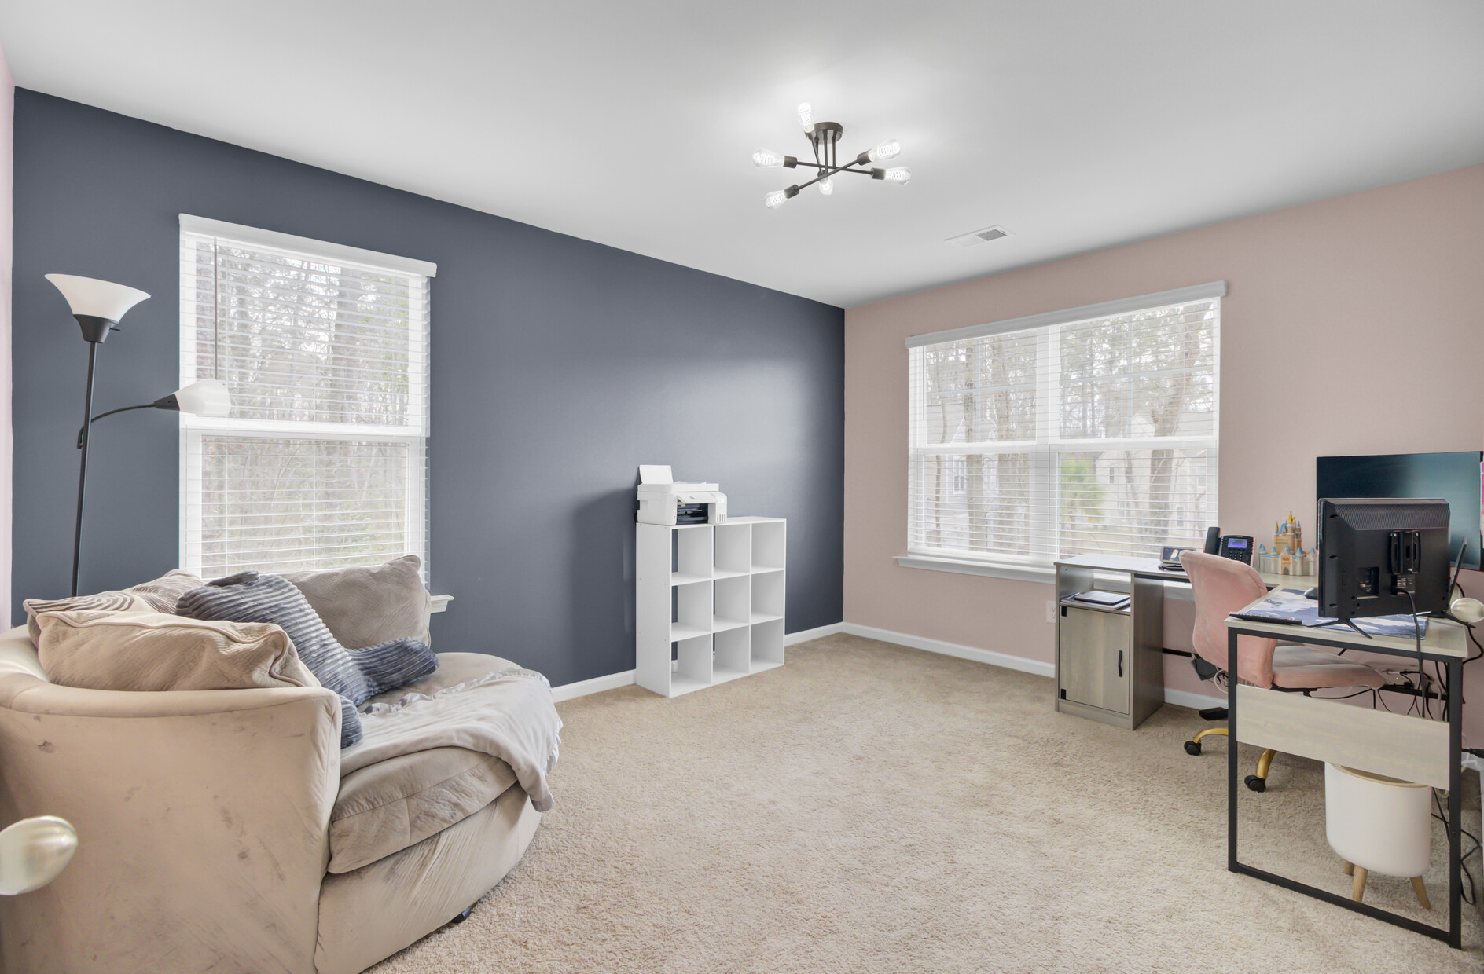
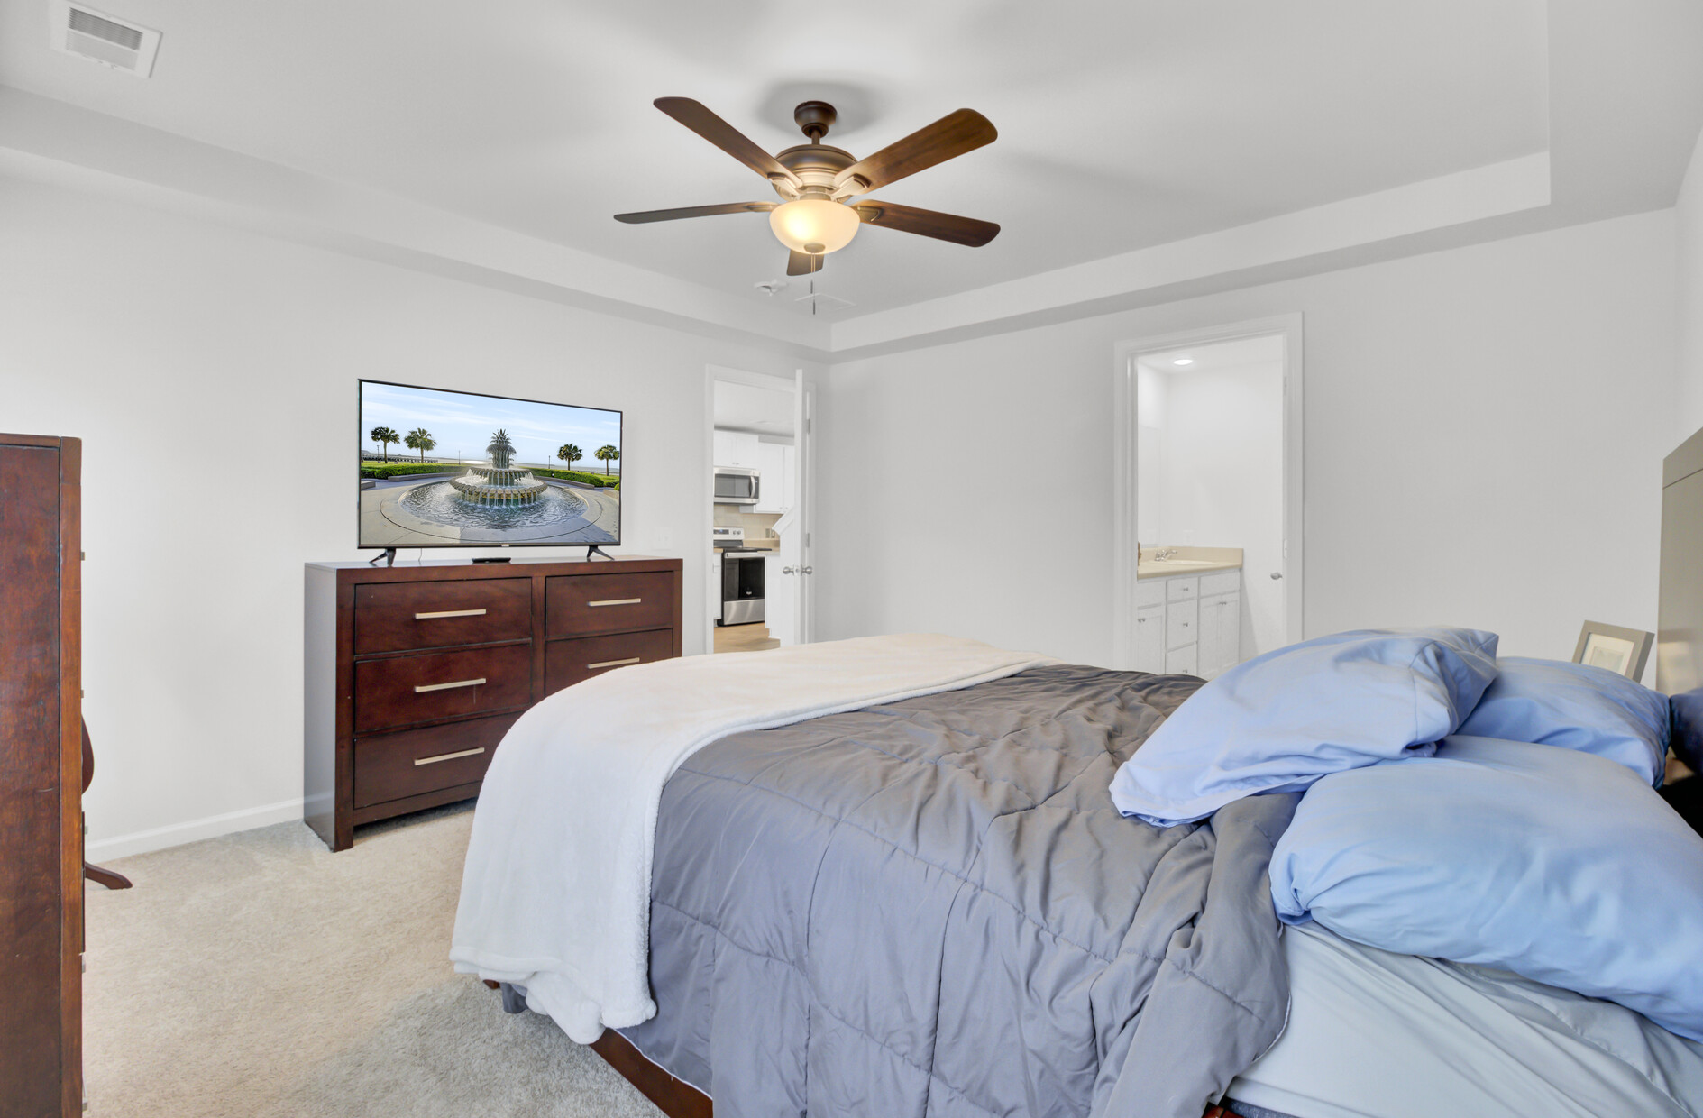
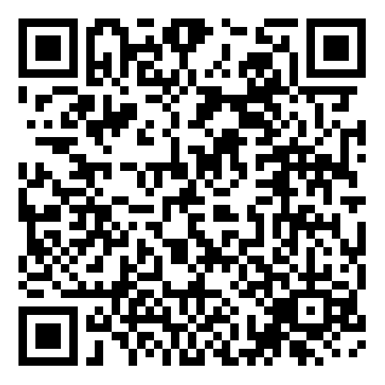
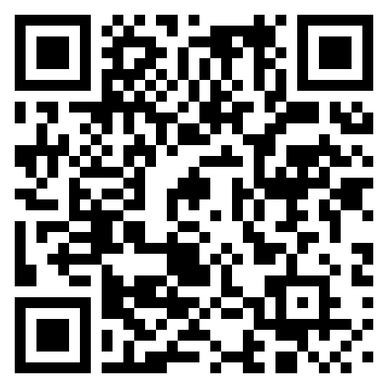


RARE 5-BEDROOM END-UNIT TOWNHOME IN SUMMERVILLE DON’T MISS OUT!
127 Rosefield Court
Palmetto Reach
Summerville, SC 29485
MLS# 25006766 | $354,000
Virtual Tour
Video Tour
A rare opportunity—this 5-bedroom end-unit townhome in the Palmetto Reach community is now available! Featuring dual primary suites, an open-concept floor plan, and modern finishes, this home offers both space and flexibility.
The first-floor primary suite includes a spacious ensuite bath and walk-in closet, while the second primary suite upstairs provides additional versatility. The beautifully designed kitchen boasts stainless steel appliances, bright white cabinetry, and stylish finishes. A large driveway and attached garage offer ample parking.
Located just minutes from Downtown Summerville, this home provides easy access to shopping, dining, and community events—all with the convenience of low-maintenance townhome living.
Join us for an Open House on Saturday, March 22, from 11 AM - 1 PM!
Sellers are offering Buyer Agent Compensation up to 2.5% with an acceptable offer.
Don't miss out on this unique opportunity—contact Ellen today to schedule your showing or stop by the Open House!
Virtual Tour | Video Tour
Ellen O'Neil
Broker/Owner, ABR, e-PRO, CNE
Charleston Realtor of Distinction
843-300-8530
www.EllenONeilProperties.com

