Slide 1


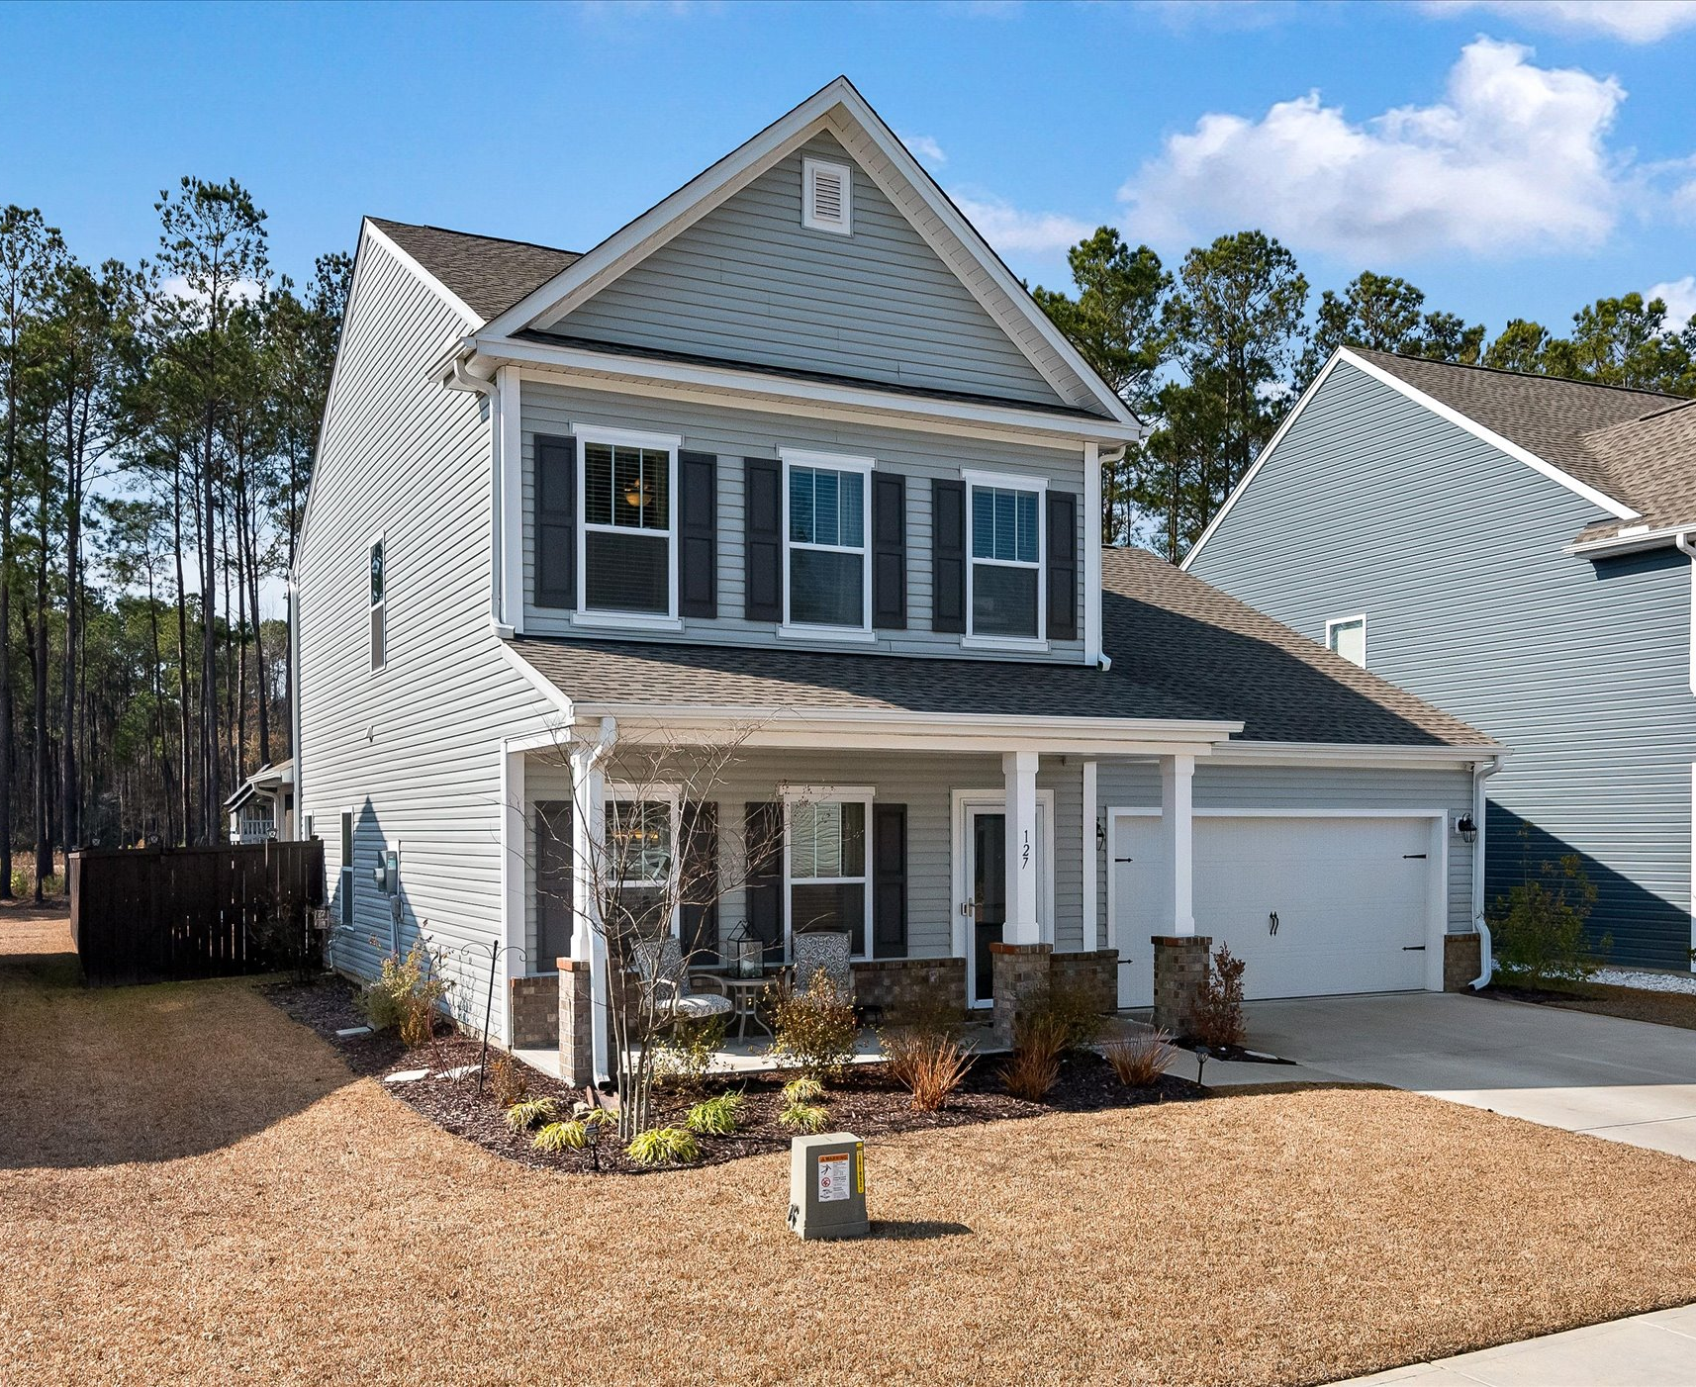
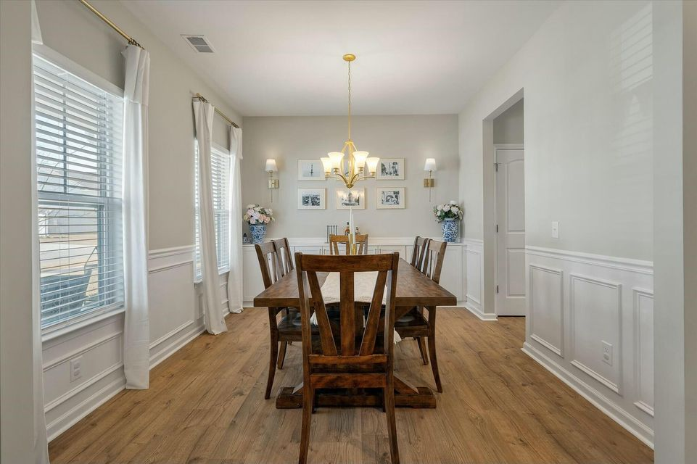
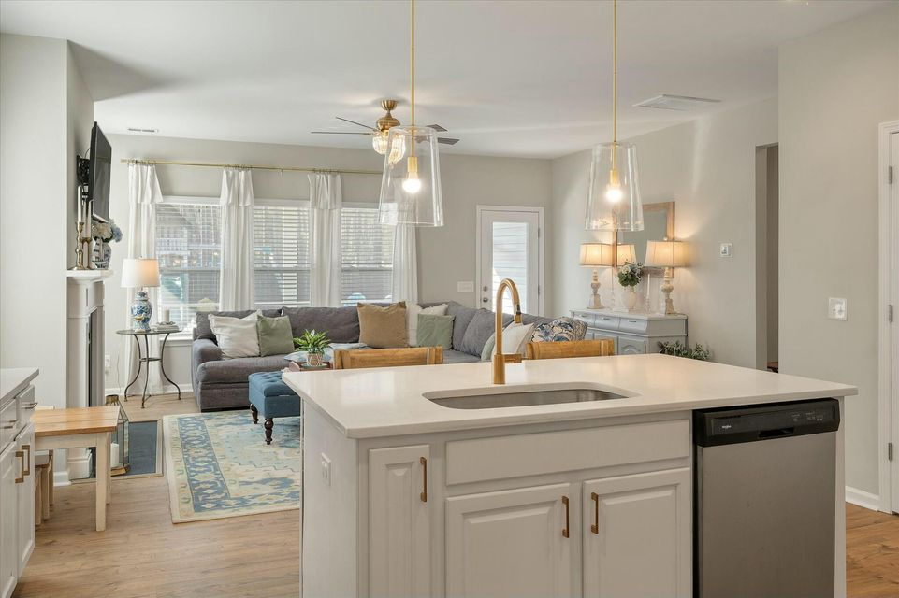
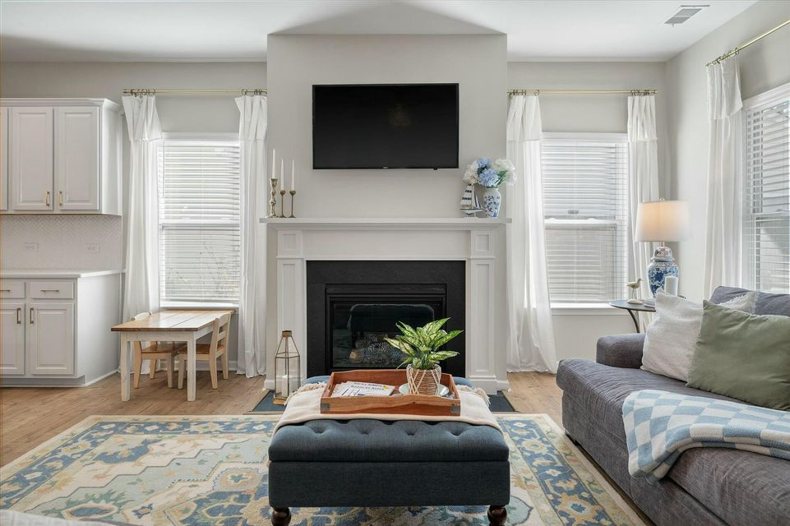
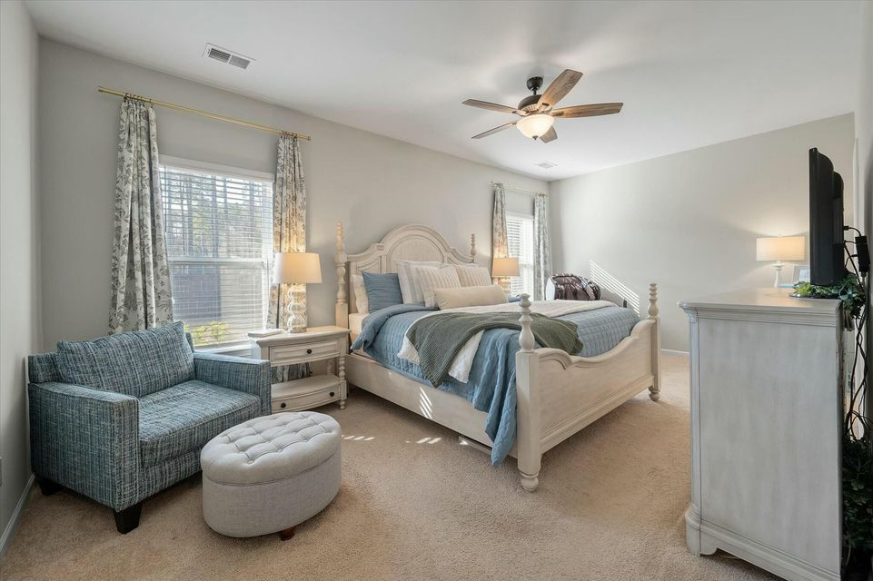
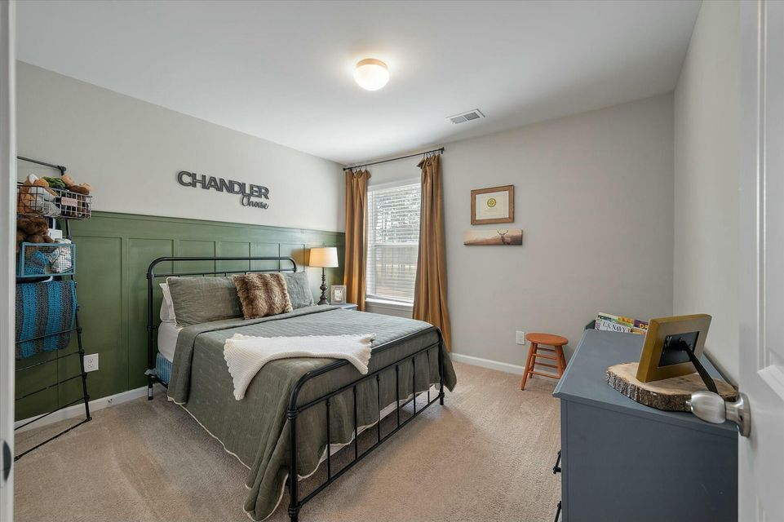
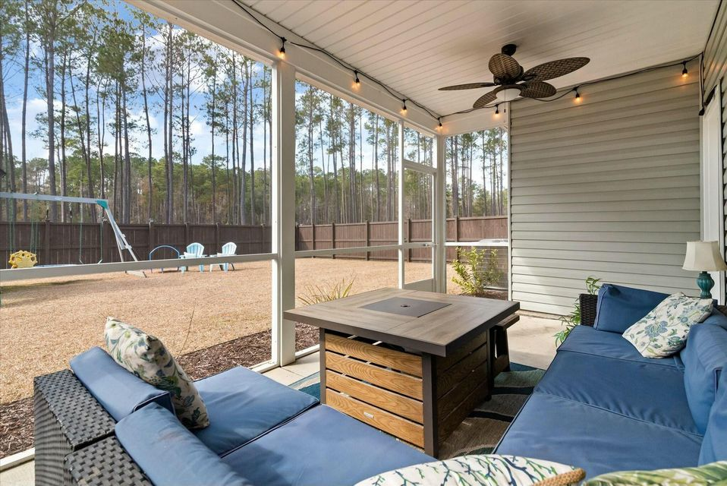
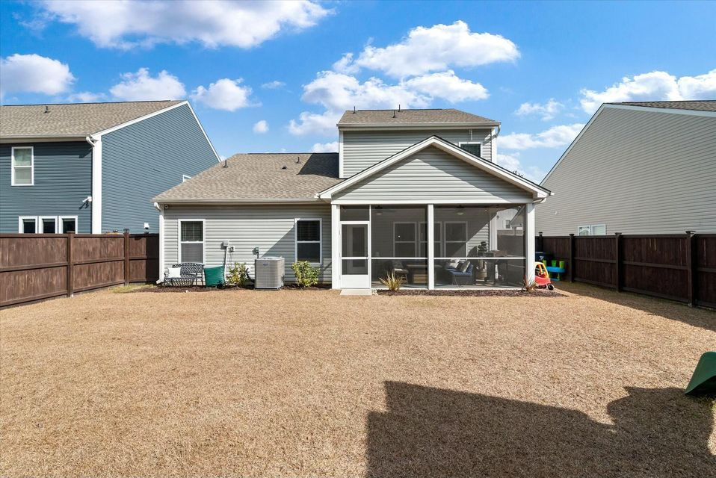
Do Your Buyers Need
Closing Costs?
127 Surfbird Road
Nexton | Summerville, SC 29486 | MLS# 25003489 | $484,500
Beautiful home in North Creek Village with designer touches
Convenient to all Nexton and Cane Bay have to offer
VA assumable @ 5.25% with a small gap
Preferred lender contribution up to $4500
Sellers may cover a portion of the closing costs
Video Tour
Tina Hartford
The Boulevard Company
843-779-8646
tinahartford@lowcoasthomes.com

